Slide 1
Monthly LHD Update Meeting
Sept. 10, 2024

Slide 2
Agenda
Opening Remarks | Stacie Turpin Saunders, MPH Deputy Director/Section Chief, Local and Community Support
Epi Section Update | Zack Moore, MD, MPH: State Epidemiologist and Epidemiology Section Chief
MCU Update | Erica Wilson, MD, MPH: Medical Director, Medical Consultation Unit
Foodborne and Vector borne | Carl Williams, DVM, DACVPM State Public Health Veterinarian
Respiratory and MPOX Update | Emma Doran, MD MPH Medical Director, Vaccine Preventable and Respiratory Diseases
Wastewater Surveillance | Nicole Snyder, PhD, MPH Public Health Epidemiologist
Vaccine Update | Carrie Blanchard, Pharm D, MPH Immunization Branch Director
Question & Answer Session | Open for Questions — Please use the Zoom Q&A function

Slide 3
Agenda
Opening Remarks | Stacie Turpin Saunders, MPH Deputy Director/Section Chief, Local and Community Support
Epi Section Update | Zack Moore, MD, MPH: State Epidemiologist and Epidemiology Section Chief
MCU Update | Erica Wilson, MD, MPH: Medical Director, Medical Consultation Unit
Foodborne and Vector borne | Carl Williams, DVM, DACVPM State Public Health Veterinarian
Respiratory and MPOX Update | Emma Doran, MD MPH Medical Director, Vaccine Preventable and Respiratory Diseases
Wastewater Surveillance | Nicole Snyder, PhD, MPH Public Health Epidemiologist
Vaccine Update | Carrie Blanchard, Pharm D, MPH Immunization Branch Director
Question & Answer Session | Open for Questions — Please use the Zoom Q&A function

Slide 4
Agenda
Opening Remarks | Stacie Turpin Saunders, MPH Deputy Director/Section Chief, Local and Community Support
Epi Section Update | Zack Moore, MD, MPH: State Epidemiologist and Epidemiology Section Chief
MCU Update | Erica Wilson, MD, MPH: Medical Director, Medical Consultation Unit
Foodborne and Vector borne | Carl Williams, DVM, DACVPM State Public Health Veterinarian
Respiratory and MPOX Update | Emma Doran, MD MPH Medical Director, Vaccine Preventable and Respiratory Diseases
Wastewater Surveillance | Nicole Snyder, PhD, MPH Public Health Epidemiologist
Vaccine Update | Carrie Blanchard, Pharm D, MPH Immunization Branch Director
Question & Answer Session | Open for Questions — Please use the Zoom Q&A function

Slide 5
Agenda
Opening Remarks | Stacie Turpin Saunders, MPH Deputy Director/Section Chief, Local and Community Support
Epi Section Update | Zack Moore, MD, MPH: State Epidemiologist and Epidemiology Section Chief
MCU Update | Erica Wilson, MD, MPH: Medical Director, Medical Consultation Unit
Foodborne and Vector borne | Carl Williams, DVM, DACVPM State Public Health Veterinarian
Respiratory and MPOX Update | Emma Doran, MD MPH Medical Director, Vaccine Preventable and Respiratory Diseases
Wastewater Surveillance | Nicole Snyder, PhD, MPH Public Health Epidemiologist
Vaccine Update | Carrie Blanchard, Pharm D, MPH Immunization Branch Director
Question & Answer Session | Open for Questions — Please use the Zoom Q&A function

Slide 6
NC Department of Health and Human Services
Foodborne – Salmonella & Infants
Vector-borne – Arbovirus
Carl Williams
Public Health Veterinarian
September 10, 2024

Slide 7
Reported increase in Salmonellosis among infants
Initially small geographic and molecular clusters reported to DPH by LHDs and SLPH
Among those ages 0, 1 and 2 years, data analysis showed increases above baseline for those age 0-12 months only.

Slide 8
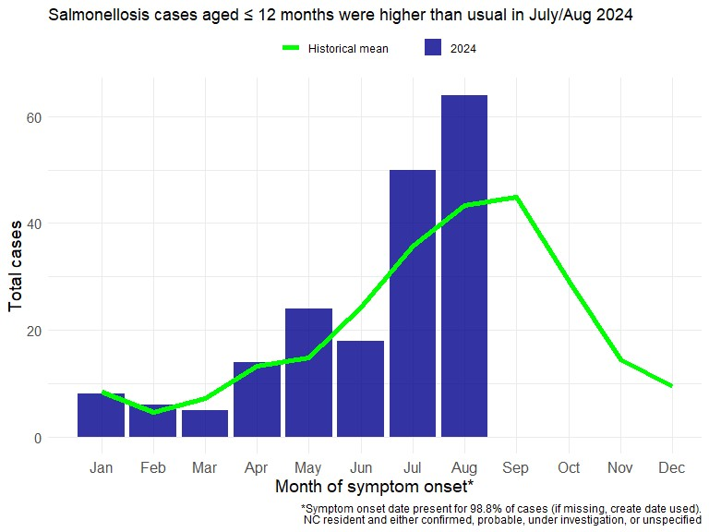
2022
278 infant cases
36 serotypes
2023
212 infant cases
41 serotypes
2024
183 infant cases
35 serotypes
2024 Hospitalization Rate
0 – 12 months: 19%
All other ages: 25%
Notes:
The number of cases we’ve seen by month for infant Salmonella, has been above what we’d expected for the months of May, July and August, this year, as compared to the average during the last five years.

Slide 9
Contaminated Powdered Infant Formula
2022 – Salmonella Newport and Cronobacter sakazakii
2023 – FDA calls on Infant Formula manufacturers to improve production systems to limit contamination
https://www.fda.gov/food/resources-you-food/infant-formula
https://www.fda.gov/media/166044/download
Contamination of powdered infant formula and milk does occur. Identified outbreaks date to the 1970s
PH surveillance may be the last line of defense to ID contaminated product in distribution

Slide 10
So, is there an outbreak going on?
At this time there are no significant epidemiologic or molecular links for the majority of cases
CDC and FDA have been notified of the increase
Powdered Infant Formula consumption is very common among infants
It is not uncommon to see PIF as a possible risk factor in many cases
Notes:
Whole genome sequencing is performed at the North Carolina State Laboratory of Public Health. Analysis results are shared with the epi team daily. Exposure info is essential to trying to find commonalities.
We’re investigating multiple groups of genetically related isolates and have not found a “smoking gun.” Some of you may have already received emails asking for investigations in this age group to be prioritized. Our main concern, is to verify that there is not a product in circulation that could create illness.
We’ve talked to our CDC and FDA colleagues. There is no indication of formula causing illnesses on a national level. We remain in communication with our federal partners, providing updates, and answering questions.

Slide 13
Lab Submission to SLPH
For Salmonella positive infants <1 year please do the following:
Ask the lab to submit the specimen to SLPH Any brand of Enteric Transport media is acceptable. If it is a bacterial isolate any type of agar slant is acceptable and if necessary we do accept agar plates. Slants just transport better.
WITH
A completed SLPH form DHHS-3390 to accompany the specimen

Slide 14
What do we need to fully investigate?
Epi Information
Laboratory Information
Breastfeeding details
Clinical Specimen or Isolate
Formula details
Name, manufacter, lot #, purchase date & location
Serotype Identification
Molecular Analysis
Pet details
Pet food brand, lot #, purchase date & location
Allele Codes and SNP analysis

Slide 15
NC Department of Health and Human Services
North Carolina Vector-borne Update

Slide 16
Reportable Mosquito-borne Diseases
Endemic*
Travel-Associated**
West Nile virus (WNV)
Eastern Equine Encephalitis (EEE)
California serogroup virus
La Crosse Encephalitis (LAC)
James Canyon virus (JCV)
Other Arboviral Encephalitides
Powassan virus (POW, tick borne)
St. Louis encephalitis (SLE)
Western Equine encephalitis (WEE)
Chikungunya
Dengue
Malaria (parasite)
Yellow Fever
Zika
*Only neuro-invasive cases are reportable
**All cases are reportable; Transmission in NC highly unlikely, but possible

Slide 17
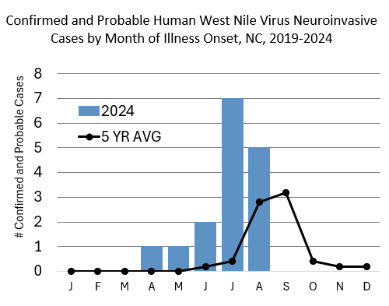
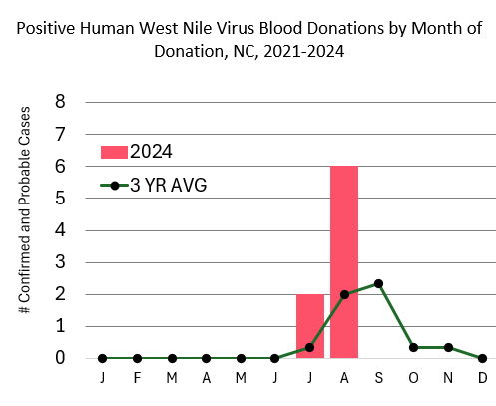
West Nile Virus
SOURCE: NCEDSS as of 9/9/24

Slide 18
Recent News

Slide 19
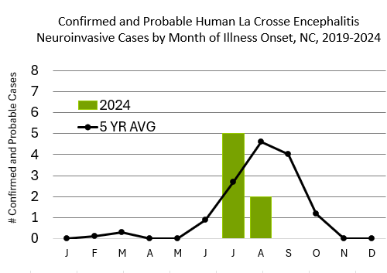
La Crosse Encephalitis (California Serogroup)
SOURCE: NCEDSS as of 9/9/24

Slide 20
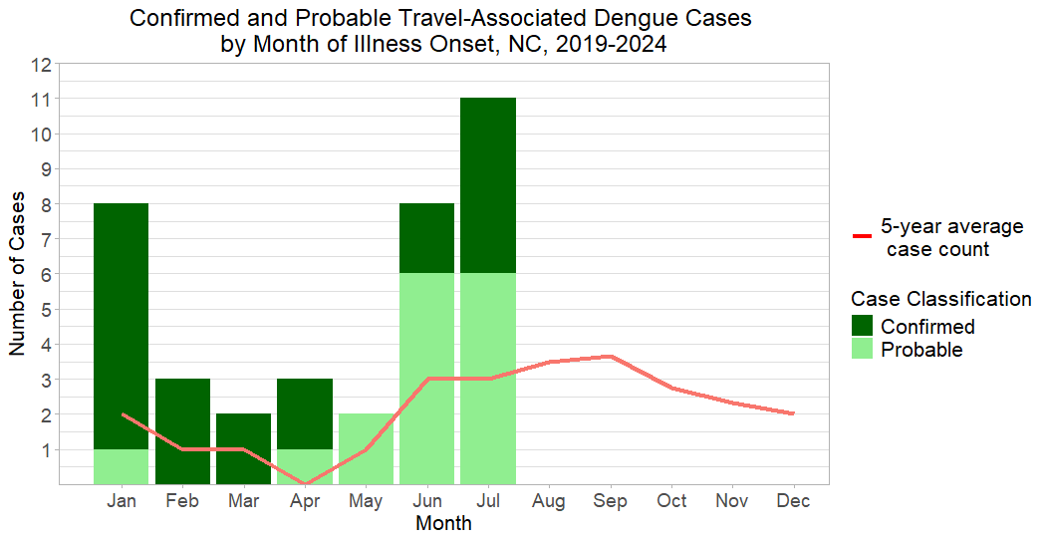
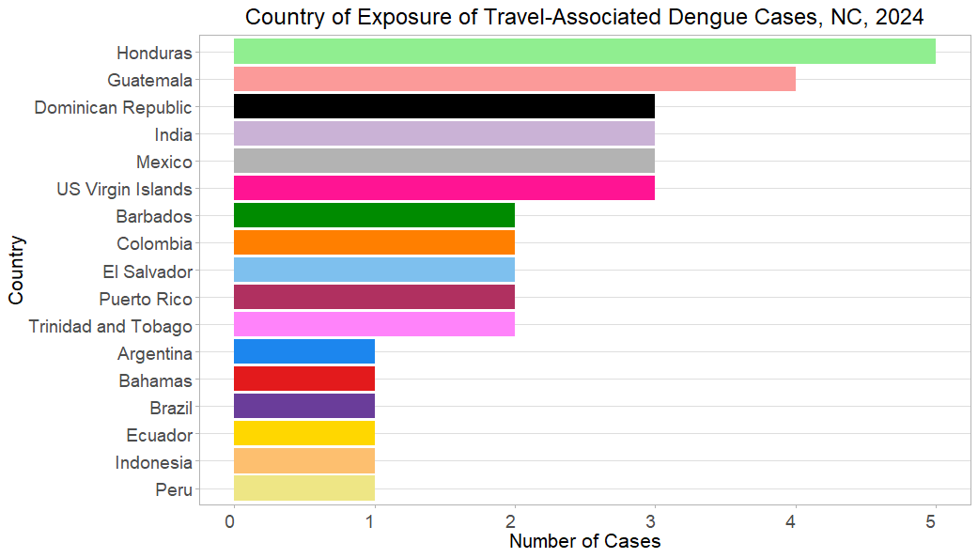
Dengue
SOURCE: NCEDSS as of 9/9/24

Slide 21
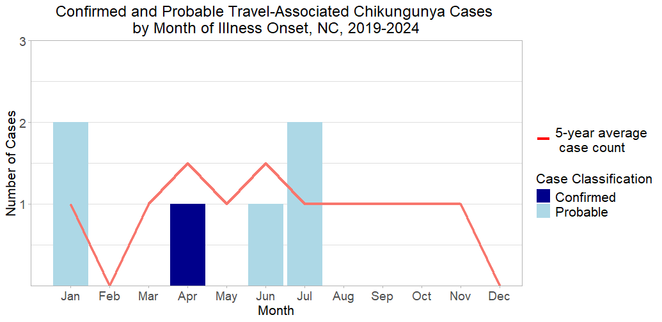
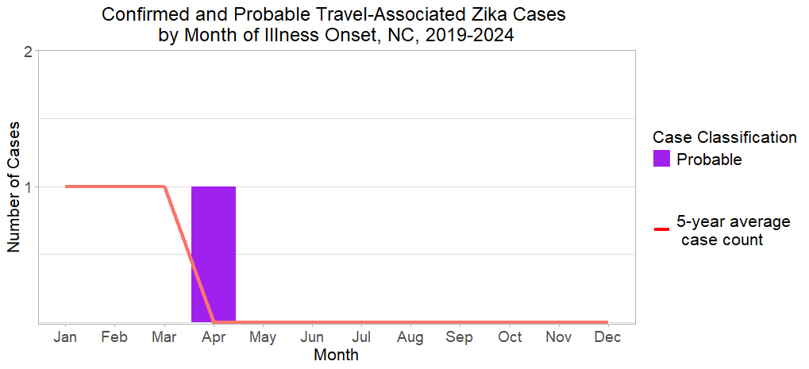
Chikungunya
Zika
SOURCE: NCEDSS as of 9/9/24

Slide 22
Recent CDC Health Alerts
Oropouche – HAN 515
Dengue – HAN 511
Ongoing outbreaks in South America and Cuba
Transmitted by mosquitoes and midges
Dengue like illness
Testing available at CDC
Maternal fetal transmission documented, similar to Zika
Must document dengue negativity prior to testing
Global incidence highest ever recorded in 2024
Have increased suspicion of dengue among people with fever who have been in areas with frequent or continuous dengue transmission within 14 days before illness onset,
Order appropriate diagnostic tests for acute DENV infection: reverse transcription polymerase chain reaction [RT-PCR] and IgM antibody tests, or non-structural protein 1 [NS1] antigen tests and IgM antibody tests,
Ensure timely reporting of dengue cases to public health authorities, and
Promote mosquito bite prevention measures among people living in or visiting areas with frequent or continuous dengue transmission.

Slide 23
County Options for Mosquito Management
NC DHHS does not perform any operational mosquito control activities. However, there are several options available to counties for mosquito control. They are:
Determine if the city or county has any local mosquito control programs and request their assistance.
Determine if the county has an agreement through Article 20 - INTERLOCAL COOPERATION (§§ 160A-460 — 160A-482) (e.g., Jones and Onslow Counties)
Work through county emergency management to activate the NCEM mosquito abatement contract. In the absence of federal or state funding it would fall to the county to pay for this.
After a declared emergency, request supplemental resources through NCEM's WebEOC.
This final option is for a long-term solution, and would not be relevant for response to TS Debby, but would be useful for the future. A county may create a mosquito control district per NCGS 130A Article 12.

Slide 24
Acknowledgements
Foodborne:
Camden Gowler
Deen Gu
Melanie D’Angelo
Molly Deutsch Feldman
Vanessa Brown Moore
Tammra Morrison
Nicole Lee
Vector-borne:
Michael Doyle
Teresa Fisher
Emily Herring
Camden Gowler

Slide 25
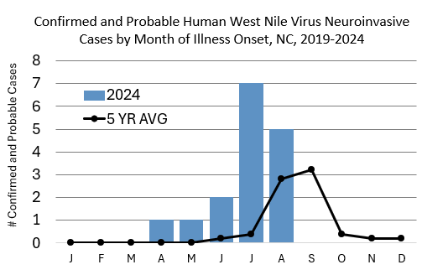
West Nile Virus
SOURCE: NCEDSS as of 9/9/24

Slide 26
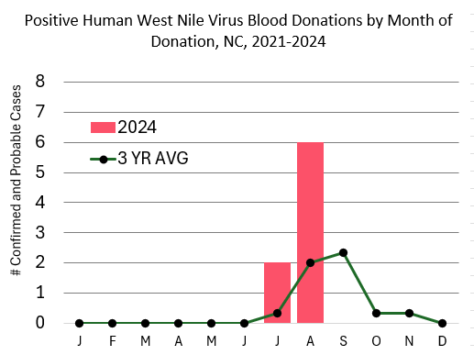
West Nile Virus – Blood Donations
SOURCE: NCEDSS as of 9/9/24

Slide 27
Agenda
Opening Remarks | Stacie Turpin Saunders, MPH Deputy Director/Section Chief, Local and Community Support
Epi Section Update | Zack Moore, MD, MPH: State Epidemiologist and Epidemiology Section Chief
MCU Update | Erica Wilson, MD, MPH: Medical Director, Medical Consultation Unit
Foodborne and Vector borne | Carl Williams, DVM, DACVPM State Public Health Veterinarian
Respiratory and MPOX Update | Emma Doran, MD MPH Medical Director, Vaccine Preventable and Respiratory Diseases
Wastewater Surveillance | Nicole Snyder, PhD, MPH Public Health Epidemiologist
Vaccine Update | Carrie Blanchard, Pharm D, MPH Immunization Branch Director
Question & Answer Session | Open for Questions — Please use the Zoom Q&A function

Slide 28
Respiratory and VPD Updates
Emma Doran
September 10, 2024

Slide 29
Confirmed Measles Case in North Carolina
NCDHHS Press Release issued September 9, 2024
Confirmed case of measles in a child residing in Mecklenburg with a history of international travel
Fortunately, child was kept home while ill besides seeking medical care
Infectious period is four days before to four days after rash onset
As of September 5, 2024 a total of 247 measles cases were reported by 29 jurisdictions in the United States
https://www.cdc.gov/measles/data-research/index.html

Slide 30
Measles Testing at NCSLPH
Measles PCR testing is available at the NCSLPH, but requires prior approval from the Communicable Disease Branch. Call epi on call 24/7 at (919)733-3419 for approval
BTEP courier may be utilized and there is a faster turn-around-time then sending specimen to commercial labs
NP or throat swabs are the preferred specimen source. Urine must be accompanied by a paired NP or throat swab.
NCSLPH SCOPE Guide Measles PCR information on page 163

Slide 31
MMR Vaccine
Infants aged 6 through 11 months should receive one dose of MMR vaccine before travel if they will be traveling internationally
Children aged 12 months or older should receive two doses of MMR vaccine, separated by at least 28 days
Teenagers and adults without evidence of measles immunity should receive two doses of MMR vaccine separated by at least 28 days

Slide 32
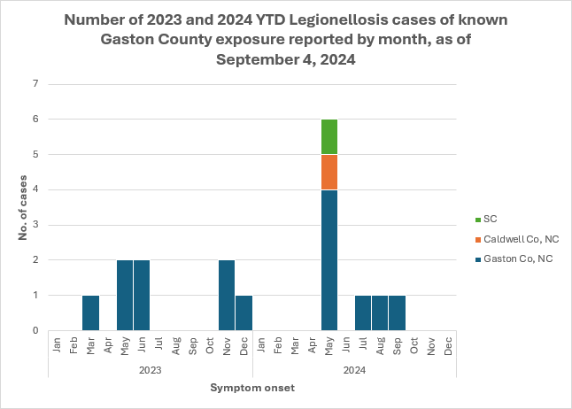
Legionnaires’ Disease (LD)
Investigating a cluster of LD among people who live or spent time in Gaston County in 2024 with additional cases in 2023
Ask LD cases about travel to Gastonia and Gaston County even if they did not stay overnight

Slide 33
Pertussis
Over 400 cases of pertussis have been reported this year in North Carolina
This is a return to pre-pandemic levels and we will likely surpass the 496 cases reported in 2019
We are seeing the highest incidence in infants <1 year old

Slide 34
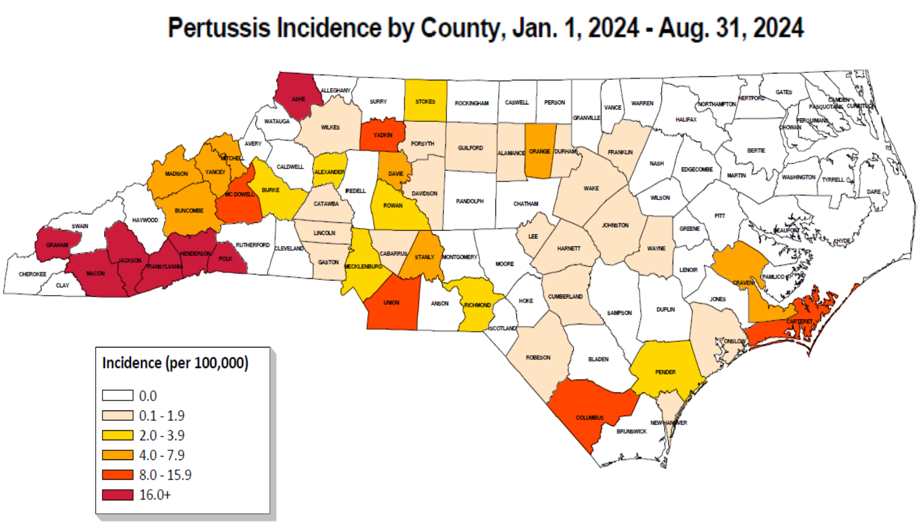

Slide 35
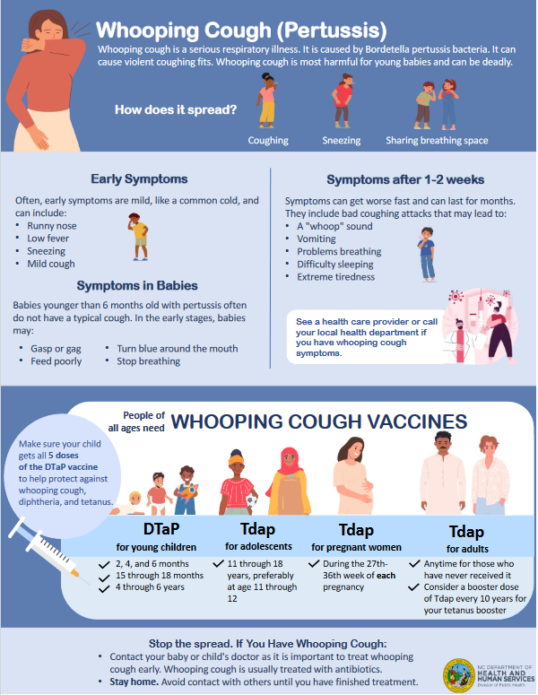
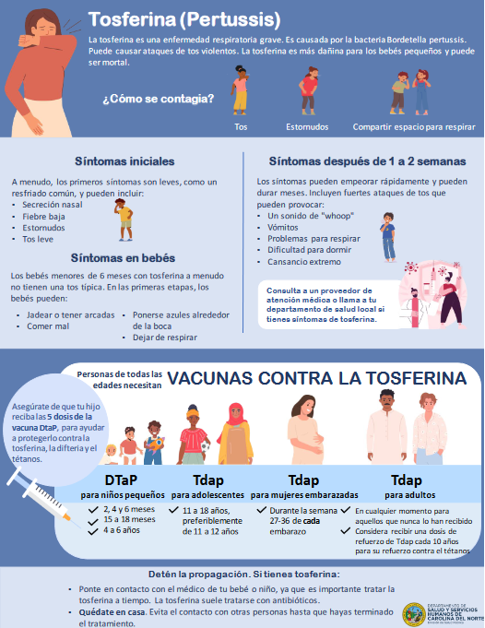
https://epi.dph.ncdhhs.gov/cd/lhds/manuals/cd/pertussis.html

Slide 36
Pertussis Vaccination Messaging
Goal is to prevent infant morbidity and mortality
To provide the best protection to infants, the CDC recommends that pregnant women receive the Tdap vaccine during the 27th through 36th week of EACH pregnancy
Of the 44 infants who developed pertussis in North Carolina so far in 2024, only 43% off mothers had received the recommended vaccination
Work with OB providers in your region to ensure maternal Tdap is being offered

Slide 37
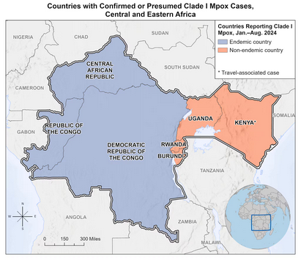
Clade I Mpox
The Democratic Republic of the Congo (DRC) is having its largest mpox outbreak ever recorded
Since January 1, 2023, DRC has reported more than 27,000 suspect mpox cases and more than 1,300 suspected deaths per the CDC
Clade I mpox has spread to some neighboring countries
https://www.cdc.gov/poxvirus/mpox/outbreak/2023-drc.html

Slide 38
Clade I Mpox
Clade I has previously been observed to be more transmissible and cause more severe illness than Clade II (US MPXV outbreak is Clade IIb)
Ask patients with suspected MPXV infection about:
Travel to DRC
Travel to countries neighboring DRC
Close contact with someone with such recent travel
Contact the Communicable Disease Branch epidemiologist on call at 919-733-3419 to coordinate clade-specific testing for patients with these risk factors
https://www.cdc.gov/poxvirus/mpox/health-departments/index.html

Slide 39
Clade I Mpox
Isolate people with possible clade I mpox during and following orthopoxvirus and mpox clade differentiation testing results
Perform active monitoring of all high and some intermediate risk exposure contacts
Close collaboration to monitor the clinical course of patients with clade I mpox where possible to increase understanding of the clinical severity and transmission patterns of clade I mpox in the United States
https://www.cdc.gov/poxvirus/mpox/health-departments/index.html

Slide 40
Agenda
Opening Remarks | Stacie Turpin Saunders, MPH Deputy Director/Section Chief, Local and Community Support
Epi Section Update | Zack Moore, MD, MPH: State Epidemiologist and Epidemiology Section Chief
MCU Update | Erica Wilson, MD, MPH: Medical Director, Medical Consultation Unit
Foodborne and Vector borne | Carl Williams, DVM, DACVPM State Public Health Veterinarian
Respiratory and MPOX Update | Emma Doran, MD MPH Medical Director, Vaccine Preventable and Respiratory Diseases
Wastewater Surveillance | Nicole Snyder, PhD, MPH Public Health Epidemiologist
Vaccine Update | Carrie Blanchard, Pharm D, MPH Immunization Branch Director
Question & Answer Session | Open for Questions — Please use the Zoom Q&A function

Slide 41
NC Wastewater Monitoring Network
Update
Nicole L. Snyder
(nicole.snyder@dhhs.nc.gov)
NCWMN Epidemiologist
Occupational and Environmental Epidemiology Branch

Slide 42
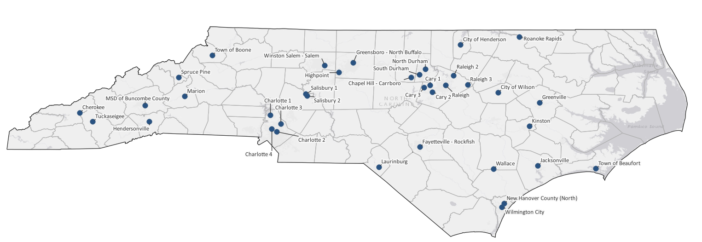
37 sites in NCWMN

Slide 43
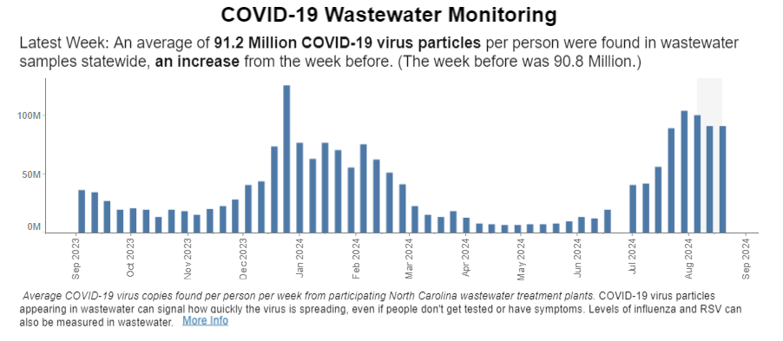
Wastewater shows high levels at the state level.
https://covid19.ncdhhs.gov/dashboard
Notes:
Update

Slide 44
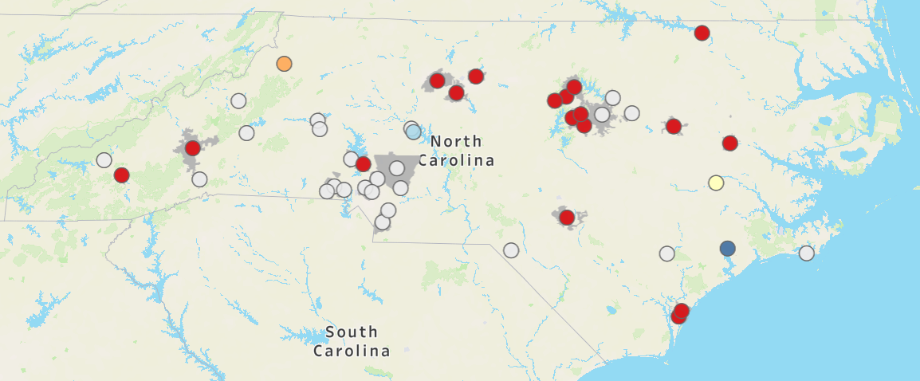
SARS-CoV-2 Wastewater Percentiles (LEVELS)
NC Sites (current as of 09/04): 19/22 sites are in the highest 2 percentiles
Notes:
Update

Slide 45
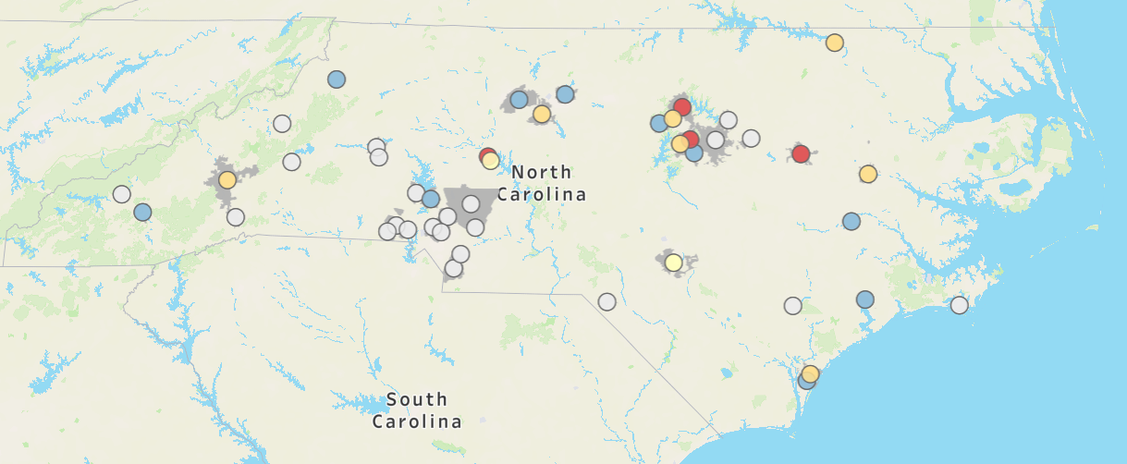
SARS-CoV-2 Wastewater Percent Change (TRENDS)
NC Sites (current as of 09/04): 10/22 sites are decreasing
Notes:
Update

Slide 46
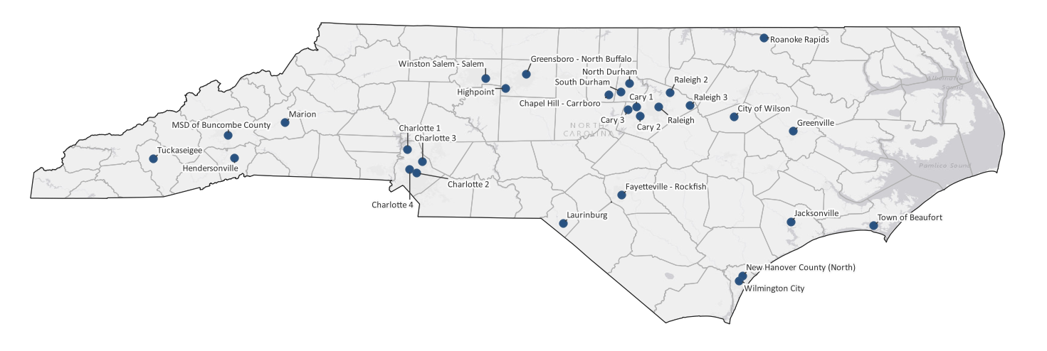
FLU A, FLU B, and RSV Detections
29 Sites (current as of 09/04): 1 detection in the last eight weeks (Cary 1, FLU A, 7/15)
Notes:
Update

Slide 47
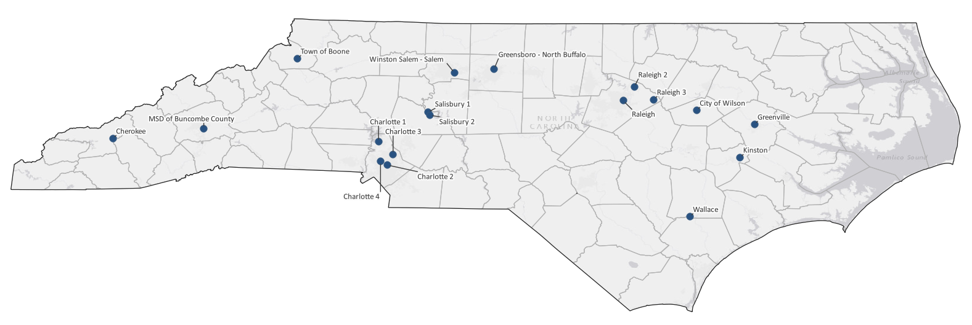
MPOX Detections
18 Sites (current as of 09/04): 1 detection in the last eight weeks (Greenville 07/15)
Notes:
Update

Slide 48
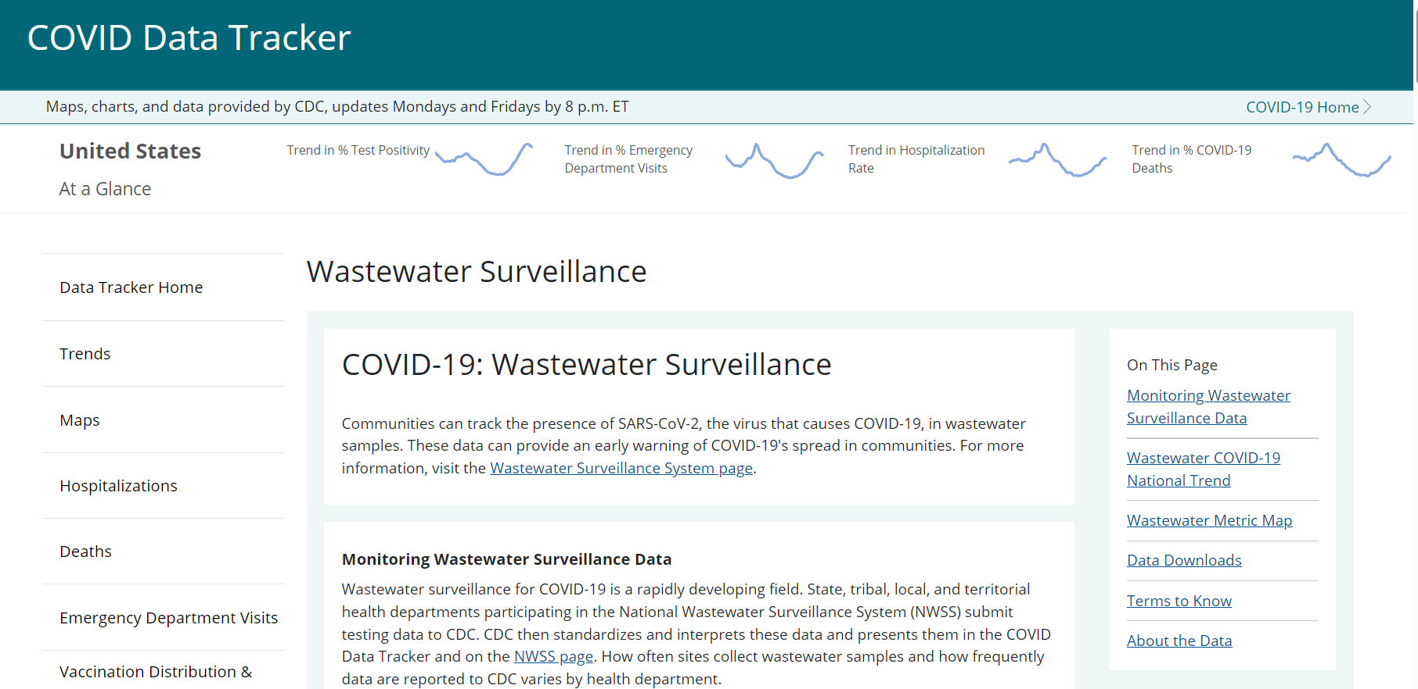
National Wastewater Trends – CDC Dashboard (New Look!)
https://covid.cdc.gov/covid-data-tracker/#wastewater-surveillance

Slide 49
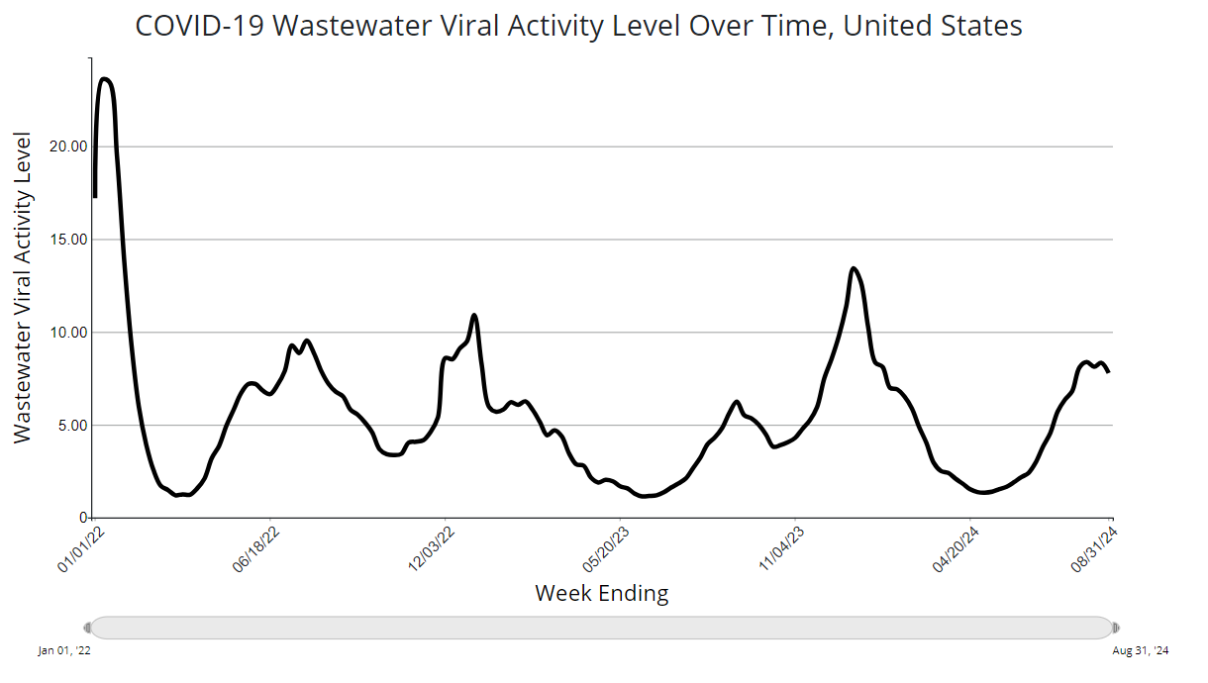
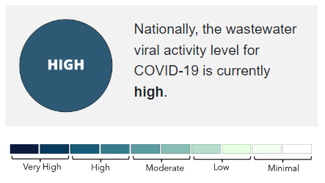
National Wastewater Trends – CDC Dashboard

Slide 50
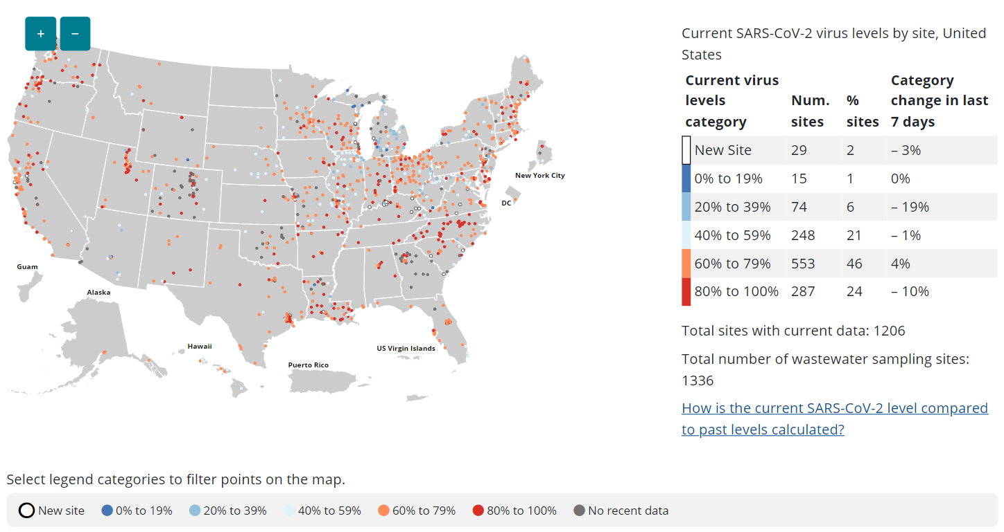
National Wastewater Trends – CDC Dashboard

Slide 51
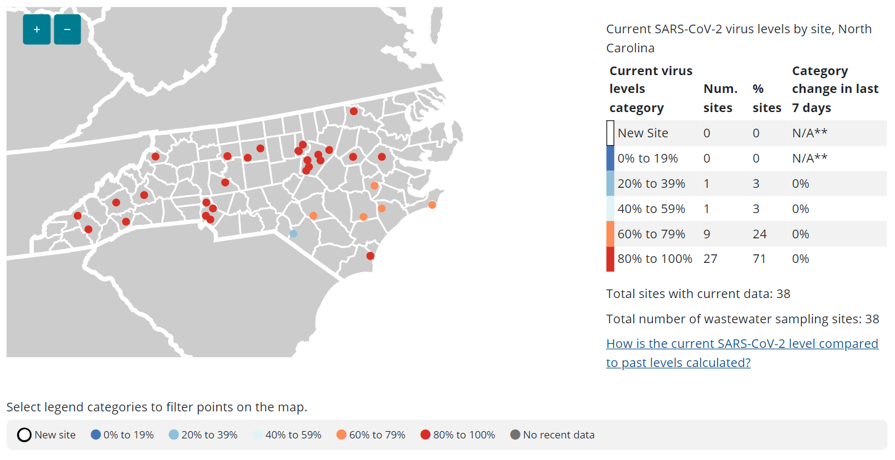
North Carolina Wastewater Trends – CDC Dashboard

Slide 52
National Wastewater Trends – NEW! Respiratory Illness Data Channel
https://www.cdc.gov/respiratory-viruses/data/index.html

Slide 53
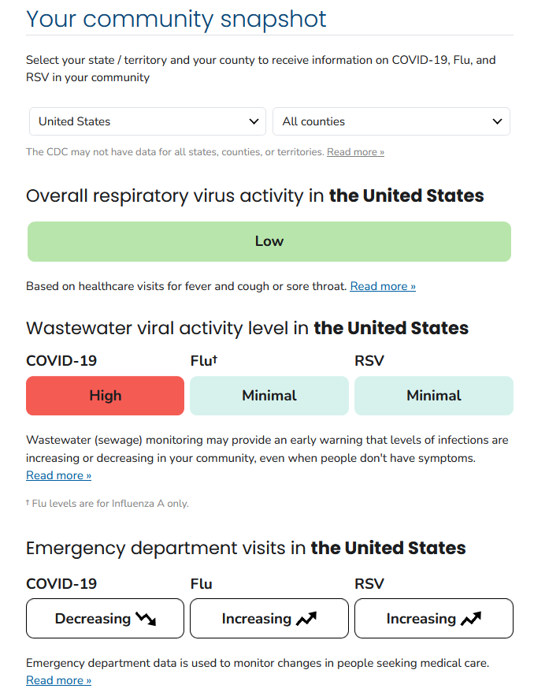
National Wastewater Trends – NEW! Respiratory Illness Data Channel

Slide 54
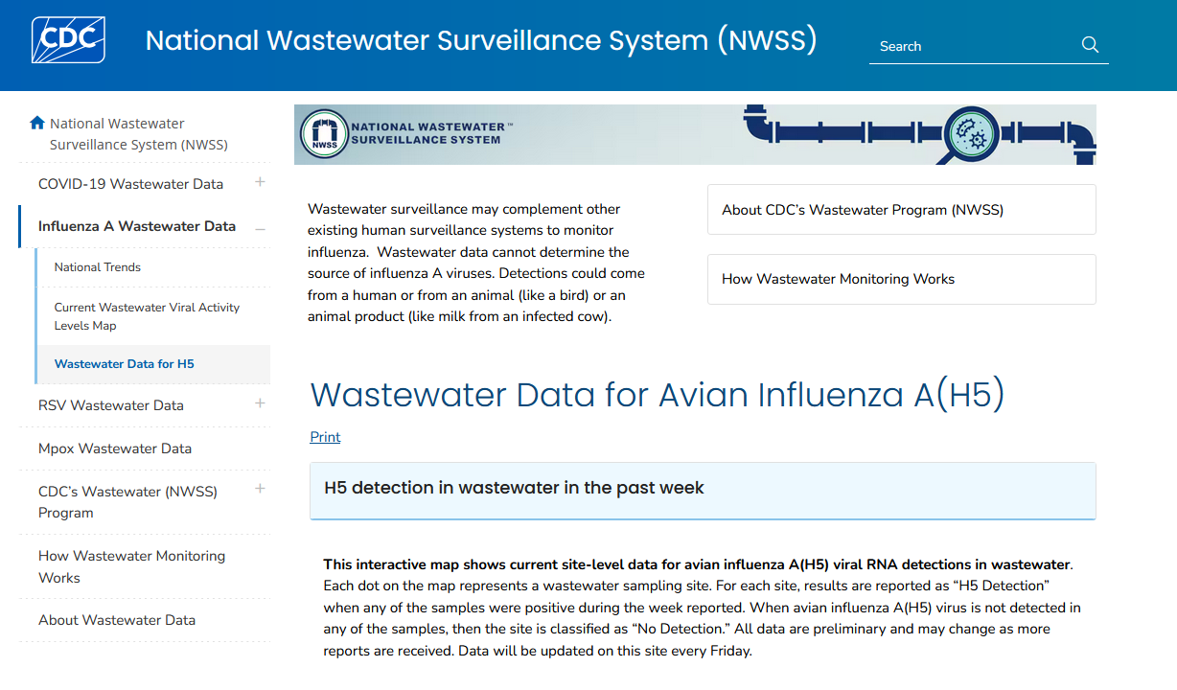
National Wastewater Trends – NEW! Wastewater Data for Avian Influenza
https://www.cdc.gov/nwss/rv/wwd-h5.html

Slide 55
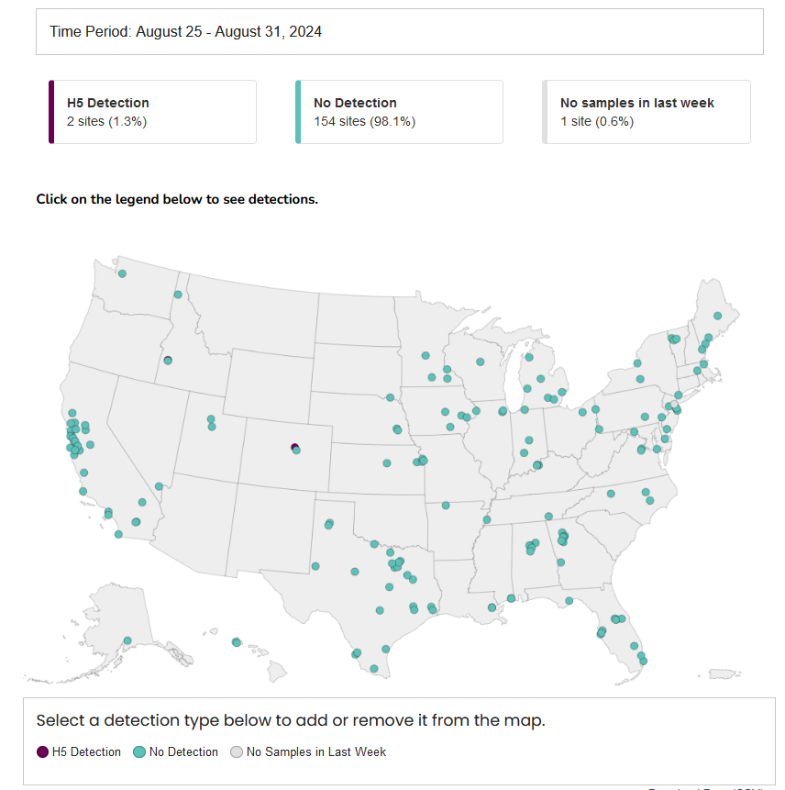
National Wastewater Trends – NEW! Wastewater Data for Avian Influenza

Slide 56
Agenda
Opening Remarks | Stacie Turpin Saunders, MPH Deputy Director/Section Chief, Local and Community Support
Epi Section Update | Zack Moore, MD, MPH: State Epidemiologist and Epidemiology Section Chief
MCU Update | Erica Wilson, MD, MPH: Medical Director, Medical Consultation Unit
Foodborne and Vector borne | Carl Williams, DVM, DACVPM State Public Health Veterinarian
Respiratory and MPOX Update | Emma Doran, MD MPH Medical Director, Vaccine Preventable and Respiratory Diseases
Wastewater Surveillance | Nicole Snyder, PhD, MPH Public Health Epidemiologist
Vaccine Update | Carrie Blanchard, Pharm D, MPH Immunization Branch Director
Question & Answer Session | Open for Questions — Please use the Zoom Q&A function

Slide 57
Today’s agenda
News & Updates
Vaccines for Adults (317)
COVID-19 Updates
Flu Updates
RSV Updates
Mpox Updates
Questions

Slide 58
News & Updates

Slide 59
New Dosing Schedule for BEXSERO
Previous schedule: 2 doses, 1 month apart
New Schedule (two options)*:
Two doses, 6 months apart (if the second dose is administered earlier than 6 months after the first dose, a third dose should be administered at least 4 months after the second dose)
Three dose series at 0, 1-2, and 6 months
View the updated package insert
Update standing orders accordingly
Use shared clinical decision-making when considering MenB for adolescents and young adults who are not at high risk
Visit CDC's Meningococcal Vaccine Recommendations website for more information.
BEXSERO and TRUMENBA® are NOT interchangeable; Series should be completed using the same product
For privately insured patients, check with the insurance plan to ensure a third dose of Bexsero is covered.
*Schedule is subject to change pending ACIP's October 2024 meeting

Slide 60
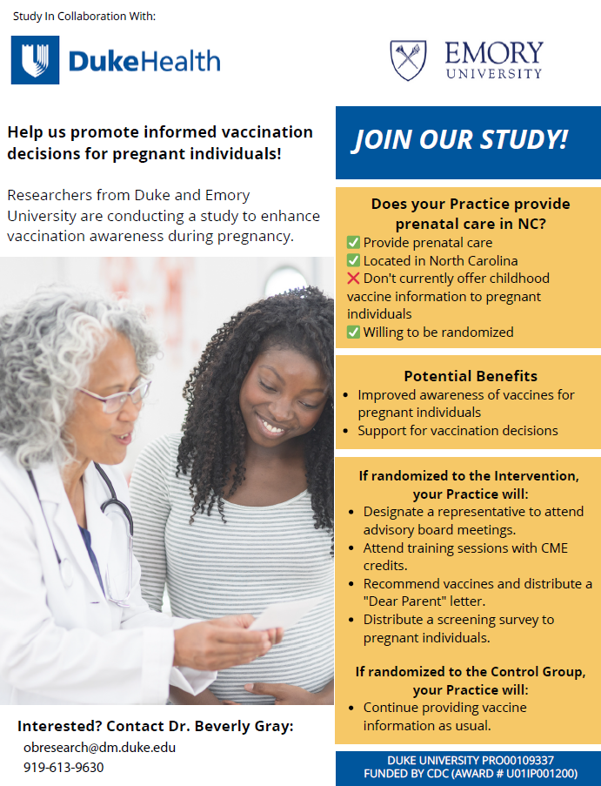
Researchers from Duke and Emory University are conducting a study to understand benefits of proactively connecting first-time pregnant individuals with information about vaccines recommended during pregnancy and for their child(ren) after birth.
Eligibility criteria
We invite practices meeting the following criteria to participate in the study:
Provide routine prenatal care.
Located in North Carolina.
Don’t currently offer information about childhood vaccines to pregnant patients.
Agree to be randomized to deliver the intervention or not.

Slide 61
Pertussis Cases Are Rising in NC
Ensure both children and adults are up-to-date on DTaP/Tdap vaccinations
Collaborate with local OB offices to encourage Tdap administrations for pregnant individuals during the 27th through 36th week of each pregnancy.
OB offices can obtain NCIR access to document Tdap, flu, RSV, COVID-19, and other vaccines being administered in their office.
Encourage local hospitals and childcare centers to promote Tdap vaccination among workers.

Slide 62
Vaccines for Adults (317)

Slide 63
Coverage Criteria Updates
Coverage criteria distinguishes which North Carolinians are eligible for state-supplied vaccine from the North Carolina Immunization Program (NCIP).
NCIP state-supplied vaccine is generally available for children through the age of 18 in compliance with recommendations made by the Advisory Committee for Immunization Practices (ACIP) and the Vaccines for Children (VFC) program. ACIP recommends certain vaccines for certain individuals who are not covered by NCIP state-supplied vaccine.
Health care providers must use privately purchased vaccine for those individuals who wish to have vaccine and are not covered by this coverage criteria.
Please review new coverage criteria to ensure VFC and 317 vaccines are being administered to the correct individuals.

Slide 64
What are 317 vaccines?
Section 317 of the Public Health Service Act: authorizes federal purchase of vaccines for children, adolescents, and adults.
Over its 50-year history, 317-purchased vaccine has been directed toward priority populations - uninsured adults and a few other select patient populations (i.e., HepB birth dose).
VFC - Provides no cost vaccines to eligible children from birth through age 18. This includes children who are uninsured, underinsured, Medicaid eligible, and American Indian or Alaska Native.
317 - Supports immunization of uninsured and underinsured adults as well as a few other select patient populations (i.e., HepB birth dose).
There are two (2) components of the “State Supply” program:

Slide 65
The need to separate VFC and 317 stock
Previous Operations
NCIP used available data to determine funding (VFC vs 317) of doses ordered on the back end
Changing Vaccine Landscape
Increase in products where populations receiving vaccine brands overlap between adults and children
Compliance
Providers receiving 317 adult vaccines need to account for doses to assist in complying with CDC requirements for vaccine accountability
Increase in the number of available brands
Current NCIR Limitations
No way to visually show which doses are 317 funded for eligible adults vs VFC funded for eligible children
Providers see both VFC and 317 vaccines as “State Supplied”
Vaccine Usage reports can be used to view STATE vaccines given to ADULTS to help reconcile inventory when doing your count in the vaccine storage unit

Slide 66
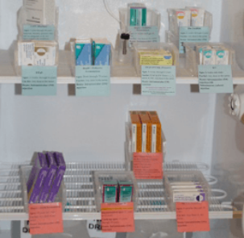
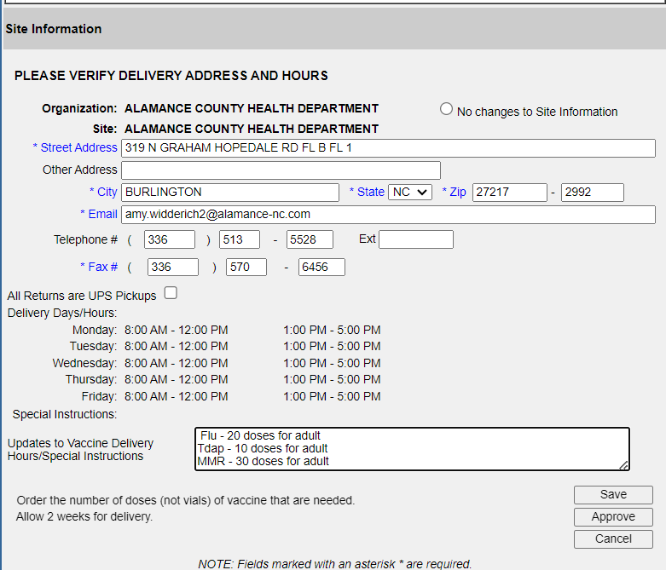
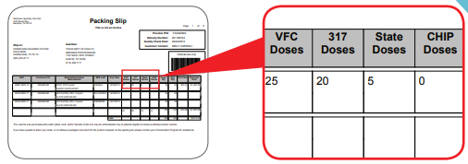
Adult vaccines
Providers that are authorized (LHDs, FQHCs, RHCs) to order adult (317) vaccines, will need to separate 317 doses from VFC doses
When ordering for adult population that falls under the coverage criteria please do the following:
In NCIR under Site Information on your order screen, you will need to tell us how many doses you plan on using for your approved adult population
When doses arrive:
Check the packing slip to ensure the correct number of 317 vaccines were delivered
Label the vaccines "317 Only"; store separately from VFC and Private stock vaccines within the storage unit.
Due to the limited number of 317 doses, borrowing between 317 and other funding sources (private/VFC), will not be allowed. (If accidental borrowing occurs, doses must be paid back within 30 days using the VFC borrowing process)

Slide 67
VFA 317 Office Hours
The North Carolina Immunization Program (NCIP) will host office hours for local health departments (LHDs), federally qualified health centers (FQHCs), rural health clinics (RHCs), and other Vaccines for Adult (VFA) providers to learn more about how to properly order and separate adult “317” vaccines provided by the NCIP on September 12, 2024, at 12:00pm ET.
Meeting link
Meeting ID: 237 794 194 268
Passcode: QX4ja7
Dial in: +1 984-204-1487,,22636747#

Slide 68
COVID-19 Updates

Slide 69
COVID-19: IMPORTANT: Do Not Administer 23-24 COVID-19 Vaccines
On August 22, 2024, the FDA approved and authorized updated mRNA Pfizer-BioNTech and Moderna COVID-19 Vaccines (2024-2025 formula).
Discontinue administration of the 2023-2024 formulation immediately to avoid administration errors.
All 2023-2024 formulations of COVID-19 vaccines are no longer authorized for use in the United States.
On August 30, 2024, the FDA authorized the updated Novavax Vaccine (2024-2025 formula).
Updated mRNA COVID-19 vaccines include Comirnaty and Spikevax, both of which are approved for individuals 12 years of age and older, and the Moderna COVID-19 Vaccine and Pfizer-BioNTech COVID-19 Vaccine, both of which are authorized for emergency use for individuals 6 months through 11 years of age.
Updated Novavax vaccine is authorized for emergency use for individuals 12 years of age and older.
Notes:
The FDA's action updates the 2024-2025 formula to include a monovalent (single) component that corresponds to the Omicron variant KP.2 strain of the SARS-CoV2. We are awaiting FDA action on Novavax's 2024-2025 formulation and will communicate again when we learn more.

Slide 70
Medicaid Bulletin Counseling Codes
COVID-19 Vaccines Reimbursement
NC Medicaid will reimburse at the Medicare-approved COVID-19 vaccination administration rate of $65 until Sept. 30, 2024. Effective Oct. 1, 2024, reimbursement for COVID-19 vaccine administration will align with the standard administration rate per COVID-19 vaccine dose.
NC Medicaid will continue to cover COVID-19 Counseling for members who are under age 21 until Sept. 30, 2024, per guidance from CMS and consistent with EPSDT.
For Medicaid Billing
The ICD-10-CM diagnosis code(s) required for billing is/are: Z23 - Encounter for immunization.
Providers must bill with the correct HCPCS codes for the COVID-19 vaccine administered.
The maximum reimbursement rate per unit is: $0.00 for COVID vaccines.
Providers must bill 11-digit NDCs and appropriate NDC units for the COVID-19 vaccine administered.
Source: SPECIAL BULLETIN COVID-19 #268: COVID-19 Testing, Vaccination and Counseling Coverage After the Federal Public Health Emergency | NC Medicaid (ncdhhs.gov)

Slide 71
Adult COVID-19 Vaccines
Bridge Access Program has officially ended with the authorization of updated mRNA vaccines
Additional adult (317) COVID-19 doses of uninsured and underinsured adults will be available end of September/beginning of October for LHDs, FQHCs, and RHCs
LHDs with AA719 Bridge Access Funding: Funding can continue to be used on operational costs until the end of the year; however, LHDs can NO LONGER bill the AA for the COVID-19 vaccine admin fee

Slide 72
COVID-19 Resources
CDC’s Interim Clinical Considerations for Use of COVID-19 Vaccines in the United States
Updated Pfizer and Moderna Statewide Standing Orders*
COVID-19 Updates for 2024-2025 Respiratory Season Memo
NCDHHS COVID-19 FAQs
*Novavax Standing Orders will be updated soon.

Slide 73
Flu Updates

Slide 74
Farm Worker Program: Flu and COVID-19 Campaign
What You Need to Know:
NCIP will allocate additional 2024-2025 seasonal flu and COVID-19 vaccines to local health departments to support this vaccination effort.
Focus on the following counties: Alexander, Anson, Bladen, Chatham, Cleveland, Duplin, Greene, Harnett, Iredell, Johnston, Moore, Pender, Pitt, Randolph, Robeson, Sampson, Surry, Union, Wayne and Yadkin
A new AA to support efforts in these counties is in draft
This seasonal flu vaccine campaign for farmworkers should start on or around October 1, 2024.
Immunization partners are encouraged to provide COVID-19 vaccine through this effort.
Office Hours on September 11, 2024, 1:00-2:00pm:
NCIP will host office hours to answer questions about the program on Wednesday September 11, 2024, from 1:00 – 2:00 pm. Join the meeting here.

Slide 75
Flu: Available Vaccines and Shipping Times
NCIP will supply several brands of trivalent flu vaccine
This year's composition will protect against an H1N1, H3N2 and a B/Victoria lineage virus
You may receive shipments that include flu and non-flu vaccines.
CDC is allowing one-directional vaccine borrowing for flu vaccine this season. Private vaccine may be used to vaccinate VFC eligible patients and later replaced with VFC vaccine once available.
This is unique to seasonal influenza vaccine and can be used as a mitigating strategy if private flu stock is received earlier than your VFC doses.
A Vaccine Borrowing Report must be completed when a privately purchased vaccine is administered to a VFC-eligible child.
See the 2024-2025 Flu Memo sent August 12, 2024.

Slide 76
RSV Updates

Slide 77
RSV Vaccine Available for Ordering
Initial ordering for Beyfortus® opened on August 15, 2024. Shipping began on September 3, 2024.
ABRYSVO® is available for order for VFC-eligible pregnant people 18 and under. Shipping began on August 8, 2024.
Suborder requests for VFC doses of RSV immunizations using this survey.
Requests will be reviewed and approved on a biweekly cadence. Ordering will cut off at 9:00am every other Thursday beginning August 29, 2024.
Requests for doses are reviewed to ensure equitable distribution. Examples of data reviewed include geographic location, doses administered, and current inventory.
Download the NCDHHS Memo sent on August 5, 2024.
Notes:
NCDHHS will utilize an allocation request survey to fill VFC Beyfortus® and ABRYSVO® order requests. VFC providers should consider the number of VFC doses used in a two-week period, along with the number of VFC doses in their current inventory to determine the amount to request.

Slide 78
RSV Vaccine: Administration Timing
Based on NC’s RSV surveillance data, which indicates a trend of an earlier start to the RSV season, NCDHHS recommends administrations of Beyfortus® and ABRYSVO® earlier than CDC’s national recommendation.
ABRYSVO® administration should begin on August 15, 2024.
Beyfortus® administration should begin on September 15, 2024.
*Beyfortus® and ABRYSVO® can be co-administered with other recommended vaccines.
Medicaid Counseling Coverage:
For service on or before Sept. 30, 2024, the COVID-19 Counseling code 99401 can be used for children aged 0 to 20 months for RSV prevention. Don’t use if the monoclonal antibody is administered on the same day.
Effective Oct. 1, 2024, code 96380 should be used when counseling is provided by physician or other qualified health care professional for the use of Monoclonal Antibody for RSV prevention.
NCDHHS Memo sent on August 5, 2024 NC Medicaid RSV Guidelines
Notes:
Routine administration of all age-appropriate doses of vaccines simultaneously, also known as co-administration, is a recommended best practice. It avoids missed opportunities to vaccinate and increases the chance that a person will be up to date on their vaccinations.

Slide 79
Mpox Updates

Slide 80
JYNNEOS Vaccine Update & Availability
VFC Program for VFC-eligible 18-year-olds at increased risk
Order through NCIR
317 (VFA) Program for uninsured adults at increased risk
Available beginning of October via transfer
Strategic National Stockpile (SNS) for eligible individuals regardless of insurance status
Only available for enrolled mpox providers via transfer
SNS and 317 JYNNEOS Transfer Request Form
JYNNEOS Ordering Instructions Memo

Slide 81
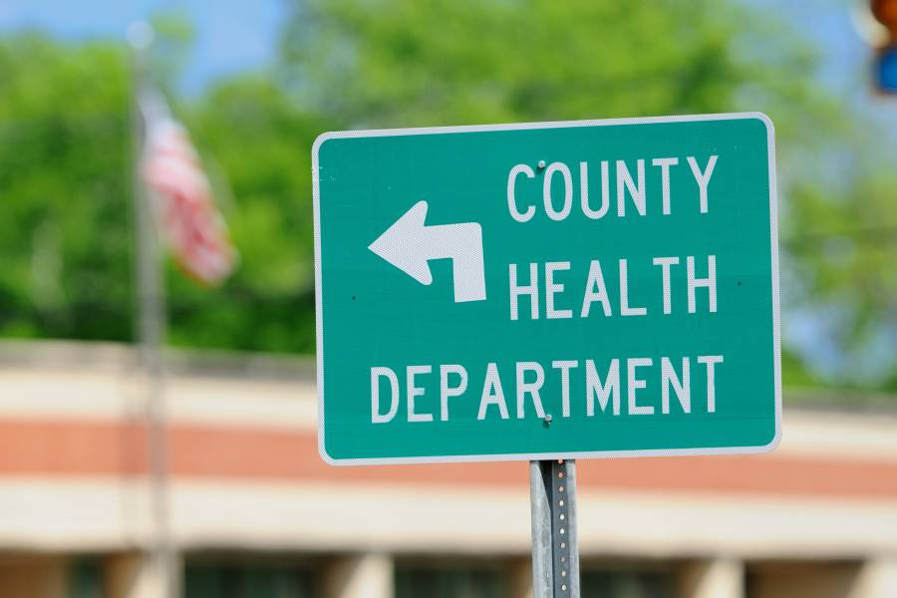
Q&A

