Slide 1
Monthly LHD Update Meeting
August 13, 2024

Slide 2
Agenda
Opening Remarks | Stacie Turpin Saunders, MPH Deputy Director/Section Chief, Local and Community Support
Epi Section Update | Zack Moore, MD, MPH: State Epidemiologist and Epidemiology Section Chief
MCU Update | Erica Wilson, MD, MPH: Medical Director, Medical Consultation Unit
Respiratory and MPOX Update | Emma Doran, MD MPH Medical Director, Vaccine Preventable and Respiratory Diseases
Vaccine Update | Elizabeth Draper, RN, CPHN Immunization Nurse Consultant
Therapeutics Update | Tim Davis, PharmD, PMP Medical Countermeasures Coordinator
NC EDSS Update | Jennifer Stewart, MS Surveillance Systems Unit Manager
Question & Answer Session | Open for Questions — Please use the Zoom Q&A function

Slide 3
Agenda
Opening Remarks | Stacie Turpin Saunders, MPH Deputy Director/Section Chief, Local and Community Support
Epi Section Update | Zack Moore, MD, MPH: State Epidemiologist and Epidemiology Section Chief
MCU Update | Erica Wilson, MD, MPH: Medical Director, Medical Consultation Unit
Respiratory and MPOX Update | Emma Doran, MD MPH Medical Director, Vaccine Preventable and Respiratory Diseases
Vaccine Update | Elizabeth Draper, RN, CPHN Immunization Nurse Consultant
Therapeutics Update | Tim Davis, PharmD, PMP Medical Countermeasures Coordinator
NC EDSS Update | Jennifer Stewart, MS Surveillance Systems Unit Manager
Question & Answer Session | Open for Questions — Please use the Zoom Q&A function

Slide 4
Agenda
Opening Remarks | Stacie Turpin Saunders, MPH Deputy Director/Section Chief, Local and Community Support
Epi Section Update | Zack Moore, MD, MPH: State Epidemiologist and Epidemiology Section Chief
MCU Update | Erica Wilson, MD, MPH: Medical Director, Medical Consultation Unit
Respiratory and MPOX Update | Emma Doran, MD MPH Medical Director, Vaccine Preventable and Respiratory Diseases
Vaccine Update | Elizabeth Draper, RN, CPHN Immunization Nurse Consultant
Therapeutics Update | Tim Davis, PharmD, PMP Medical Countermeasures Coordinator
NC EDSS Update | Jennifer Stewart, MS Surveillance Systems Unit Manager
Question & Answer Session | Open for Questions — Please use the Zoom Q&A function

Slide 5
MCU Updates

Slide 6
New Staff
Emily Herring Public Health Veterinarian
Kacee Morgan TB Nurse Consultant for the Western Region
Devon Nelson RIPS Consultant for the Western Region
Evan Klayman RIPS Consultant for the Eastern Region

Slide 7
Changes to .0101
Adding invasive cronobacter infection reportable in individuals under 12 months of age
Change reporting of carbapenem-resistant enterobacteriaceae (CRE) to reporting of all carbapenemase-producing organisms (CPO)
Terminology changes for typhoid and mpox

Slide 8
Agenda
Opening Remarks | Stacie Turpin Saunders, MPH Deputy Director/Section Chief, Local and Community Support
Epi Section Update | Zack Moore, MD, MPH: State Epidemiologist and Epidemiology Section Chief
MCU Update | Erica Wilson, MD, MPH: Medical Director, Medical Consultation Unit
Respiratory and MPOX Update | Emma Doran, MD MPH Medical Director, Vaccine Preventable and Respiratory Diseases
Vaccine Update | Elizabeth Draper, RN, CPHN Immunization Nurse Consultant
Therapeutics Update | Tim Davis, PharmD, PMP Medical Countermeasures Coordinator
NC EDSS Update | Jennifer Stewart, MS Surveillance Systems Unit Manager
Question & Answer Session | Open for Questions — Please use the Zoom Q&A function

Slide 9
LHD Updates
Emma Doran
August 13, 2024

Slide 10
Respiratory Updates
COVID-19 cases are increasing
Increasing percent of ED visits and number of hospital admissions for COVID-Like Illness (CLI)
Increasing COVID-19 in wastewater
PHE networks reporting a large increase in COVID-19 test positivity
No sign of Flu and RSV increasing

Slide 11
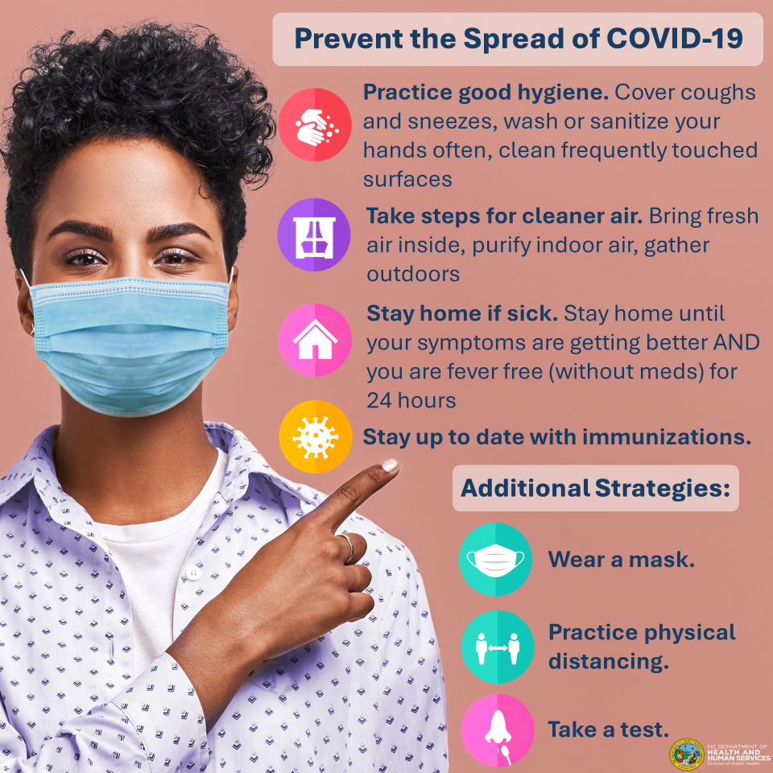
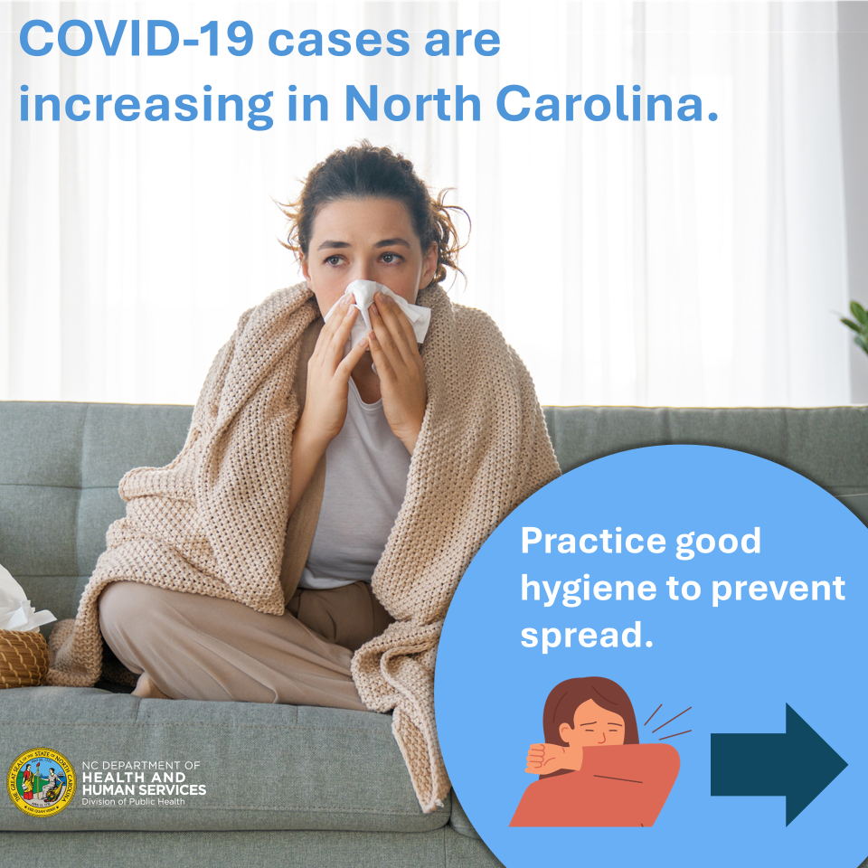

Slide 12
Human Infections with H5N1 in the US
Associated with poultry exposures: 10
April 2022: 1 case reported fatigue while depopulating poultry (CO)
July 2024: 9 cases in poultry workers performing poultry depopulation (CO)
All cases were clinically mild, not hospitalized
Associated with dairy cattle exposures: 4
March -July 2024: 4 cases in dairy farm workers (TX, MI, CO)
All cases were clinically mild, not hospitalized
https://www.cdc.gov/bird-flu/situation-summary/index.html
Notes:
Adult dairy farm workers in contact with cows, all with clinically mild illness
Not wearing recommended PPE (no respiratory or eye protection)
3 cases with conjunctivitis only, 1 case with acute respiratory symptoms
All offered oseltamivir, and recovered without hospitalization
No human-to-human transmission

Slide 13
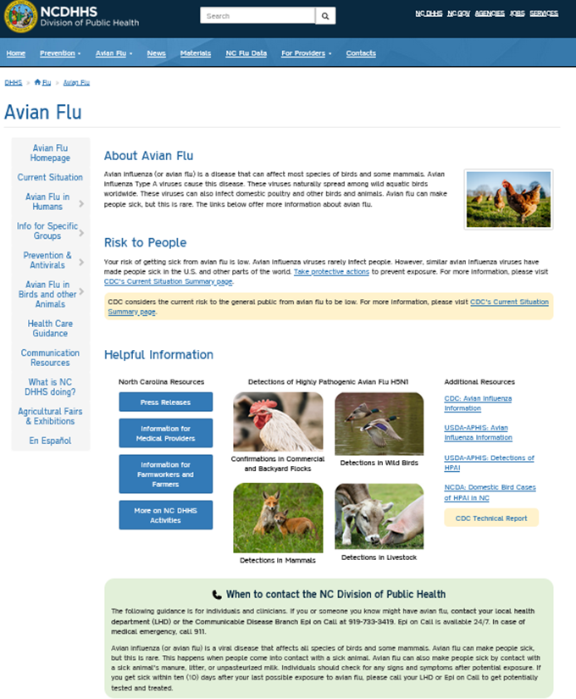
Enhanced Surveillance
NC DPH released guidance to providers and clinics for enhanced influenza surveillance and testing for novel or variant influenza viruses. Available here.
Help understand the risk to people from H5N1 and assess for genetic changes that could change the risk
https://flu.ncdhhs.gov/HPAI/index.htm

Slide 15
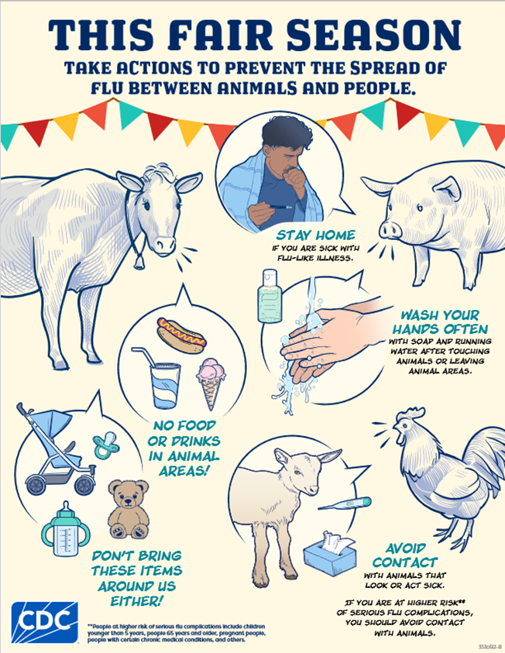
Fair Guidance
Aedin’s Law provides protection to the public while in animal exhibits at agricultural fairs. Animals in public contact.
Animals present for show or exhibition (public contact not intended) are not covered by Aedin’s law, but these animals should still be considered in planning and education efforts.
https://flu.ncdhhs.gov/HPAI/agricultural-fairs.htm
https://www.cdc.gov/bird-flu/print-materials/index.html

Slide 16
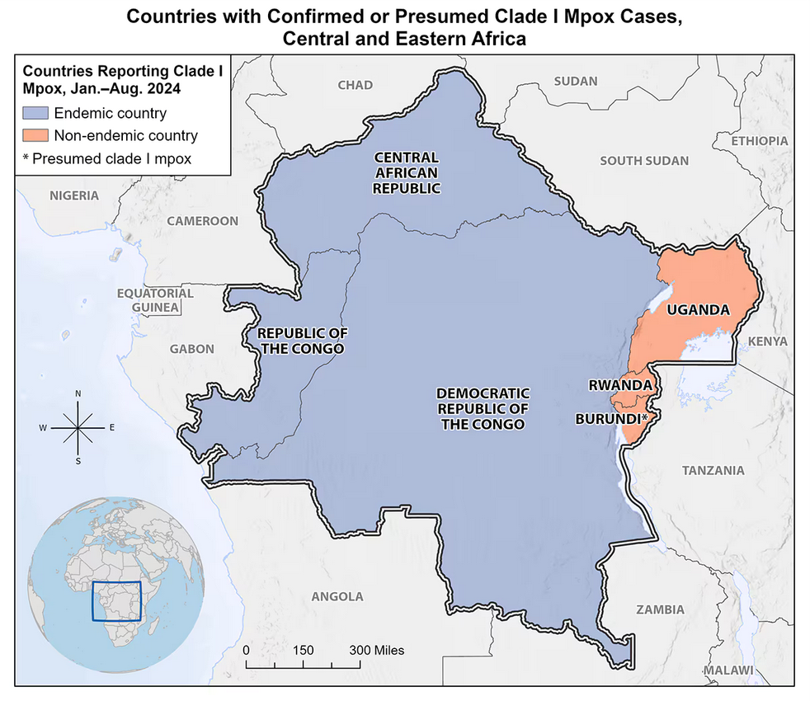
Clade I Mpox
The Democratic Republic of the Congo (DRC) is having its largest mpox outbreak ever recorded.
Since January 1, 2023, DRC has reported more than 22,000 suspect mpox cases and more than 1,200 suspected deaths per the CDC.
Clade I mpox has spread to some neighboring countries.
https://www.cdc.gov/poxvirus/mpox/outbreak/2023-drc.html

Slide 17
Clade I Mpox
Clade I has previously been observed to be more transmissible and cause more severe illness than Clade II (US MPXV outbreak is Clade IIb).
Ask patients with suspected MPXV infection about:
Travel to DRC
Travel to countries neighboring DRC
Close contact with someone with such recent travel
Contact the Communicable Disease Branch epidemiologist on call at 919-733-3419 with any questions
https://epi.dph.ncdhhs.gov/cd/lhds/manuals/cd/monkeypox.html

Slide 18
Back to School
If two or more cases or suspected cases of a communicable disease are connected by person, place and time then investigate for a possible cluster or outbreak
COVID-19 clusters in schools are reportable:
Five or more cases of COVID-19 within 7 days with evidence of epidemiologic linkage between cases OR
Fifteen or more cases of COVID-19 within 7 days associated with the same setting or facility in the absence of specific information about epidemiologic linkage.

Slide 19
Agenda
Opening Remarks | Stacie Turpin Saunders, MPH Deputy Director/Section Chief, Local and Community Support
Epi Section Update | Zack Moore, MD, MPH: State Epidemiologist and Epidemiology Section Chief
MCU Update | Erica Wilson, MD, MPH: Medical Director, Medical Consultation Unit
Respiratory and MPOX Update | Emma Doran, MD MPH Medical Director, Vaccine Preventable and Respiratory Diseases
Vaccine Update | Elizabeth Draper, RN, CPHN Immunization Nurse Consultant
Therapeutics Update | Tim Davis, PharmD, PMP Medical Countermeasures Coordinator
NC EDSS Update | Jennifer Stewart, MS Surveillance Systems Unit Manager
Question & Answer Session | Open for Questions — Please use the Zoom Q&A function

Slide 20
Local Health Department Monthly Update
August 13, 2024

Slide 21
Today’s agenda
General Updates/Reminders
RSV
COVID-19
Mpox
Questions

Slide 22
August is Immunization Awareness Month
Recommended Actions:
Engage in learning opportunities with CDC’s Immunization Education and Training courses.
Make your practice a supportive space that welcomes vaccine questions and concerns from patients and parents.
Use proven strategies to encourage parents and patients to stay up to date on vaccinations.
Make immunization schedules easy for parents and patients to find by displaying them on your website.
Use tools like PneumoRecs VaxAdvisor Mobile App to help you make vaccine recommendations.
Share clear and accurate information about the latest vaccine recommendations, including COVID-19 vaccines.
Governor’s Proclamation

Slide 23
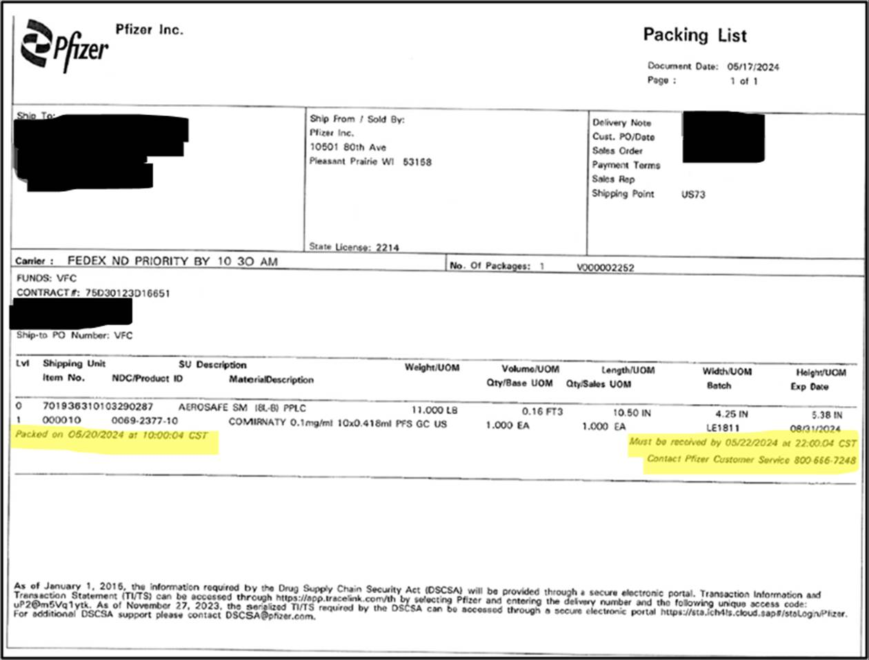
New Refrigerated Pfizer 12+ COVID-19 Vaccine Packing List Information
Pfizer has begun to use a new Packing List with the 12+ COVID-19 Never Frozen shipments.
Image at right highlights date and time by which the product should be received.
If the shipment is not received by the stated time on packing list, recipients are instructed to contact Pfizer Customer Service to determine product viability.

Slide 24
Coverage Criteria Updates
*NCIP Coverage Criteria Supplement has been discontinued.
“Be Smart” has been updated to “Family Planning Medicaid”.
Addition of “317 vaccines” for adult products to differentiate funding source from VFC.
*Allowance of two doses and those entering college for adult MMR has been removed.
*Hepatitis A will no longer be offered universally for high-risk individuals. Uninsured high-risk adults can continue to receive state-supplied vaccine.
JYNNEOS has been added for VFC-eligible 18-year-olds that are at increased risk of mpox disease.
Bridge program has been updated to reflect the new end date of August 31, 2024.
Flulaval removed from available adult flu products for 2024-2025 flu season.
*Universal IPV-Polio coverage for Afghanistan evacuees removed.
One-time LHD allocation for displaced Ukrainian adults added.
Administration timing updated for RSV products.
VFC IPV age updated to 18 years of age (previously 17)
* Effective September 1st. All other changes effective now.

Slide 25
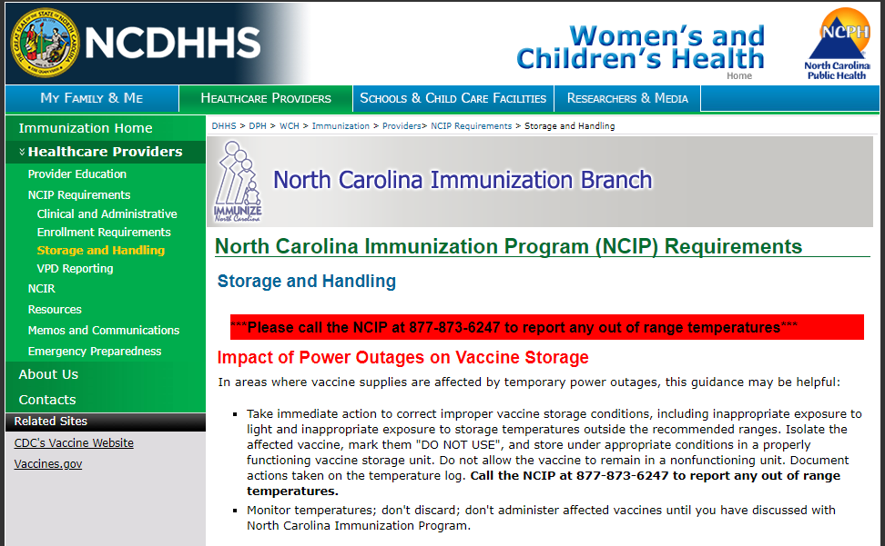
Storage and Handling Change
As of July 1, 2024, VFC providers are required to document temperature readings once a day in the morning with the minimum/maximum readings for all vaccine storage units.
Daily temperature readings with min/max readings are vital to help identify temperature excursions quickly so corrections can be made to prevent vaccine loss and to ensure administered vaccines are viable.
Updated documents are available on the Storage and Handling page.
Questions:
Contact the NCIR Help Desk by phone: 1-877-USE-NCIR (873-6247) or by email: ncirhelp@dhhs.nc.gov.
Notes:
The previous requirement was to document temperatures twice per day.
This change is due to updated storage and handling requirements from the CDC. This new requirement will be reflected in the NCIP Minimum Required Vaccine Ordering, Handling, and Storage Procedures and NCIP Temperature Logs.

Slide 26
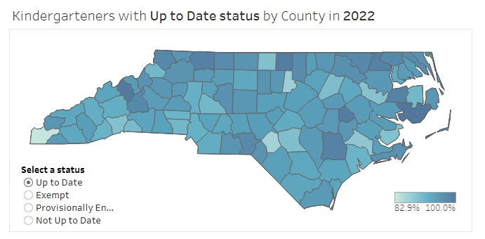
New Tool: Kindergarten Immunization Dashboard
The NC Immunization Program (NCIP) launched a new Kindergarten Immunization Dashboard.
Key Features:
Access up-to-date information on immunization coverage and trends over the previous three years.
Generate reports for specific schools or counties.
View immunization data at the state, county, and school levels.
Find the Dashboard on the Schools section of the Immunization Branch website.
Read the NCDHHS Memo sent July 9, 2024.
Notes:
Local health departments, schools, and parents can use this tool to find vaccination coverage and exemption rates across their communities, regions, and schools.

Slide 27
End of Summer Reminders
Be prepared for Hurricane Season by following the guidance outlined in the 2024 Hurricane Memo (May 2024).
Back-to-school vaccinations are underway. Ensure your clinics are adequately stocked for the 30-day exclusion rush.

Slide 28
New Resource: Provider Update Request Form
Immunization providers are required to notify the North Carolina Immunization Program (NCIP) when the following information changes:
Key staff (lead provider, primary or back-up coordinators)
Change of address (prior to move), and
Change in facility name.
Request updates via this link: NCIP Provider Update Request
Questions:
Contact the NCIR Help Desk by phone: 1-877-USE-NCIR (873-6247) or by email: ncirhelp@dhhs.nc.gov.

Slide 29
New CDC Resource for Respiratory Vaccine Products
The new Immunization and Vaccine Product Summaries site offers information on immunizations for flu, RSV, and COVID-19.
Use this site to find:
Detailed product summaries to inform vaccine ordering for the fall/winter respiratory virus season.
Estimated product availability dates.
Procurement guidance for private providers.

Slide 30
Borrowing for the 2024-2025 Respiratory Virus Season
For those VFC providers who maintain private stock of COVID-19 vaccine or Beyfortus® (nirsevimab) and vaccinating privately insured children, bidirectional borrowing of COVID-19 vaccine and Beyfortus® will be allowed for the 2024-2025 respiratory virus season as described below. VFC providers should ensure they have funds to procure sufficient private stock before COVID-19 vaccine or Beyfortus® is borrowed from VFC stock for a non-VFC eligible child.
Borrowing is only applicable if the provider is purchasing private stock and is approved only for instances when:
There is a lack of vaccine stock because of delayed or spoiled shipments.
As part of the initial set up of private purchasing contracts and ordering systems, there has been a delay for the provider in being able to procure private stock of COVID-19 vaccine or Beyfortus®.
Vaccine will expire soon and will be lost if not used.
Provider locations with a small privately insured patient population can use this option to administer short-dated, privately purchased vaccine to a VFC-eligible child and replace it with a longer-dated, VFC dose.
New staff calculated ordering intervals incorrectly, leading to a lack of sufficient private or public vaccine stock.
CDC is allowing one-directional vaccine borrowing for the 2024-2025 respiratory season. This means private vaccine may be used to vaccinate VFC eligible patients and later replaced with VFC vaccine once available. This one-directional borrowing is unique to seasonal influenza vaccine and can be used as a mitigating strategy if private flu stock is received earlier than your VFC doses.
All instances of borrowing between VFC vaccine and private vaccine must be recorded using the Vaccine Borrowing Report and the vaccine must be replaced dose for dose within 30 days using NCIR.

Slide 31
RSV Vaccine

Slide 32
RSV Vaccine: Administration Timing
Based on NC’s RSV surveillance data, which indicates a trend of an earlier start to the RSV season, NCDHHS is recommending administrations of Beyfortus® and ABRYSVO® earlier than CDC’s national recommendation.
ABRYSVO® administration should begin on August 15, 2024.
Beyfortus® administration should begin on September 15, 2024.
*Beyfortus® and ABRYSVO® can be co-administered with other recommended vaccines.
Download the NCDHHS Memo sent on August 5, 2024.
Notes:
Routine administration of all age-appropriate doses of vaccines simultaneously, also known as co-administration, is a recommended best practice. It avoids missed opportunities to vaccinate and increases the chance that a person will be up to date on their vaccinations.

Slide 33
RSV Vaccine Available for Ordering
Initial ordering for Beyfortus® will open on August 15, 2024 with shipping expected to begin on September 1, 2024.
Please submit an order request for VFC doses to cover the first two-week period of RSV season using this survey.
Requests will be reviewed and approved on a biweekly cadence.
Requests for doses are reviewed to ensure equitable distribution. Examples of data reviewed include geographic location, doses administered, and current inventory.
ABRYSVO® is now available to order using this survey.
Requests will be reviewed and approved on a biweekly cadence.
Ordering will cut off at 9:00 am every other Thursday beginning August 8, 2024.
Download the NCDHHS Memo sent on August 5, 2024.
Notes:
NCDHHS will utilize an allocation request survey to fill VFC Beyfortus® and ABRYSVO® order requests. VFC providers should consider the number of VFC doses used in a two-week period, along with the number of VFC doses in their current inventory to determine the amount to request.

Slide 34
COVID-19 Vaccine

Slide 35
Access to Bridge Program Vaccines Ends in August
The federally funded Bridge Access Program, which provides no-cost COVID-19 vaccines for uninsured and underinsured adults, ends in August 2024.
Vaccines obtained through this program will no longer be available after August 2024.
However, you may continue to administer doses already in your inventory through their expiration dates to eligible patients.
Local health departments who have Agreement Addendum (AA 719) funds may continue to use funds per the agreement (service period through May 2025).
North Carolinians who were served by the Bridge Program are encouraged to apply for Medicaid. Eligibility has been expanded.

Slide 36
Mpox

Slide 37
Mpox Updates
In the last six months, 58 cases of mpox have been reported in NC.
Vaccines (JYNNEOS) and other medical countermeasures are available. However, only one in four eligible people have received both doses of JYNNEOS.
Providers should be aware of Pride events happening locally throughout the year that can be outreach opportunities.
For assistance with procuring non-commercialized vaccine, please complete the allocation request HERE.
Reminder: VFC Providers can order JYNNEOS vaccine through NCIR for patients ages 18 and below.
Clinicians should encourage vaccination for eligible patients:
Multiple sex partners
Partners eligible per above
People who know/suspect they have been exposed in last 14 days
Anyone who considers themselves at risk
Resources
NCDHHS Mpox Communications Toolkit
NCSH Mpox Vaccine: Promotion Materials Toolkit
CDC Standards for Practice: Vaccine Recommendations
Health Education Materials Order Form (English) (Spanish)
Current mpox metrics in North Carolina: MPOX | NCDHHS
Notes:
Thirty-three cases in Mecklenburg, nine in Wake, three each in Buncombe, Cabarrus and Durham, two in Robeson, and one case each in Cleveland, Cumberland, Forsyth, Guilford, Moore, Rowan, Union, and Warren. 93% of the cases have occurred in men, 56% in Black/African Americans, and 49% in PLWH. 93% of the cases have occurred in men, 56% in Black/African Americans, and 51% in PLWH. Two cases reported travel to Mexico and one case reported travel to South Africa.

Slide 38
Questions?
Contact Us: Contact the Help Desk at 877-873-6247 or ncirhelp@dhhs.nc.gov.

Slide 39
Agenda
Opening Remarks | Stacie Turpin Saunders, MPH Deputy Director/Section Chief, Local and Community Support
Epi Section Update | Zack Moore, MD, MPH: State Epidemiologist and Epidemiology Section Chief
MCU Update | Erica Wilson, MD, MPH: Medical Director, Medical Consultation Unit
Respiratory and MPOX Update | Emma Doran, MD MPH Medical Director, Vaccine Preventable and Respiratory Diseases
Vaccine Update | Elizabeth Draper, RN, CPHN Immunization Nurse Consultant
Therapeutics Update | Tim Davis, PharmD, PMP Medical Countermeasures Coordinator
NC EDSS Update | Jennifer Stewart, MS Surveillance Systems Unit Manager
Question & Answer Session | Open for Questions — Please use the Zoom Q&A function

Slide 40
Testing and Therapeutics Updates
Tim Davis, PharmD
Medial Countermeasure Coordinator
North Carolina Public Health Preparedness and Response

Slide 41
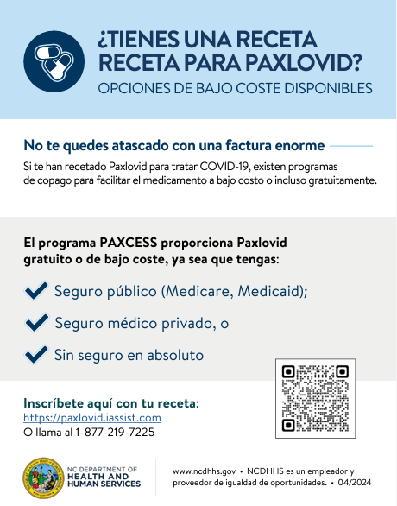
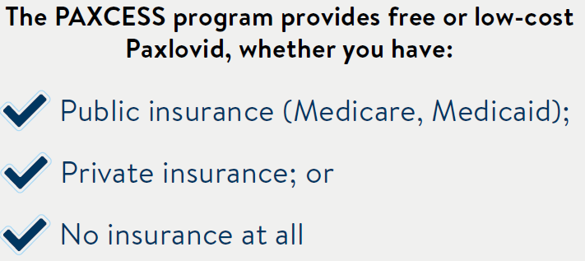
PAXCESS provides affordable access to Paxlovid for ALL patients
Enroll with your prescription at https://paxlovid.iassist.com or call 1-877-219-7225
Download NC PAXCESS Program Flyer

Slide 42
Free at-home COVID Test kits remain available for order in HPOP
For Health Departments, Long Term Care Facilities, Community Organizations, etc:
HPOP COVID-19 Test Ordering Instructions
Don’t have an HPOP account?
Fill out our HPOP Registration Form or email covid19testingandtreatments@dhhs.nc.gov
We strongly encourage all LHDs and partners to order tests as needed
Current expiration dates being shipped are 3-4 months out
Can order as many and as often as needed
Availability expected until December 2025
Find a Community Access Point (CAP) near you: https://covid19.ncdhhs.gov/PickUpHomeTests
284 CAPs are operational in 96 Counties
Brunswick, Hyde, Rockingham & Rutherford CAP sites needed!
Distributing tests and not on the locator? Email covid19testingandtreatments@dhhs.nc.gov

Slide 43
Current Avian Influenza (HPAI) H5N1 MCM guidance
Tamiflu (oseltamivir) remains MCM of choice for H5N1 treatment and PEP
On July 19, 2024, CDC issued Emergency Use Instructions for oseltamivir for treatment or PEP of pandemic influenza A viruses and novel influenza A viruses with pandemic potential. See NC Tamiflu EUI Memo.
VS
Per HHS, Tamiflu (oseltamivir) stockpiles remaining from H1N1 (2009) are available for use during the current H5N1 outbreak, in accordance with CDC guidelines, if needed.
Emergency Use Instructions (EUI)
Issued by CDC
Informs providers and patients about certain uses of medical products already licensed (approved) by the FDA
Often used when recommendations go beyond FDA approved package inserts
Emergency Use Authorization (EUA)
Issued by FDA
Authorizes the use of unapproved medical products or unapproved uses of approved medical products to be used in an emergency to diagnose, treat, or prevent serious or life-threatening diseases

Slide 44
Local Health Department Tamiflu Stockpile Guidance
Inventory any local Tamiflu stockpiles remaining from the 2009 H1N1 response
Specifically noting the NDC (national drug code), Lot number(s), and quantity remaining of each lot.
Cross reference local stockpile inventory against the most current FDA extension list, found here: ASPR: Improving Access to Influenza Countermeasures for U.S. Jurisdictions
If local stockpiles are on the ASPR list linked above and still within FDA extended expiration dates:
Continue to store this Tamiflu in a secure location at room temperature (68ºF to 77ºF or 20ºC to 25ºC) for potential future use.
Record this Tamiflu inventory in IMATS, as previously discussed during regional preparedness coordinator meetings.
If local stockpiles are 1) Already beyond their FDA extended expiration date or are 2) Beyond their labeled expiration date and do NOT appear on the FDA extension list:
This product can be disposed of in accordance with local drug disposal protocols.
Record of the disposal should be kept locally in accordance with appropriate local record retention policies. There are no additional reporting requirements.
Make sure to update local inventory systems following any disposal.
3. Tamiflu and oseltamivir are available commercially
There are currently no supply chain issues with either product
Acquiring prescription medications through normal commercial processes should always be attempted FIRST before leveraging emergency stockpiles

Slide 45
Agenda
Opening Remarks | Stacie Turpin Saunders, MPH Deputy Director/Section Chief, Local and Community Support
Epi Section Update | Zack Moore, MD, MPH: State Epidemiologist and Epidemiology Section Chief
MCU Update | Erica Wilson, MD, MPH: Medical Director, Medical Consultation Unit
Respiratory and MPOX Update | Emma Doran, MD MPH Medical Director, Vaccine Preventable and Respiratory Diseases
Vaccine Update | Elizabeth Draper, RN, CPHN Immunization Nurse Consultant
Therapeutics Update | Tim Davis, PharmD, PMP Medical Countermeasures Coordinator
NC EDSS Update | Jennifer Stewart, MS Surveillance Systems Unit Manager
Question & Answer Session | Open for Questions — Please use the Zoom Q&A function

Slide 46
Q&A

