Slide 1

Monthly LHD Update Meeting
Jan. 14, 2025

Slide 2
Agenda
Opening Remarks | Erica Wilson, MD, MPH: Medical Director, Medical Consultation Unit
Epi Section Update | Zack Moore, MD, MPH: State Epidemiologist and Epidemiology Section Chief
MCU Update | Erica Wilson, MD, MPH: Medical Director, Medical Consultation Unit
Respiratory and MPOX Update | Emma Doran, MD MPH: Medical Director, Vaccine Preventable and Respiratory Diseases
Vaccine Update | Carrie Blanchard, Pharm D, MPH: Immunization Branch Director
Therapeutics (Covid + H5) Update | Tim Davis, PharmD, PMP: Medical Countermeasures Coordinator
RIPS Team Update | Megan Davies, MD SHARPPS
Question & Answer Session | Open for Questions — Please use the Zoom Q&A function

Slide 3
Agenda
Opening Remarks | Erica Wilson, MD, MPH: Medical Director, Medical Consultation Unit
Epi Section Update | Zack Moore, MD, MPH: State Epidemiologist and Epidemiology Section Chief
MCU Update | Erica Wilson, MD, MPH: Medical Director, Medical Consultation Unit
Respiratory and MPOX Update | Emma Doran, MD MPH: Medical Director, Vaccine Preventable and Respiratory Diseases
Vaccine Update | Carrie Blanchard, Pharm D, MPH: Immunization Branch Director
Therapeutics (Covid + H5) Update | Tim Davis, PharmD, PMP: Medical Countermeasures Coordinator
RIPS Team Update | Megan Davies, MD SHARPPS
Question & Answer Session | Open for Questions — Please use the Zoom Q&A function

Slide 4
Agenda
Opening Remarks | Erica Wilson, MD, MPH: Medical Director, Medical Consultation Unit
Epi Section Update | Zack Moore, MD, MPH: State Epidemiologist and Epidemiology Section Chief
MCU Update | Erica Wilson, MD, MPH: Medical Director, Medical Consultation Unit
Respiratory and MPOX Update | Emma Doran, MD MPH: Medical Director, Vaccine Preventable and Respiratory Diseases
Vaccine Update | Carrie Blanchard, Pharm D, MPH: Immunization Branch Director
Therapeutics (Covid + H5) Update | Tim Davis, PharmD, PMP: Medical Countermeasures Coordinator
RIPS Team Update | Megan Davies, MD SHARPPS
Question & Answer Session | Open for Questions — Please use the Zoom Q&A function

Slide 5
Agenda
Opening Remarks | Erica Wilson, MD, MPH: Medical Director, Medical Consultation Unit
Epi Section Update | Zack Moore, MD, MPH: State Epidemiologist and Epidemiology Section Chief
MCU Update | Erica Wilson, MD, MPH: Medical Director, Medical Consultation Unit
Respiratory and MPOX Update | Emma Doran, MD MPH: Medical Director, Vaccine Preventable and Respiratory Diseases
Vaccine Update | Carrie Blanchard, Pharm D, MPH: Immunization Branch Director
Therapeutics (Covid + H5) Update | Tim Davis, PharmD, PMP: Medical Countermeasures Coordinator
RIPS Team Update | Megan Davies, MD SHARPPS
Question & Answer Session | Open for Questions — Please use the Zoom Q&A function

Slide 6
LHD Update
Highly Pathogenic Avian Influenza A H5N1
January 14, 2025

Slide 7
Background
Current public health risk is LOW
  Low risk to general population
  Medium-high risk of exposure to commercial livestock workers and owners of backyard flocks
H5N1 is widespread in wild birds and has been causing outbreaks in poultry since 2022 and U.S. dairy cows since spring of 2024
Strong flu surveillance systems to monitor for H5N1 activity in people
Notes:
North Carolina has been managing Highly Pathogenic Avian Influenza (HPAI) or “bird flu” over the past several years.
Bird flu has been detected in birds –including commercial poultry – over the years and has been found to have spread to mammals.
While there is a threat of more widespread and severe impact on animal and human health, and other states have been affected more substantially, currently the threat to North Carolina and the general public is relatively low.
We know viruses like to change
Close monitoring for changes that might suggest H5 viruses are becoming better adapted to mammals and therefore might spread more easily from animals-to-humans or human-to-human or cause more severe disease
Another theoretical concern is avian flu mixes with seasonal flu – get your seasonal flu shot.

Slide 8


Confirmed Human Infections in the US since 2024
40 cases associated with exposure to dairy cattle
1 Death
24 cases associated with exposure to poultry
No evidence of person-to-person spread
2 cases with unknown exposure
https://www.cdc.gov/bird-flu/situation-summary/index.html
Notes:
Avian influenza A virus infections in people happen most often after close, prolonged and unprotected (no gloves or other protective wear) contact with infected birds or other animals. People with close or prolonged contact with infected birds or animals or their contaminated environments are at greater risk of infection.
For the most part, cases are mild. There has been 1 death reported in LA associated with backyard poultry.

Slide 9
H5N1 Identifications in North Carolina 2022—Present
12 commercial poultry operations
  A commercial layer operation in Hyde County tested positive for HPAI on 1/8
8 backyard flocks
1 commercial dairy herd
1 raptor rehabilitation center
1 black bear
5 wastewater detections (difficult to know source)

Slide 10






Novel Influenza Surveillance
Emergency Room Surveillance
Hospital-based Surveillance
Wastewater Monitoring
Worker Monitoring
Virologic Surveillance
Surveillance of Rabies Negative Cats
North Carolina has a Robust Influenza Surveillance Program

Slide 11





Individuals with known exposures to infected animals
10 day symptom monitoring
Expedited testing if symptoms develop
Novel Influenza Surveillance
Emergency Room Surveillance
Hospital-based Surveillance
Wastewater Monitoring
Worker Monitoring
Virologic Surveillance
Surveillance of Rabies Negative Cats
NC known exposures:
    Commercial poultry operations
    Depopulation (and composting) crews deployed to other states
    USDA and NCDA&CS workers
    Backyard flocks
    Animal rescue
    Dairy herd
NC Monitoring 2022-Present:
>350 individuals monitored
>15 symptomatic individuals tested
0 individuals positive for H5

Slide 12

Novel Influenza Surveillance
Cats submitted to SLPH for rabies testing, which test negative for rabies from:
  Counties with highest number of dairy cattle farms
  Counties with positive wastewater detections
  Counties with positive poultry flocks
Emergency Room Surveillance
Hospital-based Surveillance
Wastewater Monitoring
Worker Monitoring
Virologic Surveillance
Surveillance of Rabies Negative Cats
2024 Cat Testing
Cats submitted for rabies testing | Cats submitted for HPAI testing | HPAI positive cats
868 | 47 | 0
Notes:
Cross-species transmission from dairy
20 positive for rabies

Slide 13
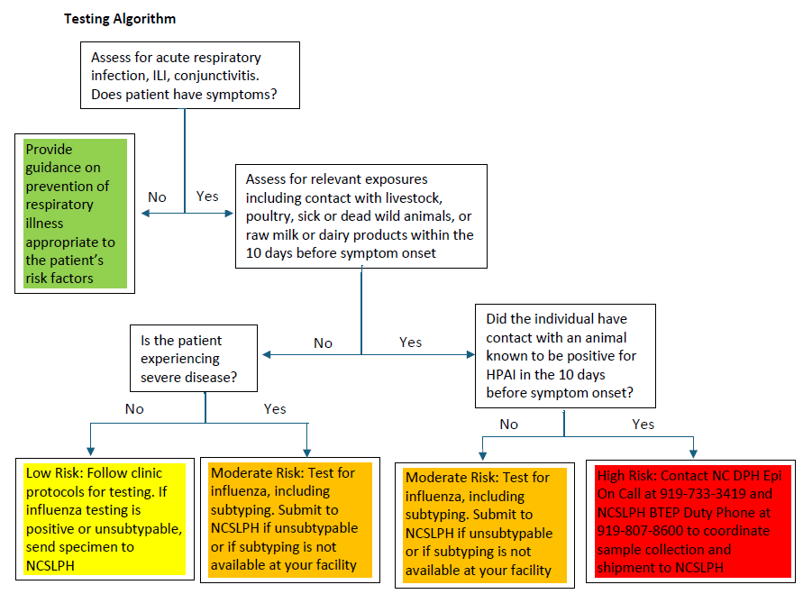
Testing Algorithm
Low to medium risk = surveillance testing
High risk = diagnostic testing
High risk = symptoms + contact with an animal or person with known or suspected HPAI
https://epi.dph.ncdhhs.gov/cd/flu/hpai/Provider-Memo-Novel-and-Variant-Influenza.pdf?ver=1.1

Slide 14
Influenza A/H5 Testing at NCSLPH
High risk: Test for Influenza A/H5 first. Reflex to seasonal influenza typing panel if A/H5 not detected.
Low/Moderate risk: Test for Influenza A/B + SARS-CoV-2 first. Reflex to H5 typing if Influenza A detected.
Results for any H5-detected sample are reported to Epidemiology, Local Health Department, and submitter
H5 results are considered "presumptive" and specimens are submitted to CDC for confirmation

Slide 15
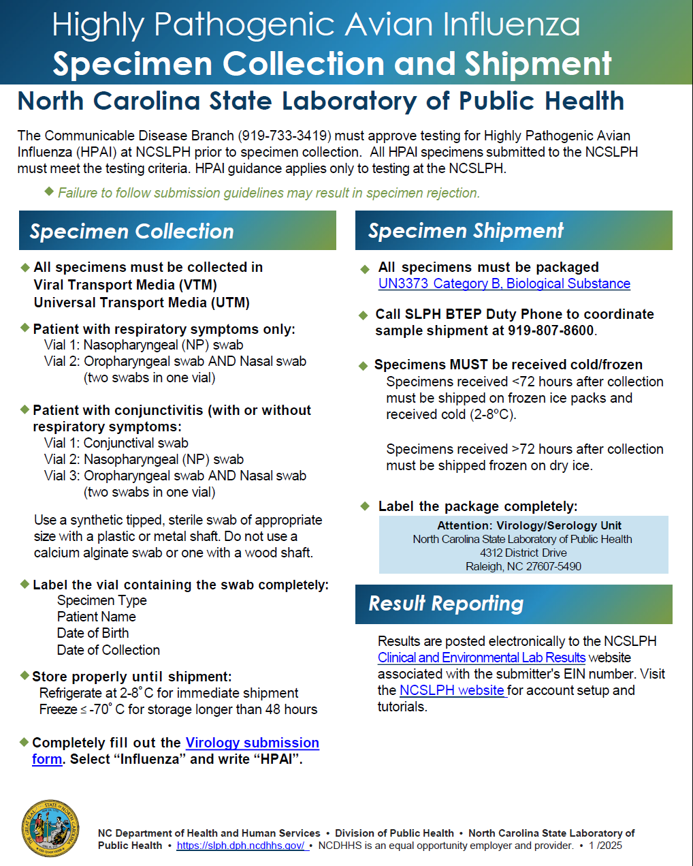
High Risk Flu Specimen Collection and Shipment Instructions
https://slph.dph.ncdhhs.gov/doc/NCSLPH-HPAI-Specimen-Handout_final.pdf

Slide 16
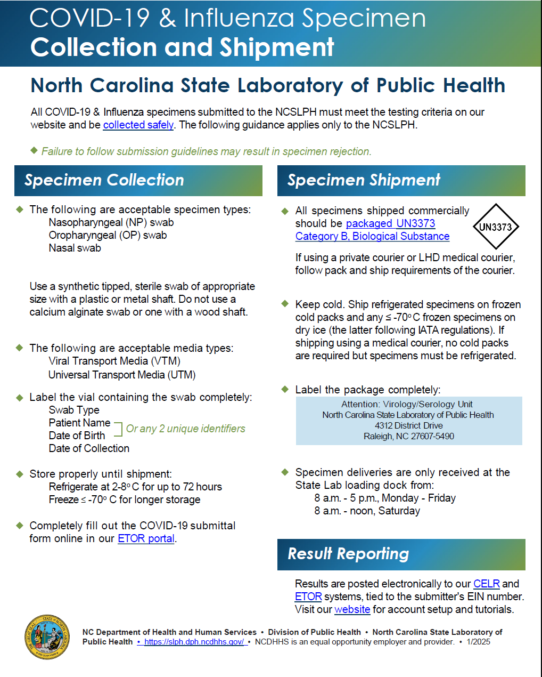
Low to Medium Risk Flu Specimen Collection and Shipment Instructions
https://slph.dph.ncdhhs.gov/doc/NCSLPH-COVID-19_Influenza-Specimen-Handout.pdf

Slide 17
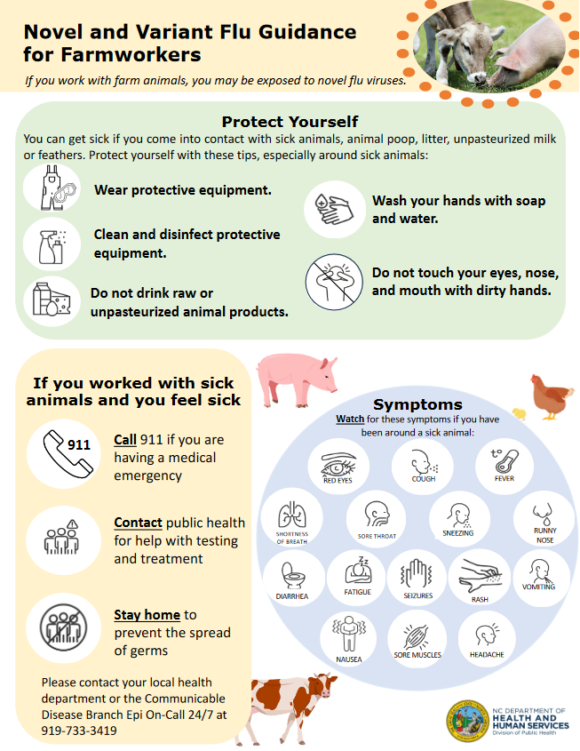
Novel Flu Education
All documents are available at https://flu.ncdhhs.gov/ in English and Spanish with some documents available in Vietnamese

Slide 18
Medical Countermeasures
Seasonal flu vaccines do not provide protection against avian influenza A viruses
Oseltamivir (Tamiflu®) is drug of choice for treatment and post-exposure prophylaxis
  Commercially available; Local spot shortages can occur during flu season
Currently no state stockpile of Tamiflu
  State cache remaining from 2009 H1N1 response expired October 2024
  Some LHD's may have small caches of Tamiflu remaining from 2009
https://www.cdc.gov/bird-flu/media/pdfs/2024/07/Oseltamivir-EUI-HCP_1.pdf

Slide 19
DPH Hyde County Response
Worker Monitoring
Company doing daily monitoring
CCNC doing intermittent monitoring
Testing
Specimen collection kits pre-positioned
Expedited transportation and testing at SLPH
Medical Countermeasures
Rabies submitted cats from Hyde and surrounding counties
Subtyping of flu A positive wastewater results from Beaufort, Greenville, and Kinston
Enhanced Surveillance
Fifteen pharmacies identified with oseltamivir
Encourage LHDs with dispensing capability to purchase oseltamivir
Developing oseltamivir standing order template

Slide 20
Additional Resources
Specimen instructions for low/medium risk
Specimen instructions for high risk
NC DHHS Avian Influenza Webpage
USDA Avian Influenza Webpage
NC Department of Agriculture HPAI Webpage
CDC H5 Bird Flu Current Situation

Slide 21
Agenda
Opening Remarks | Erica Wilson, MD, MPH: Medical Director, Medical Consultation Unit
Epi Section Update | Zack Moore, MD, MPH: State Epidemiologist and Epidemiology Section Chief
MCU Update | Erica Wilson, MD, MPH: Medical Director, Medical Consultation Unit
Respiratory and MPOX Update | Emma Doran, MD MPH: Medical Director, Vaccine Preventable and Respiratory Diseases
Vaccine Update | Carrie Blanchard, Pharm D, MPH: Immunization Branch Director
Therapeutics (Covid + H5) Update | Tim Davis, PharmD, PMP: Medical Countermeasures Coordinator
RIPS Team Update | Megan Davies, MD SHARPPS
Question & Answer Session | Open for Questions — Please use the Zoom Q&A function

Slide 22

Local Health
Department Webinar
January 14, 2025

Slide 23
General Updates & Reminders

Slide 24


Save the Date!
2025 NCDHHS VFC Virtual Conference!
Save the Date!
More details soon! Registration opens January 13, 2025.
Save the Date!
Registration Link

Slide 25
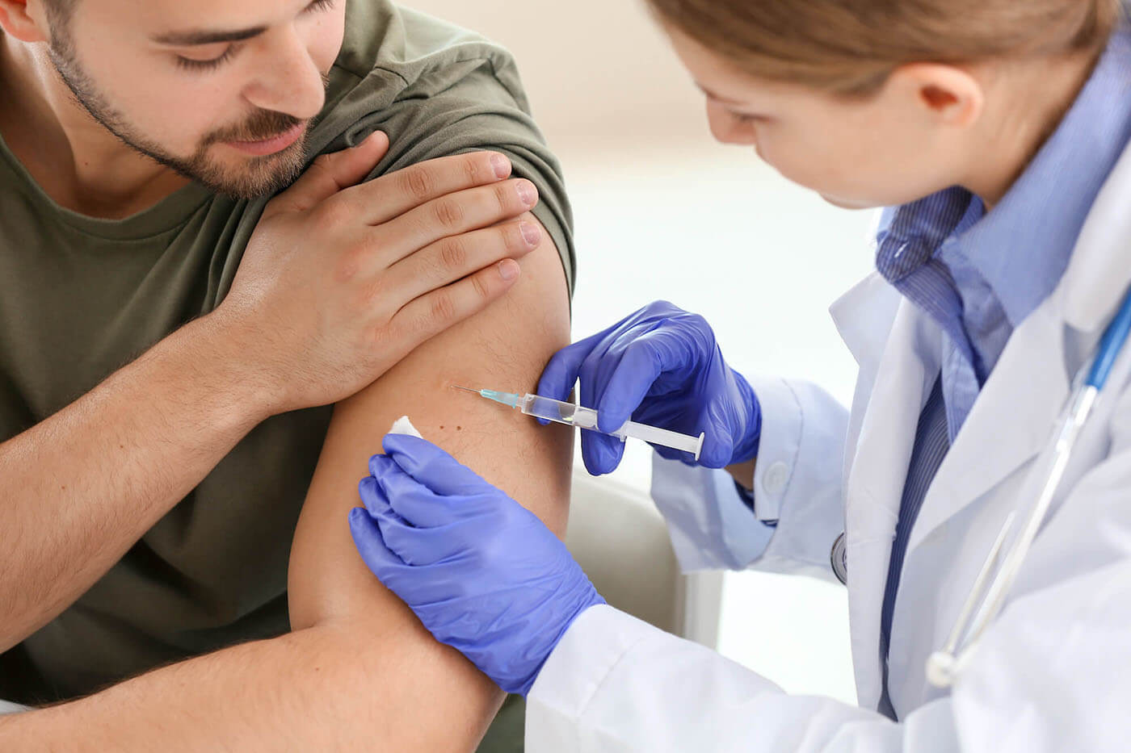
2025 Immunization Updated Schedule
The updated 2025 Immunization Schedules are now available. These schedules apply to children, adolescents, and adults.
Key Highlights:
Approved by the Advisory Committee on Immunization Practices (ACIP)
and the CDC Director on October 24, 2024.
The schedules summarize recommendations from ACIP to guide providers
in determining recommended vaccines in each age group.
These resources ensure immunizations are timely, effective, and
safely administered.
Resources Available:
Healthcare Provider Immunization Schedules:
Comprehensive schedules covering all age groups
Simplified Immunization Schedules: Easy-to-read formats for patients and families to understand recommendations and vaccine-preventable diseases.
Notes:
Updated 2025 Immunization Schedules link to CDC site.
Resources Available on the CDC site as well to easily print off.

Slide 26

Public Health Service Act Extension
Secretary Xavier Becerra signed the 12th amendment to the PREP Act on December 10, 2024.
The amendment extends the declaration's duration until December 31, 2029, and took effect on January 1, 2025.
Key Points:
Provides liability immunity for those involved in the manufacture, distribution, and administration of medical countermeasures (e.g., vaccines, therapeutics, and tests) for COVID-19 and seasonal flu.
Immunity applies to pharmacists, pharmacy interns, and pharmacy technicians who administer COVID-19 vaccines, therapeutics, flu vaccines, and COVID-19 tests.
Pharmacists, pharmacy interns, and pharmacy technicians can continue to administer seasonal flu and COVID-19 vaccines to individuals aged 3 and older.
Protections apply regardless of a federal agreement or emergency declaration.
Does not cover claims of willful misconduct.
Notice of Amendment

Slide 27
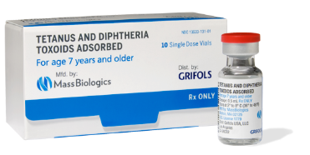
Mass Biologics’ Td Vaccine Supply Update
Grifols Td vaccine has been discontinued. There is ample supply of the Sanofi Td product available for ordering.
Only Sanofi Td vaccines ​(NDC # 49281-0215-10 and NDC # 49281-0215-15) are now available for ordering.
For questions, contact the NCIR Help Desk by phone: 1.877.USE.NCIR (873-6247) or by email.

Slide 28

Upcoming North Carolina Immunization Registry (NCIR) System Downtimes
The NCIR system will be down from 5:00 p.m. – 8:00 a.m. the following dates:
1/23/2025
2/17/2025
This maintenance is essential to ensure the continued performance, reliability, and security of the system.
We apologize in advance for any inconvenience this may cause and appreciate your understanding.

Slide 29
Immunization Assessment Rates
Highlights
Annual Local Health Department Immunization Assessment Visits are set to begin this week.
Assessment rates are based on data extracted from the North Carolina Immunization Registry (NCIR) on 10/1/2024 for children two years of age statewide.
Immunization coverage is based on completion of the 4:3:1:3:3:1:4* series by 24 months of age.
The statewide average for LHD clients increased one percentage point compared to 2023, whereas the statewide average for all North Carolina children remained the same at 71%.
*Refers to DTaP (4 doses), Polio (3 doses), MMR (1 dose), Hib (3 doses), Hep B (3 doses), Var (1 dose), and PCV (4 doses)

Slide 30
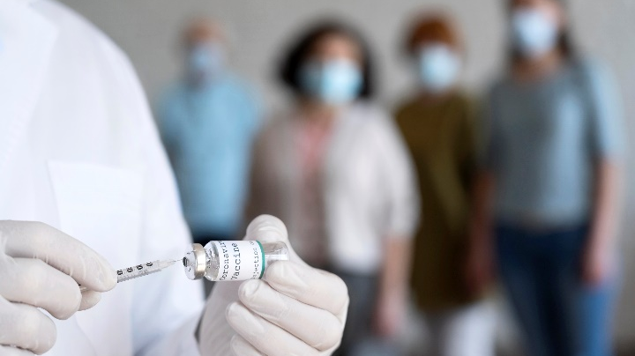
PARTICIPANT INFORMATION
Flu Updates

Slide 31
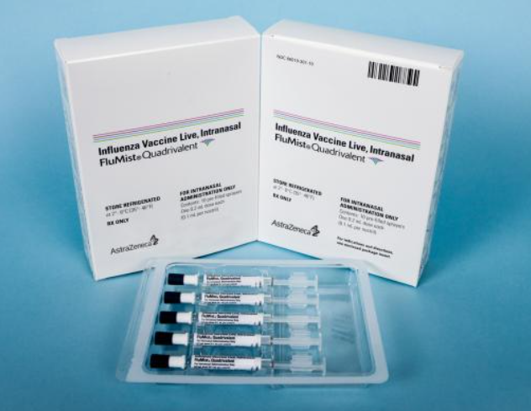
FluMist Is No Longer Available
®
If you need additional flu vaccine, refer to the Flu Vaccine Product Availability and Ordering memo for alternative ordering options.
Questions or assistance with ordering can be directed to the NCIR Help Desk: 1-877-873-6247 or ncirhelp@dhhs.nc.gov.

Slide 32
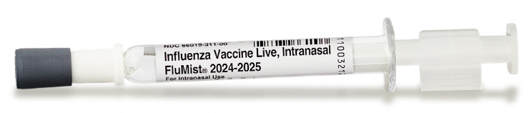
FluMist® Replacement Program Update
The FluMist® Replacement Program provides a no-cost opportunity to replace unused, expiring FluMist® doses, to help you maximize product usage opportunities.
Contact:
Contact the AstraZeneca Replacement Program by phone or by email, as detailed in
the instructions.
Requests can be made through Friday, January 31, 2025, at 7 pm CST.
Eligibility Guidelines:
Doses must have been received through the VFC program.
Product expiration date must be on or before February 2, 2025.
How to Replace Privately Purchased Doses:
Contact your distributor representative or Lauren Peters, AZ Vaccine Business Manager, lauren.peters1@astrazeneca.com.
For questions about this program, contact the FluMist® Replacement Program for CDC at
1-877-633-7375 or flumistreplacement@mckesson.com.
Notes:
-AstraZeneca has contracted with McKesson Specialty Health (MSH) for implementation of this program.
Eligibility Guidelines: AstraZeneca will replace expired doses of FluMist® while supplies last.

Slide 33
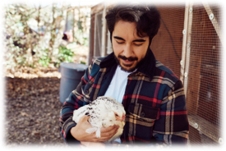
Farmworker Vaccination Program ​
​New Report Available Soon: Farmworker Vaccination Program Compliance Overview
Participating LHDs:
  Alexander, Anson, Bladen, Chatham, Duplin, Greene, Harnett, Iredell, Johnston,
  Moore, Randolph, Robeson, Sampson, Surry, Wayne and Yadkin counties
  Information coming for non-AA counties needing to access
  Farmworker flu vaccine and reporting requirements.
Program Report Cards:
This report card will provide an overview of program compliance with the
North Carolina Farmworker Vaccination Program and Includes:
  Vaccinations Administered (NCIR Report)
  Vaccines Administered Reported by Provider
  Total Number of Mobile Clinics
  Wasted or Spoiled Vaccines
  Number of Farmworkers Vaccinated
  Estimated Eligible Farmworkers
  Submission of Monthly Financial Report
How to Use the Report Card:
Assess Performance: Track your progress and identify any gaps.
Enhance Vaccination Efforts: Take proactive steps to improve outreach and compliance.
Ensure Protection: Help protect the farmworker population while meeting program requirements.
Link to recent communication on Farmworker Program updates.

Slide 34
Questions?
Contact Us:
Contact the NCIP Help Desk at 877-873-6247 or ncirhelp@dhhs.nc.gov.
Notes:
There will be no meeting in December.

Slide 35
Agenda
Opening Remarks | Erica Wilson, MD, MPH: Medical Director, Medical Consultation Unit
Epi Section Update | Zack Moore, MD, MPH: State Epidemiologist and Epidemiology Section Chief
MCU Update | Erica Wilson, MD, MPH: Medical Director, Medical Consultation Unit
Respiratory and MPOX Update | Emma Doran, MD MPH: Medical Director, Vaccine Preventable and Respiratory Diseases
Vaccine Update | Carrie Blanchard, Pharm D, MPH: Immunization Branch Director
Therapeutics (Covid + H5) Update | Tim Davis, PharmD, PMP: Medical Countermeasures Coordinator
RIPS Team Update | Megan Davies, MD SHARPPS
Question & Answer Session | Open for Questions — Please use the Zoom Q&A function

Slide 36
January LHD Call:
Medical Countermeasure Updates
Tim Davis, PharmD, BCNP, PMP
Medical Countermeasures Coordinator
NC PHP&R

Slide 37

MCM Updates: COVID-19
At-home Testing
Free test kits remain available from HHS via HPOP: Ordering Instructions
  ~2.8M tests distributed in NC during 2024!
  340 CAP sites remain active across all 100 counties
4 free tests per household available from COVIDtests.gov
Statewide standing order for testing expired 12/31/24
Treatment
Paxcess program extended
  Free/low cost Paxlovid remains available to eligible patients

Slide 38
MCM Updates: HPAI H5N1
Oseltamivir (Tamiflu) drug of choice:
  FDA approved for treatment of seasonal influenza; commercially available
  In July 2024, CDC released Emergency Use Instructions (EUIs) for use against HPAI H5N1
Recommendations
  Symptomatic individuals with history of exposure should start treatment ASAP
  Post-Exposure Prophylaxis (PEP) not generally recommended
    PEP can be considered for high-risk exposures (i.e., close contacts of human case or known PPE breach)
 | Dosing | Duration
Adults & Adolescents 13+ | 75 mg twice daily | Treatment = 5 days Post Exposure Prophylaxis = 5 or 10 days
Children birth to age 12 | Weight based dosing, twice daily

Slide 39
HPAI H5N1 MCM Planning Considerations
Tamiflu cannot be nurse dispensed
  PAs/NPs must register with the NC BOP to become dispensers
  MDs dispensing for a fee, must register with the NC BOP
    Registering with the board is not required for MDs if medication is dispensed at no cost to the patient
  Act of dispensing cannot be delegated & must comply with all Pharmacy rules & laws
  NC BOP Non-Pharmacist Dispenser Guidance
Check your Tamiflu cache remaining from 2009 H1N1 response
  ASPR’s list of Extended Date Tamiflu Lots can be used during this H5N1 response, if needed
  LHD caches of Tamiflu should be entered into IMATS, if possible
Treatment should not wait for test results

Slide 40
MCM Updates: Mpox
STOMP Trial closed early in Nov 2024
  NIH review of preliminary data showed Tecovirimat (TPOXX) was safe, but did not improve mpox resolution or pain
TPOXX remains available from SNS via CDC’s Expanded Access IND for compassionate use for patients who have, or are at higher risk, for severe disease
  Providers looking to access TPOXX should contact phpr.nc@dhhs.nc.gov or 1-888-820-0520
  NC DHHS Provider Memo - updated Dec. 2024
There are no FDA approved treatments for mpox
  Most patients will recover with supportive care & pain control
  Alternative treatments available from SNS, but no proven benefit

Slide 41
Agenda
Opening Remarks | Erica Wilson, MD, MPH: Medical Director, Medical Consultation Unit
Epi Section Update | Zack Moore, MD, MPH: State Epidemiologist and Epidemiology Section Chief
MCU Update | Erica Wilson, MD, MPH: Medical Director, Medical Consultation Unit
Respiratory and MPOX Update | Emma Doran, MD MPH: Medical Director, Vaccine Preventable and Respiratory Diseases
Vaccine Update | Carrie Blanchard, Pharm D, MPH: Immunization Branch Director
Therapeutics (Covid + H5) Update | Tim Davis, PharmD, PMP: Medical Countermeasures Coordinator
RIPS Team Update | Megan Davies, MD SHARPPS
Question & Answer Session | Open for Questions — Please use the Zoom Q&A function

Slide 42

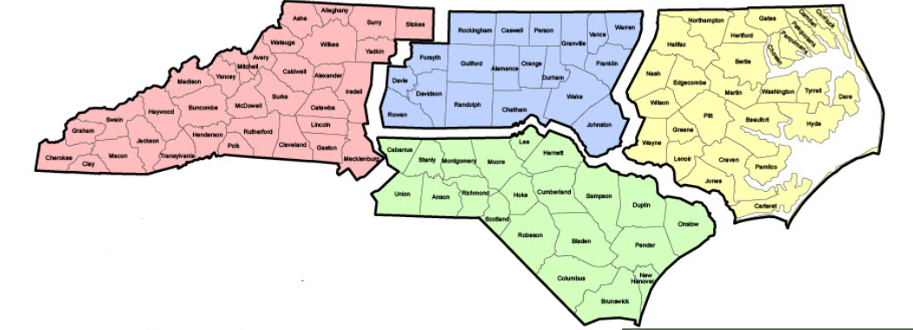
Infection prevention support, education, and consultation to protect the highly vulnerable residents of NC’s long-term care facilities
Notes:
This is our current division of regions but it will soon change.

Slide 43
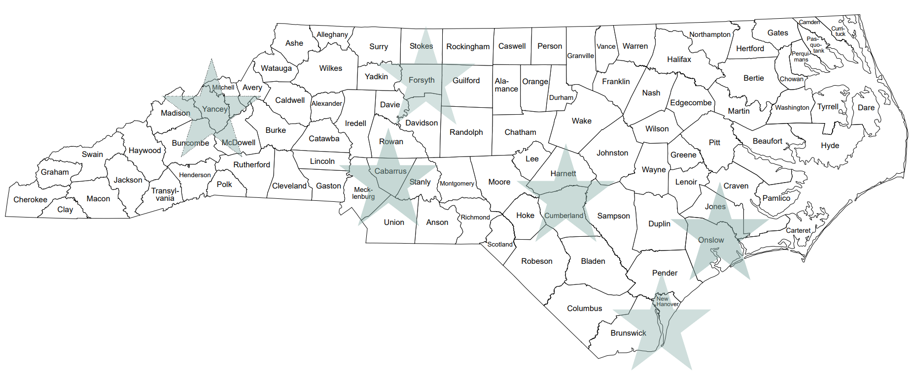
RIPS Team:
  Coordinator: Caroline Colburn-Buncombe County
  RIPS Consultants:
    Caroline Criscoe-Cabarrus County
    Deirdre Patton-Cumberland County
    Devon Nelson-Yancey County
    Evan Klayman-Onslow County
    Tonya Jolly-New Hanover County/Forsyth County

Slide 44

We Offer:
Infection prevention and control assistance that is supportive and consultative rather than regulatory
Staff training/education around infection prevention measures using practical, hands-on techniques
Site visits to assess facilities' infection control programs accompanied by written recommendations to improve policies and practices
Assistance with outbreak management and response
In-person infection prevention education
Support and training to LHD communicable disease staff
Notes:
Focus on SNFs and adult care facilities but assist all LTCF types, including behavioral/mental health facilities and family care homes.

Slide 45

Q&A

