Slide 1
Monthly LHD Update Meeting
July 9, 2024

Slide 2
Agenda
Opening Remarks | Stacie Turpin Saunders, MPH Deputy Director/Section Chief, Local and Community Support
Epi Section Update | Zack Moore, MD, MPH: State Epidemiologist and Epidemiology Section Chief
MCU Update | Erica Wilson, MD, MPH: Medical Director, Medical Consultation Unit
Wastewater Surveillance | Ariel Christensen, MPH Environmental Epidemiologist
Vaccine Update | Carrie Blanchard, Pharm D, PMP Immunization Branch Interim Director
Therapeutics Update | Tim Davis, PharmD, PMP Medical Countermeasures Coordinator
NC EDSS Update | Jennifer Stewart, MS Surveillance Systems Unit Manager
Question & Answer Session | Open for Questions — Please use the Zoom Q&A function

Slide 3
Agenda
Opening Remarks | Stacie Turpin Saunders, MPH Deputy Director/Section Chief, Local and Community Support
Epi Section Update | Zack Moore, MD, MPH: State Epidemiologist and Epidemiology Section Chief
MCU Update | Erica Wilson, MD, MPH: Medical Director, Medical Consultation Unit
Wastewater Surveillance | Ariel Christensen, MPH Environmental Epidemiologist
Vaccine Update | Carrie Blanchard, Pharm D, PMP Immunization Branch Interim Director
Therapeutics Update | Tim Davis, PharmD, PMP Medical Countermeasures Coordinator
NC EDSS Update | Jennifer Stewart, MS Surveillance Systems Unit Manager
Question & Answer Session | Open for Questions — Please use the Zoom Q&A function

Slide 4
Agenda
Opening Remarks | Stacie Turpin Saunders, MPH Deputy Director/Section Chief, Local and Community Support
Epi Section Update | Zack Moore, MD, MPH: State Epidemiologist and Epidemiology Section Chief
MCU Update | Erica Wilson, MD, MPH: Medical Director, Medical Consultation Unit
Wastewater Surveillance | Ariel Christensen, MPH Environmental Epidemiologist
Vaccine Update | Carrie Blanchard, Pharm D, PMP Immunization Branch Interim Director
Therapeutics Update | Tim Davis, PharmD, PMP Medical Countermeasures Coordinator
NC EDSS Update | Jennifer Stewart, MS Surveillance Systems Unit Manager
Question & Answer Session | Open for Questions — Please use the Zoom Q&A function

Slide 5
Agenda
Opening Remarks | Stacie Turpin Saunders, MPH Deputy Director/Section Chief, Local and Community Support
Epi Section Update | Zack Moore, MD, MPH: State Epidemiologist and Epidemiology Section Chief
MCU Update | Erica Wilson, MD, MPH: Medical Director, Medical Consultation Unit
Wastewater Surveillance | Ariel Christensen, MPH Environmental Epidemiologist
Vaccine Update | Carrie Blanchard, Pharm D, PMP Immunization Branch Interim Director
Therapeutics Update | Tim Davis, PharmD, PMP Medical Countermeasures Coordinator
NC EDSS Update | Jennifer Stewart, MS Surveillance Systems Unit Manager
Question & Answer Session | Open for Questions — Please use the Zoom Q&A function

Slide 6
Agenda
Opening Remarks | Stacie Turpin Saunders, MPH Deputy Director/Section Chief, Local and Community Support
Epi Section Update | Zack Moore, MD, MPH: State Epidemiologist and Epidemiology Section Chief
MCU Update | Erica Wilson, MD, MPH: Medical Director, Medical Consultation Unit
Wastewater Surveillance | Ariel Christensen, MPH Environmental Epidemiologist
Vaccine Update | Carrie Blanchard, Pharm D, PMP Immunization Branch Interim Director
Therapeutics Update | Tim Davis, PharmD, PMP Medical Countermeasures Coordinator
NC EDSS Update | Jennifer Stewart, MS Surveillance Systems Unit Manager
Question & Answer Session | Open for Questions — Please use the Zoom Q&A function

Slide 7
LHD Webinar
July 9, 2024

Slide 8
Today’s agenda
General Updates/Reminders
New ACIP Recommendations
COVID-19 Vaccine Updates
New Product Update
Mpox

Slide 9
New NCIR Coming in 2025
NCDHHS is modernizing the North Carolina Immunization Registry (NCIR).
NCIR is the secure database healthcare providers use to manage and report vaccinations administered within the state.
We've integrated provider feedback to empower immunization providers to deliver optimal patient care.
Questions: Email NCIRquestions@dhhs.nc.gov.
What to Know:
Target launch date is summer of 2025.
Providers will be contacted with more details.
More information as available: New NCIR website.
No action is required currently.
Please see the NCDHHS communication sent May 31, 2024.

Slide 10
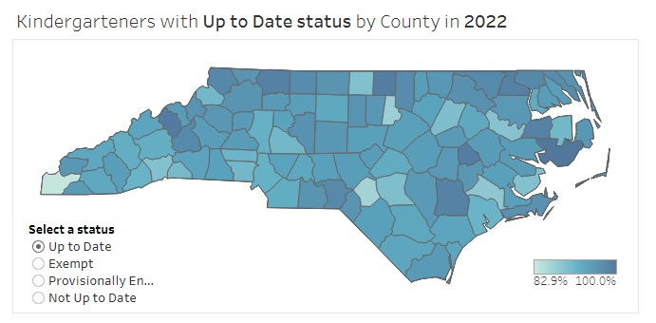
New Tool: Kindergarten Immunization Dashboard
The NC Immunization Program (NCIP) launched a new Kindergarten Immunization Dashboard.
Key Features:
Current Data: Access up-to-date information on immunization coverage and trends over the previous three years.
User-Friendly Interface: Navigate easily through an intuitive platform.
Comprehensive Reports: Generate reports for specific schools or counties.
Geographic Insights: View immunization data at the state, county, and school levels to identify areas needing attention.
Find the Dashboard on the Schools section of the Immunization Branch website.
Notes:
Local health departments, schools, and parents can use this tool to find vaccination coverage and exemption rates across their communities, regions, and schools.

Slide 11
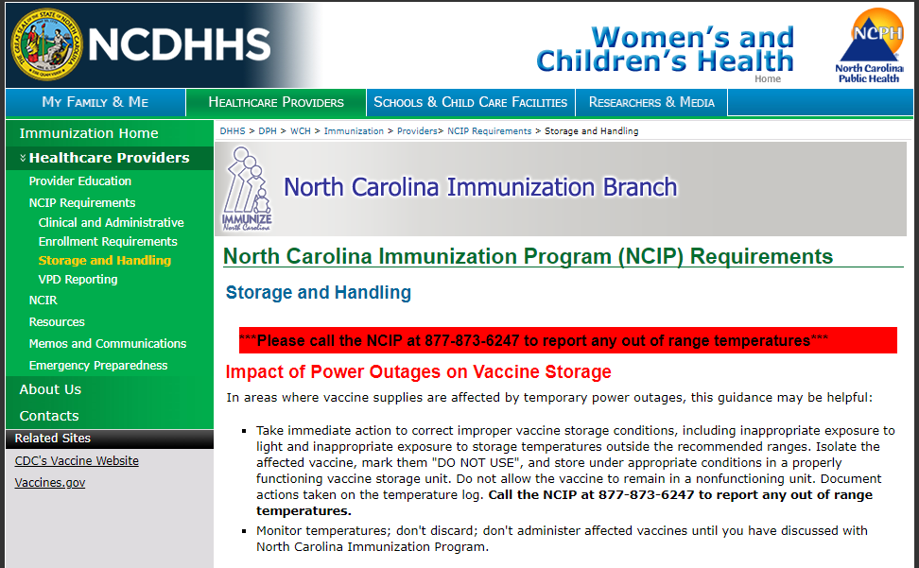
Storage and Handling Change
As of July 1, 2024, VFC providers are required to document temperature readings once a day in the morning with the minimum/maximum readings for all vaccine storage units, in alignment with CDC recommendations.
Daily temperature readings with min/max readings are vital to help identify temperature excursions quickly so corrections can be made to prevent vaccine loss and to ensure administered vaccines are viable.
Updated documents are available on the Storage and Handling page.
Questions:
Contact the NCIR Help Desk by phone: 1-877-USE-NCIR (873-6247) or by email: ncirhelp@dhhs.nc.gov.
Notes:
The previous requirement was to document temperatures twice per day.
This change is due to updated storage and handling requirements from the CDC. This new requirement will be reflected in the NCIP Minimum Required Vaccine Ordering, Handling, and Storage Procedures and NCIP Temperature Logs.

Slide 12
New Resource: Provider Update Request Link
Immunization providers are required to notify the North Carolina Immunization Program (NCIP) when the following information changes:
Key staff (lead provider, primary or back-up coordinators)
Change of address (prior to move), and
Change in facility name.
Request updates via this link: NCIP Provider Update Request
Questions:
Contact the NCIR Help Desk by phone: 1-877-USE-NCIR (873-6247) or by email: ncirhelp@dhhs.nc.gov.
Notes:
The previous requirement was to document temperatures twice per day.
This change is due to updated storage and handling requirements from the CDC. This new requirement will be reflected in the NCIP Minimum Required Vaccine Ordering, Handling, and Storage Procedures and NCIP Temperature Logs.

Slide 13
Hurricane Season: June through November
The 2024 Hurricane Season began June 1, 2024, and continues through November 30, 2024. Preparation is key to successfully handling an emergency, whether it is a hurricane, unexpected power failure, or a refrigerator or freezer malfunction. The time to prepare for a hurricane is now.
If a hurricane makes landfall, the Immunization Branch will coordinate vaccine response efforts with State and Local Preparedness and Local Health Departments to deliver Tdap vaccine to locations in need.
Please review and update your routine and emergency vaccine storage and handling plans as needed.
Resources:
Immunization Branch Emergency Preparedness page
CDC Handling a Temperature Excursion
Please see the NCDHHS memo sent May 23, 2024.

Slide 14
New ACIP Recommendations

Slide 15
Overview: New ACIP Recommendations for RSV and Pneumococcal
Vaxelis for American Indian and Alaska Native Infants
DTap-IPV-HiB-HepB (Vaxelis) should be included with PRP-OMP (PedvaxHIB) in the preferential recommendation for American Indian and Alaska Native infants based on Haemophilus influenzae type b Hib component
Pneumococcal PCV21
PCV21 optional for persons 19 or older who are recommended to receive a dose of PCV
Merck’s news release discussing details of PCV21 vaccine and ACIP’s recommendation
Please see the CDC’s ACIP Recommendations page for complete information.
Notes:
ACIP recommendations for Flu and COVID is on slide under that section.
RSV: ªRSV vaccination is recommended as a single lifetime dose only. Persons who have already received RSV vaccination are NOT recommended to receive another dose.
^{b}These recommendations supplant the current recommendation that adults 60 years of age and older may receive RSV vaccination, using shared clinical decision-making. Adults 60–74 years of age who are not at increased risk of severe RSV disease are NOT recommended to receive RSV vaccination.
^{C}CDC will publish Clinical Considerations that describe chronic medical conditions and other risk factors for severe RSV disease for use in this risk-based recommendation.

Slide 16
Flu ACIP Recommendations
Influenza
A routine annual influenza vaccination for persons 6 months and older who do not have contraindications (same as previously)
High dose inactivated (HD-IIV3), adjuvanted inactivated (allV3), and/or recombinant flu vaccines (IIV2s or RIV3) as an acceptable option for influenza vaccination for sold organ transplant recipients ages 18-64 who are on immunosuppressive medication regimens
Please see the CDC’s ACIP Recommendations page for complete information.
Notes:
RSV: ªRSV vaccination is recommended as a single lifetime dose only. Persons who have already received RSV vaccination are NOT recommended to receive another dose.
^{b}These recommendations supplant the current recommendation that adults 60 years of age and older may receive RSV vaccination, using shared clinical decision-making. Adults 60–74 years of age who are not at increased risk of severe RSV disease are NOT recommended to receive RSV vaccination.
^{C}CDC will publish Clinical Considerations that describe chronic medical conditions and other risk factors for severe RSV disease for use in this risk-based recommendation.

Slide 17
RSV ACIP Recommendations
RSV Older Adults
Adults 75 and older should receive a single lifetime dose of RSV vaccine
These recommendations replace the previous Shared Clinical Decision-Making recommendation.
Adults 60-74 who are at increased risk of severe RSV disease should receive a single lifetime dose of RSV vaccine
Please see the CDC’s ACIP Recommendations page for complete information.
Notes:
RSV: ªRSV vaccination is recommended as a single lifetime dose only. Persons who have already received RSV vaccination are NOT recommended to receive another dose.
^{b}These recommendations supplant the current recommendation that adults 60 years of age and older may receive RSV vaccination, using shared clinical decision-making. Adults 60–74 years of age who are not at increased risk of severe RSV disease are NOT recommended to receive RSV vaccination.
^{C}CDC will publish Clinical Considerations that describe chronic medical conditions and other risk factors for severe RSV disease for use in this risk-based recommendation.

Slide 18
COVID-19 2024-2025
ACIP Recommendation
ACIP recommends 2024-2025 COVID-19 vaccines as authorized or approved by FDA for persons 6 months and older.
COVID-19 Vaccine Composition for 2024-2025 Season
VRBPAC voted (6/5) to recommend “a JN.1-lineage (monovalent) vaccine composition” for the 2024-25 COVID-19 vaccines.
FDA continued to monitor circulating strains and updated their preferred linage to the KP.2 strain, if feasible.
Moderna and Pfizer (mRNAs) will be KP.2 (monovalent) and Novavax will be JN.1
Please see the CDC’s ACIP Recommendations page for complete information.
See FDA’s Announcement here for complete information.

Slide 19
COVID-19 Vaccine Updates

Slide 20
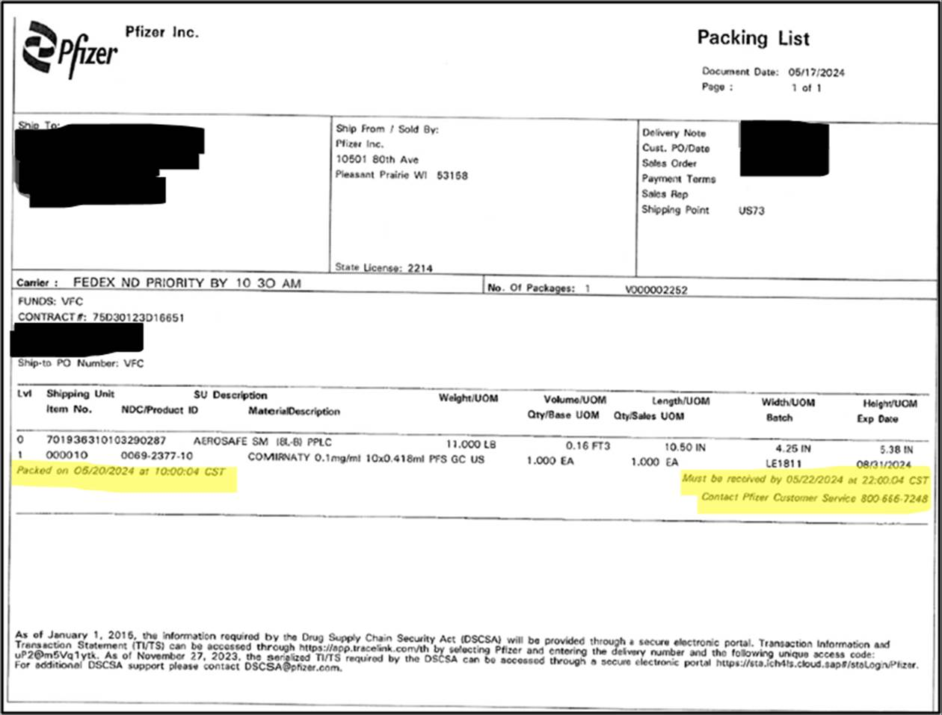
New Refrigerated Pfizer 12+ COVID-19 Vaccine Packing List Information
Please be aware that Pfizer has begun to use a new Packing List with the 12+ COVID-19 Never Frozen shipments.
The packing list image at right highlights the date and time by which the product should be received.
If the shipment is not received by the stated time on packing list, there are instructions for the recipient to contact Pfizer Customer Service to determine product viability.

Slide 21
Access to Bridge Program Vaccines Ends in August
The federally funded Bridge Access Program, which provides no-cost COVID-19 vaccines for uninsured and underinsured adults, will end in August 2024.
Vaccines obtained through this program will no longer be available after August 2024.
However, you may continue to administer doses already in your inventory through their expiration dates to eligible patients.
Local health departments who have Agreement Addendum (AA 719) funds may continue to use funds per the agreement (service period through May 2025).
North Carolinians who were served by the Bridge Program are encouraged to apply for Medicaid. Eligibility has been expanded.

Slide 22
Returning Expired State Supplied COVID-19 Vaccine
Some providers have encountered issues when attempting to return expired COVID-19 vaccine purchased through NCDHHS. If you need assistance to complete a transfer for your expired COVID-19 vaccine, please contact the Help Desk with the following information:
NDC number
Lot number
Number of doses you are returning
If you have not received a return label by email within 3 days of entering your transfer, please reach out to the Help Desk to have the email sent again.
Please note: If the email address provided is longer than 40 characters, you will need to submit an alternate email address by contacting the Help Desk.
Contact the Help Desk at 877-873-6247 or ncirhelp@dhhs.nc.gov with questions.

Slide 23
New Product Update

Slide 24
New Pentavalent Meningococcal Vaccine:
PENBRAYA™ is licensed as a two-dose series, given six months apart, to prevent invasive meningococcal disease caused by Neisseria meningitidis serogroups A, B, C, W, and Y in people 10 through 25 years of age. ACIP recommends PENBRAYA™ be used when both MenACWY and MenB vaccines are indicated at the same visit:
Routine schedule: healthy individuals aged 16-23 years when shared clinical decision-making favors administration of MenB.
For individuals at increased risk of meningococcal disease aged 10 years and older who are due for both vaccines.
Ordering VFC providers can order PENBRAYA™ via NCIR for administration among VFC-eligible adolescents (ages 10 through 18 years).
More Resources:
How to Prepare PENBRAYA™
PENBRAYA™ package insert
MMWR: Use of the Pfizer Pentavalent Meningococcal Vaccine Among Persons Aged ≥10 Years
Please see the NCDHHS memo sent July 1, 2024.
Notes:
As a reminder, MenB vaccines are not interchangeable. The same vaccine (either BEXSERO by GSK or TRUMENBA® by Pfizer) must be used for all doses in the MenB series, including booster doses. The pentavalent MenABCWY product PENBRAYA™ (Pfizer) contains MenB-Fhbp (TRUMENBA®) as its MenB component; therefore, PENBRAYA™ should only be used in series with TRUMENBA®.
Young people between the ages of 16 and 23 are at increased risk. Nine out of 10 older teens aren’t fully vaccinated against one or more types of meningococcal meningitis.

Slide 25
Mpox Updates

Slide 26
Mpox Updates
Notes:
Thirty-three cases in Mecklenburg, nine in Wake, three each in Buncombe, Cabarrus and Durham, two in Robeson, and one case each in Cleveland, Cumberland, Forsyth, Guilford, Moore, Rowan, Union, and Warren. 93% of the cases have occurred in men, 56% in Black/African Americans, and 49% in PLWH. 93% of the cases have occurred in men, 56% in Black/African Americans, and 51% in PLWH. Two cases reported travel to Mexico and one case reported travel to South Africa.

Slide 27
Guidance for Vaccine Hesitancy
Mpox cases are still on the rise, and although the request for the mpox vaccine is low, it is crucial to continue encouraging vaccine administration. Vaccine hesitancy can stem from several issues, such as a lack of confidence (in effectiveness, safety, and the system), complacency (perceived low risk of acquiring mpox), and lack of convenience (in availability and accessibility). If patients are uneasy about receiving the vaccine, use the talking points derived from the American Medical Association (AMA). Address patients' fears about side effects - ask a patient how they feel about mpox and the vaccine Ask why a patient is hesitant - simply ask, "What have you heard about JYNNEOS?" Counter any misinformation - correct mis-information a patient may give for not getting the vaccine You are the most trusted information source - patients look to their local doctor for guidance Tailor your message - focus the discussion on how getting a vaccine can help protect a loved one Understand your patients' concerns - build trust, recognize patient’s experience to move forward

Slide 28
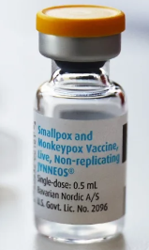
Commercialization of JYNNEOS Vaccine
JYNNEOS (Bavarian Nordic) is now available commercially.
Providers cannot order JYNNEOS vaccines from the US Government supply, as they have been.
State-supplied JYNNEOS is still available for transfer.
We anticipate JYNNEOS vaccines will be available through the VFC program for eligible 18-year-olds in August.
For assistance procuring JYNNEOS vaccine, email Kandice Oakley
More Resources:
Disposal of Expired JYNNEOS
HRSA Grant and Ryan White HIV/AIDS Program: Mpox FAQs
340B Prime Vendor Program (reduced price to eligible provider sites; e.g., FQHCs)

Slide 29
Provider Training Available
The North Carolina HIV Training & Education Center offers a series of trainings for providers working with, or interested in working with, LGBTQ+ communities. Topics: how to take a sexual-health history, mpox, sexually transmitted infections, and serving LGBTQ+ communities using supportive and affirming framework. Registration is open for these provider trainings to be held over Zoom. Continuing Education Credits (CEUs) are available:
9/10/2024
11/12/2024
Sign up here to receive these and other training updates.

Slide 30
Agenda
Opening Remarks | Stacie Turpin Saunders, MPH Deputy Director/Section Chief, Local and Community Support
Epi Section Update | Zack Moore, MD, MPH: State Epidemiologist and Epidemiology Section Chief
MCU Update | Erica Wilson, MD, MPH: Medical Director, Medical Consultation Unit
Wastewater Surveillance | Ariel Christensen, MPH Environmental Epidemiologist
Vaccine Update | Carrie Blanchard, Pharm D, PMP Immunization Branch Interim Director
Therapeutics Update | Tim Davis, PharmD, PMP Medical Countermeasures Coordinator
NC EDSS Update | Jennifer Stewart, MS Surveillance Systems Unit Manager
Question & Answer Session | Open for Questions — Please use the Zoom Q&A function

Slide 31
Testing and Therapeutics Updates
Sara Bratton, PharmD
Pharmacist
North Carolina Public Health Preparedness and Response

Slide 32
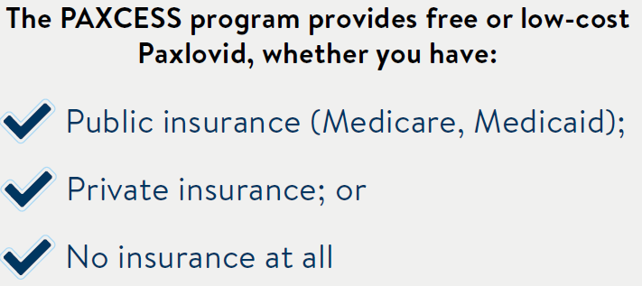
PAXCESS provides affordable access to Paxlovid for ALL patients
Enroll with your prescription at https://paxlovid.iassist.com or call 1-877-219-7225
Download NC PAXCESS Program Flyer

Slide 33
Free at-home COVID Test kits remain available for order in HPOP
For Health Departments, Long Term Care Facilities, Community Organizations, etc:
HPOP COVID-19 Test Ordering Instructions
Don’t have an HPOP account?
Fill out our HPOP Registration Form or email covid19testingandtreatments@dhhs.nc.gov
Check your test’s extended expiration dates!
We strongly encourage all LHDs and partners to order tests as needed; availability expected until December 2025
For Individuals:
Find a Community Access Point (CAP) near you: https://covid19.ncdhhs.gov/PickUpHomeTests
More than 270 CAPs remain statewide!
We encourage any LHDs/organizations that are distributing tests and not on the locator to sign up by emailing covid19testingandtreatments@dhhs.nc.gov

Slide 34
Hpop update – account validation requirements
Beginning July 22, 2024, HPOP users will be required to validate their account by logging into HPOP at least once every 180 days to remain active.
Users who have not logged in after 180 days will be switched to ‘Inactive’ status and will not be able to log in.
Automatic notifications will be sent to the affected users’ email 10 days and 5 days in advance of the account status change.
HPOP administrators can reactive the account at any time.
If your account is switched to ‘Inactive’ and you need to log in, email covid19testingandtreatments@dhhs.nc.gov to have your account reactivated.

Slide 35
ASPR Releases Pandemic influenza response preparedness and response strategy
On June 25, ASPR released the Pandemic Influenza Response Preparedness and Response Strategy through the Biomedical Advanced Research and Development Authority (BARDA), focused on efforts to support a response to the current HPAI H5N1 threat. The Strategy focuses on four objectives:
Objective 1: Strategic implementation and deployment of the U.S. National Pre-pandemic Influenza Vaccine Stockpile (NPIVS).
Objective 2: Enhanced protection through novel vaccines against pandemic influenza.
Objective 3: Leverage therapeutics through deployment, early availability, and development of novel products.
Objective 4: Ensure rapid and effective diagnostics tools to inform rapid antiviral prescription and treatment.

Slide 36
Current Avian Influenza (HPAI) H5N1 MCM guidance
Tamiflu (oseltamivir) remains MCM of choice for H5N1 treatment and PEP
Per HHS, Tamiflu (oseltamivir) stockpiles remaining from H1N1 (2009) are available for the current H5N1 bird flu situation according to CDC guidelines, if needed.
Check the current expiration date of your Tamiflu here
More details on recommendations for antiviral treatment and post-exposure prophylaxis (PEP) may be found here:
Interim Guidance on the Use of Antiviral Medications for Treatment of Human Infections with Novel Influenza A Viruses Associated with Severe Human Disease | Bird Flu | CDC
Interim Guidance on Influenza Antiviral Chemoprophylaxis of Persons Exposed to Birds with Avian Influenza A Viruses Associated with Severe Human Disease or with the Potential to Cause Severe Human Disease | Bird Flu | CDC
Interim Guidance for Follow-up of Close Contacts of Persons Infected with Novel Influenza A Viruses and Use of Antiviral Medications for Chemoprophylaxis | Bird Flu | CDC

Slide 37
Agenda
Opening Remarks | Stacie Turpin Saunders, MPH Deputy Director/Section Chief, Local and Community Support
Epi Section Update | Zack Moore, MD, MPH: State Epidemiologist and Epidemiology Section Chief
MCU Update | Erica Wilson, MD, MPH: Medical Director, Medical Consultation Unit
Wastewater Surveillance | Ariel Christensen, MPH Environmental Epidemiologist
Vaccine Update | Carrie Blanchard, Pharm D, PMP Immunization Branch Interim Director
Therapeutics Update | Tim Davis, PharmD, PMP Medical Countermeasures Coordinator
NC EDSS Update | Jennifer Stewart, MS Surveillance Systems Unit Manager
Question & Answer Session | Open for Questions — Please use the Zoom Q&A function

Slide 38
Agenda
Opening Remarks | Stacie Turpin Saunders, MPH Deputy Director/Section Chief, Local and Community Support
Epi Section Update | Zack Moore, MD, MPH: State Epidemiologist and Epidemiology Section Chief
MCU Update | Erica Wilson, MD, MPH: Medical Director, Medical Consultation Unit
Wastewater Surveillance | Ariel Christensen, MPH Environmental Epidemiologist
Vaccine Update | Carrie Blanchard, Pharm D, PMP Immunization Branch Interim Director
Therapeutics Update | Tim Davis, PharmD, PMP Medical Countermeasures Coordinator
NC EDSS Update | Jennifer Stewart, MS Surveillance Systems Unit Manager
Question & Answer Session | Open for Questions — Please use the Zoom Q&A function

Slide 39
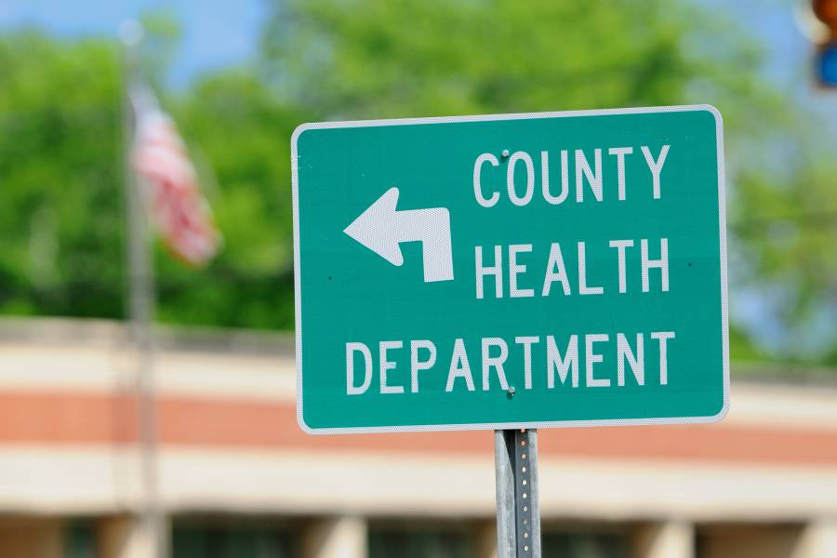
Q&A

