Slide 1
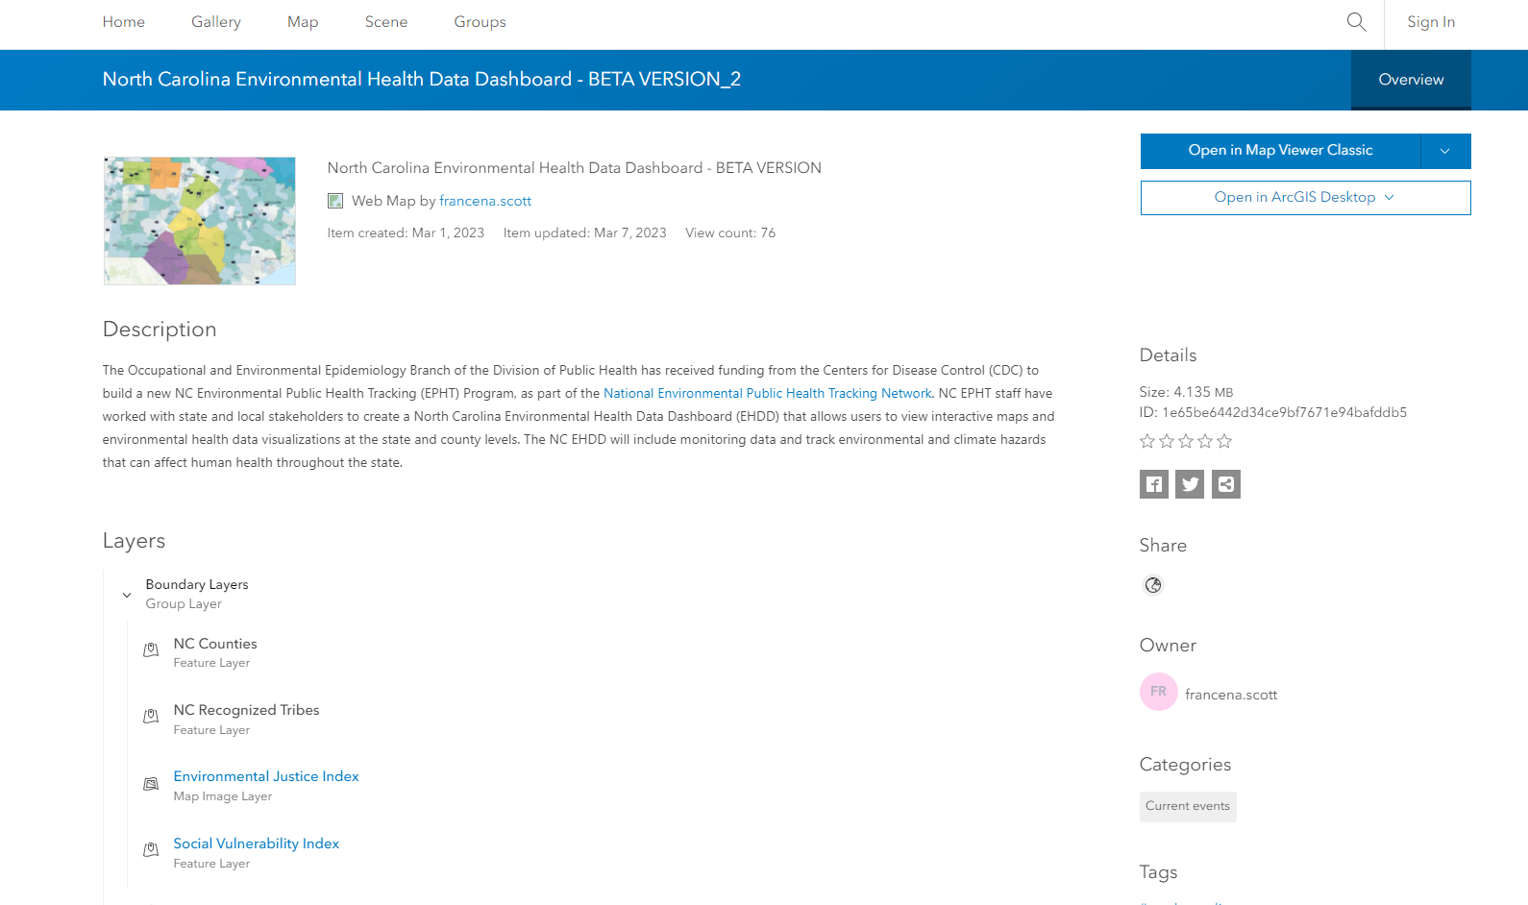
1. Select this arrow and select Open in Map Viewer

Slide 2
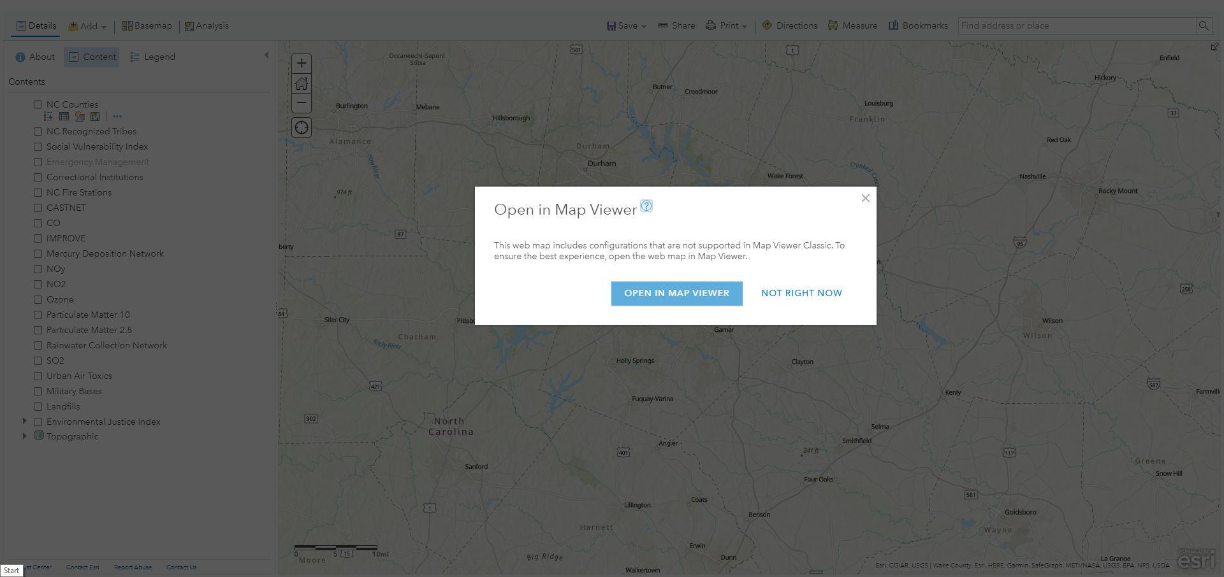
1. If you see this pop-up, please select this option.

Slide 3
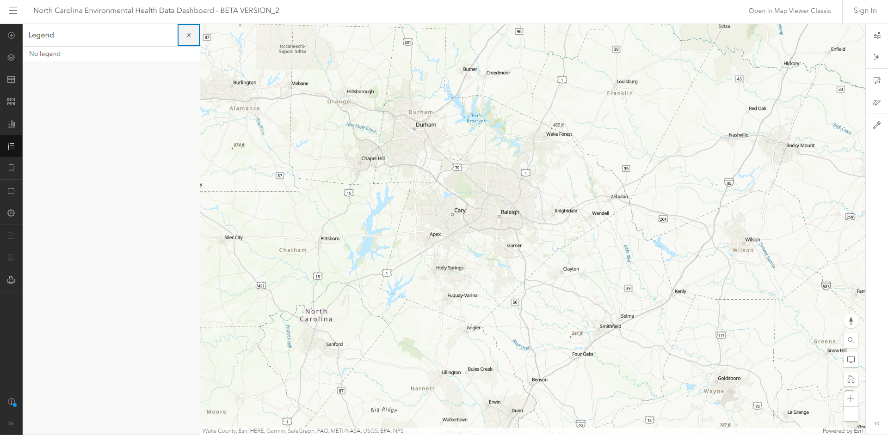
1. Select here to see the layers of the map.

Slide 4
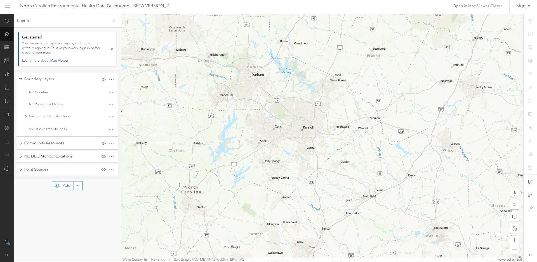
2. Select the arrow to show layers and click the eye to turn them on/off
3. Select the magnifying glass to search for an address
Notes:
2022NCEHPTOGCrew_FKKR

