Slide 1
Hepatitis C Epidemiology in North Carolina 2017
October 2018
North Carolina Division of Public Health/Epidemiology Section/Communicable Disease Branch
HIV/STD/Hepatitis Surveillance Unit

Slide 2
ACUTE HEPATITIS C (HCV)
North Carolina DHHS HIV/STD Surveillance Unit

Slide 3
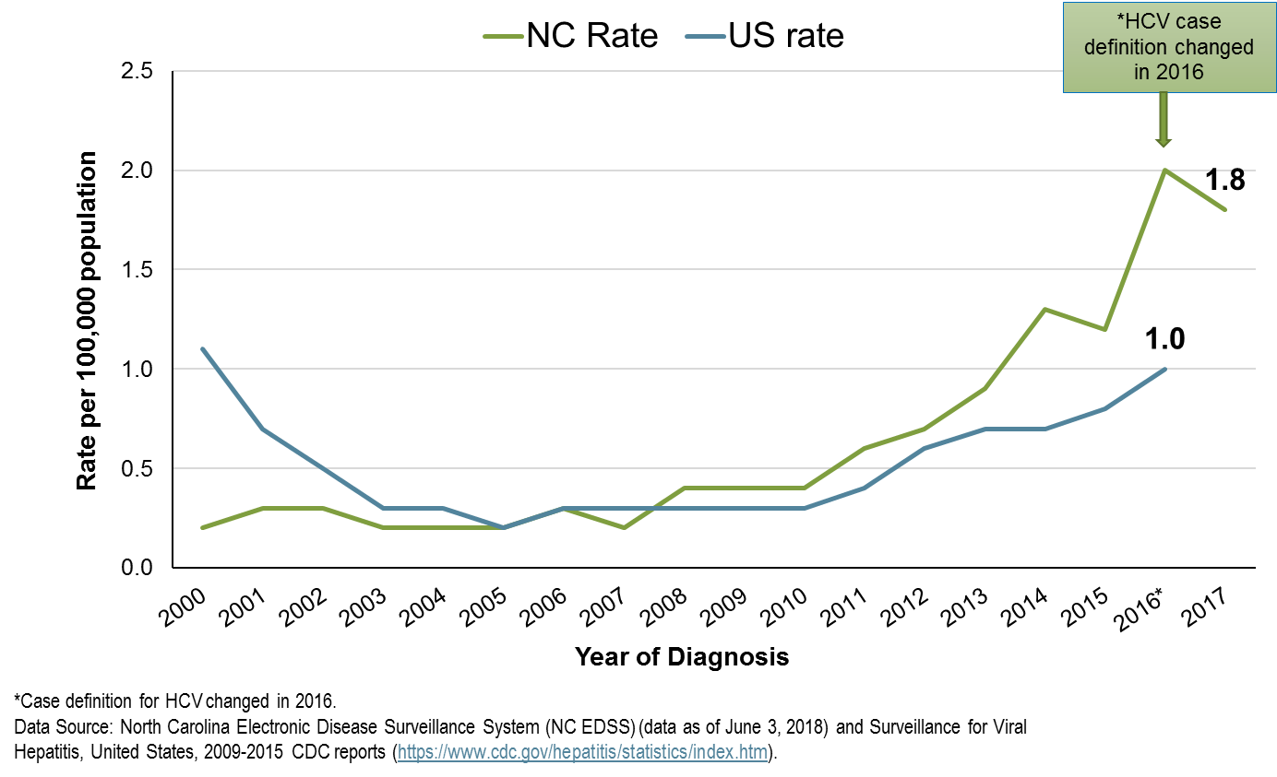

Slide 4
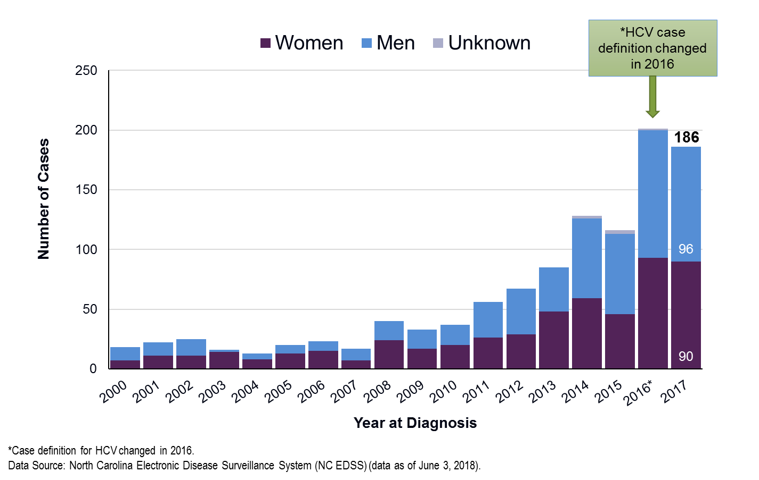

Slide 5
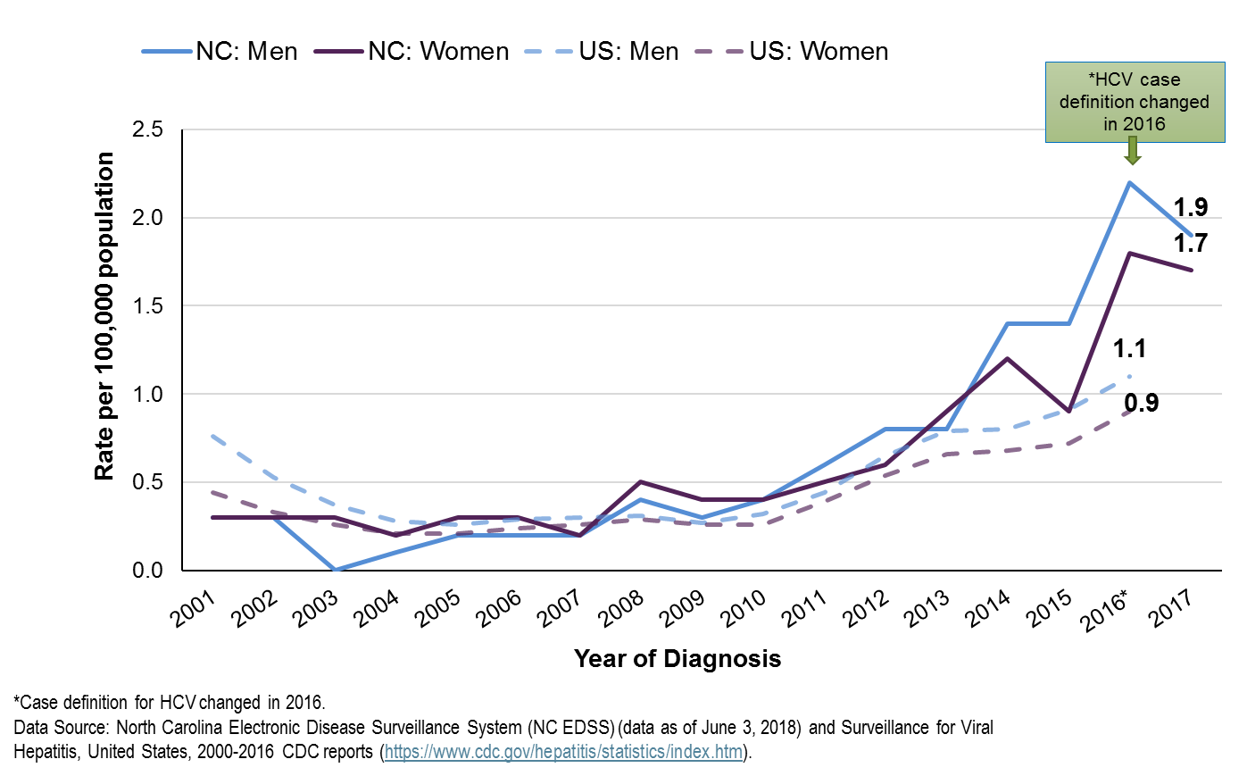

Slide 6
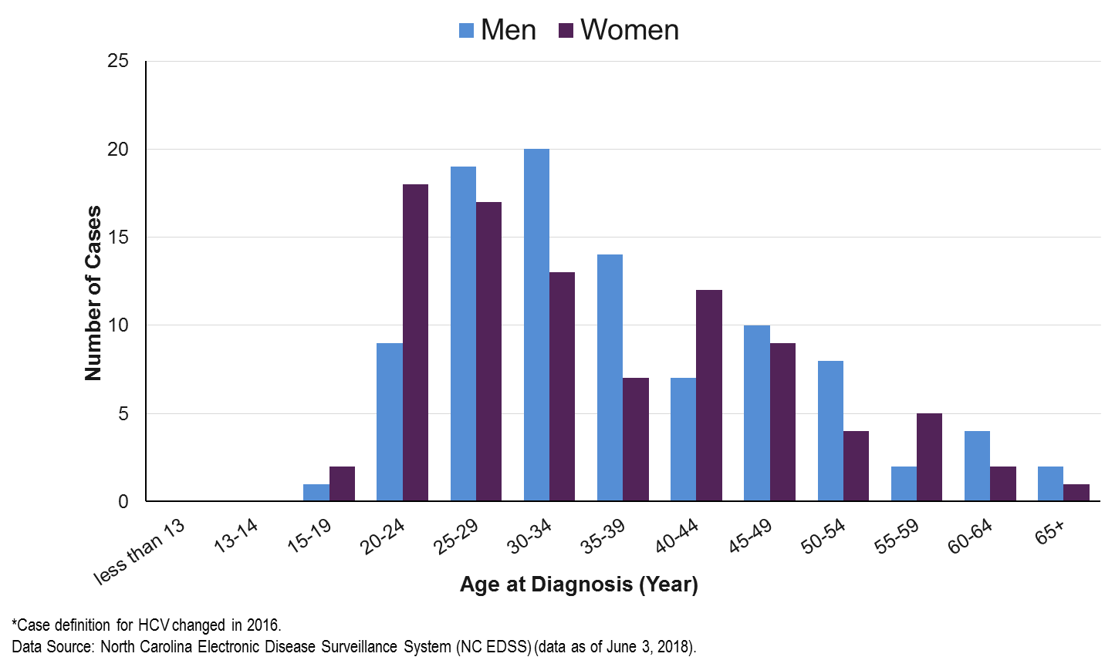

Slide 7
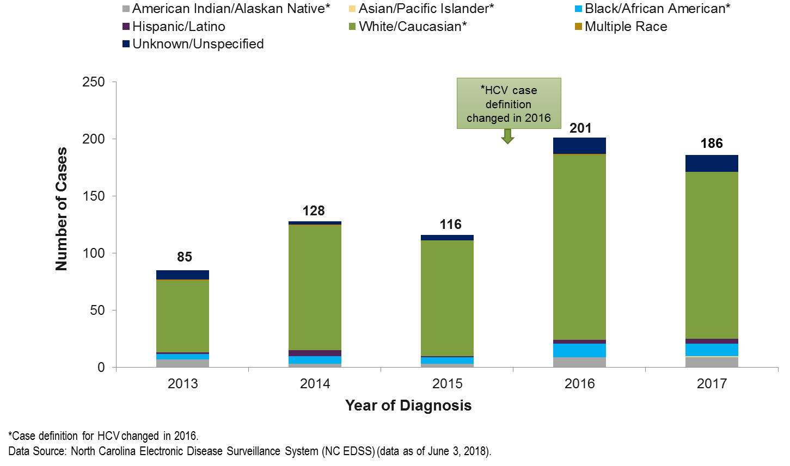

Slide 8
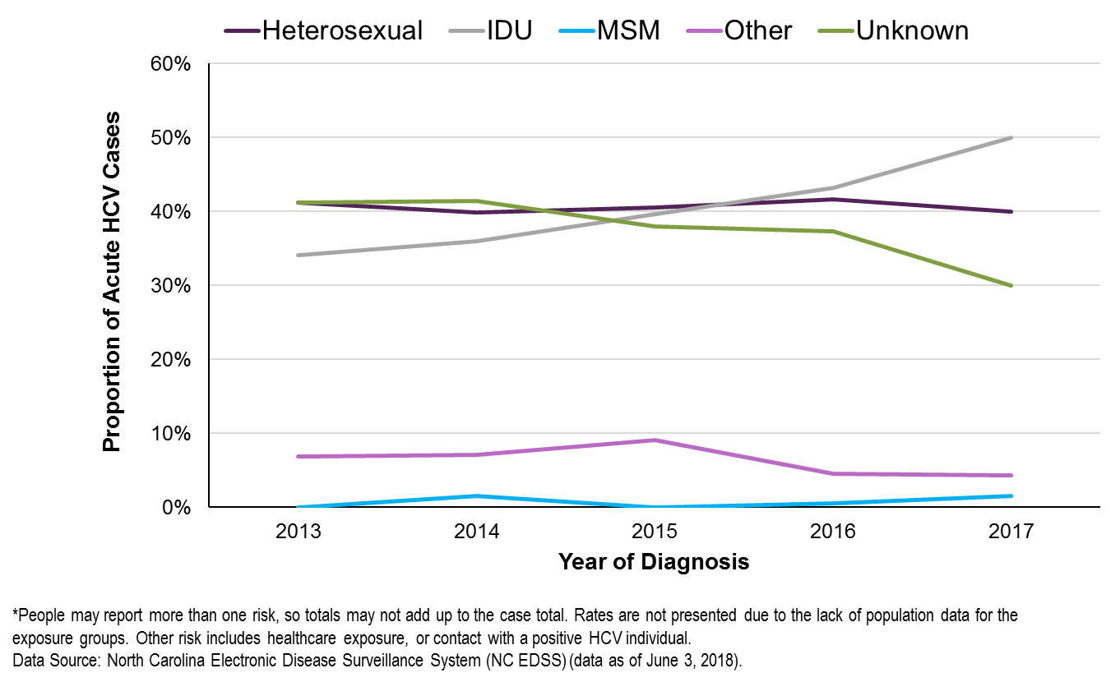

Slide 9
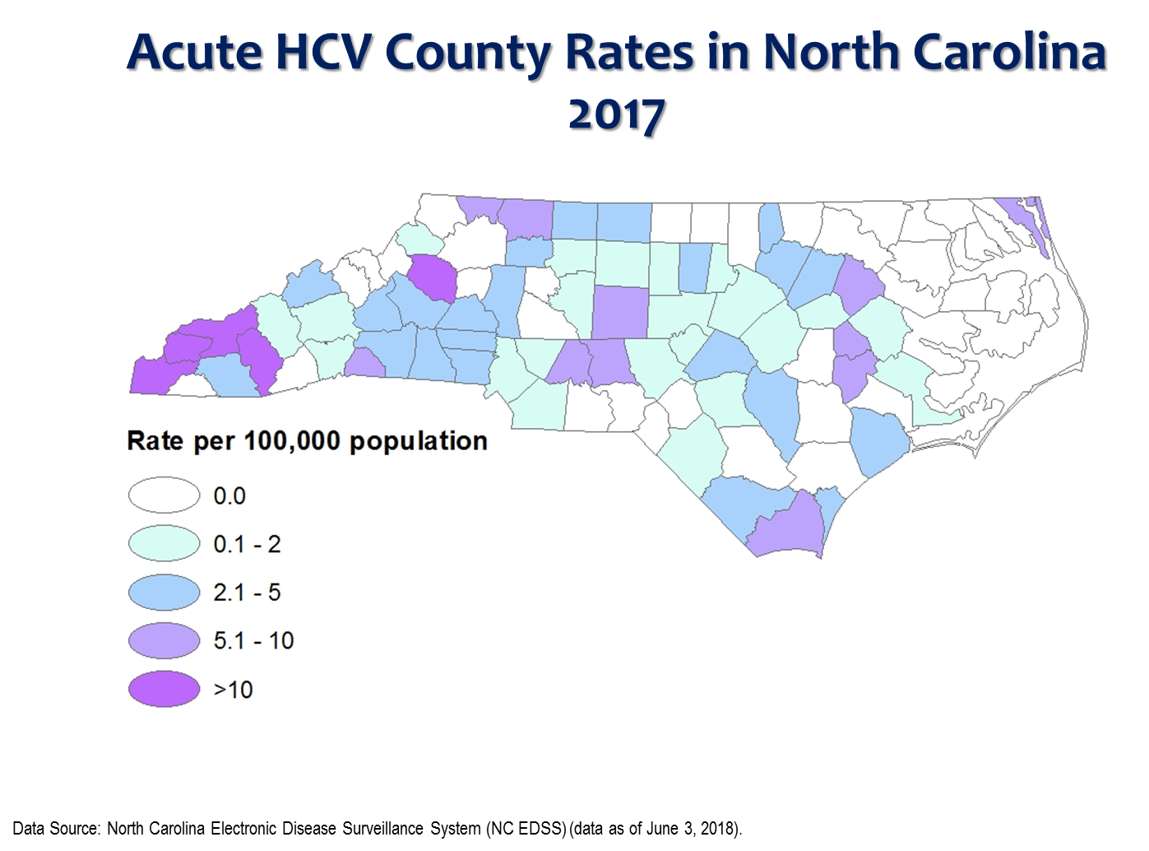

Slide 10
CHRONIC HEPATITIS C (HCV)
North Carolina DHHS HIV/STD Surveillance Unit

Slide 11
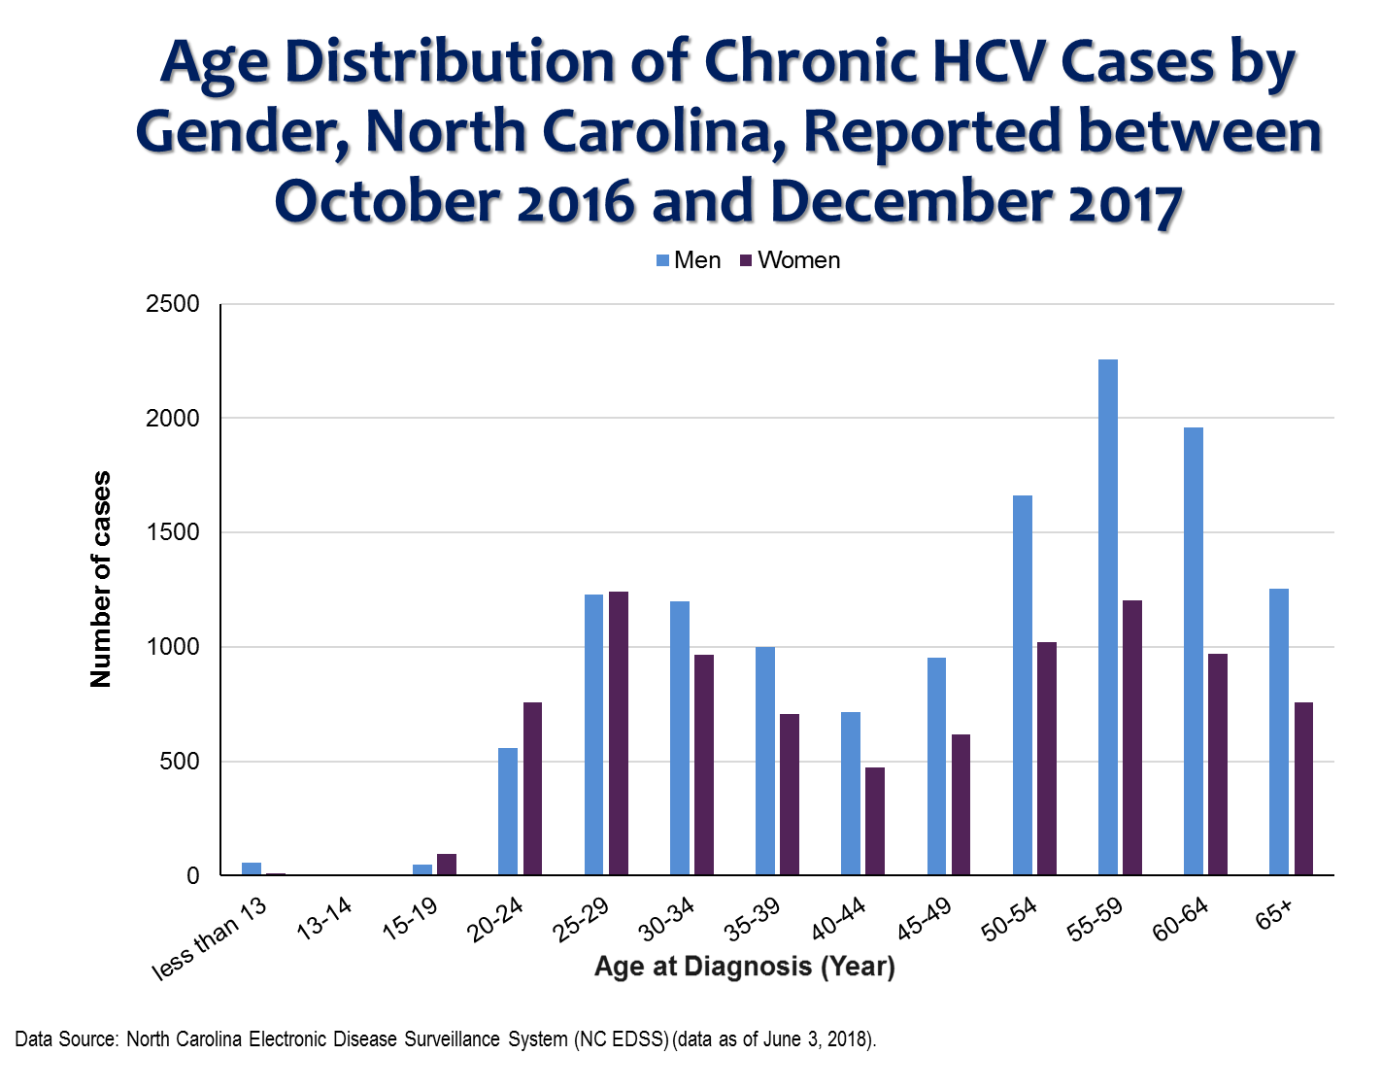
N=21,757

Slide 12
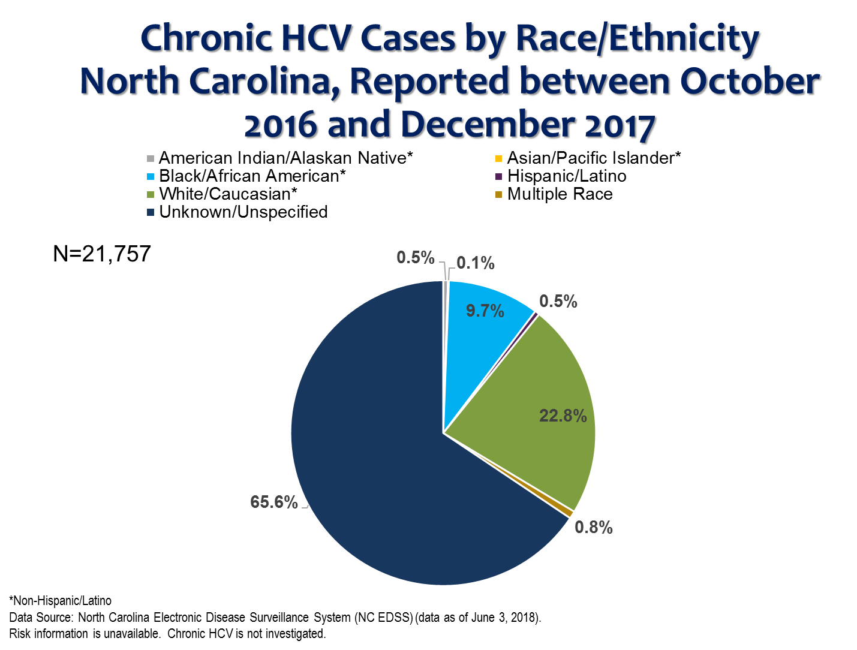

Slide 13
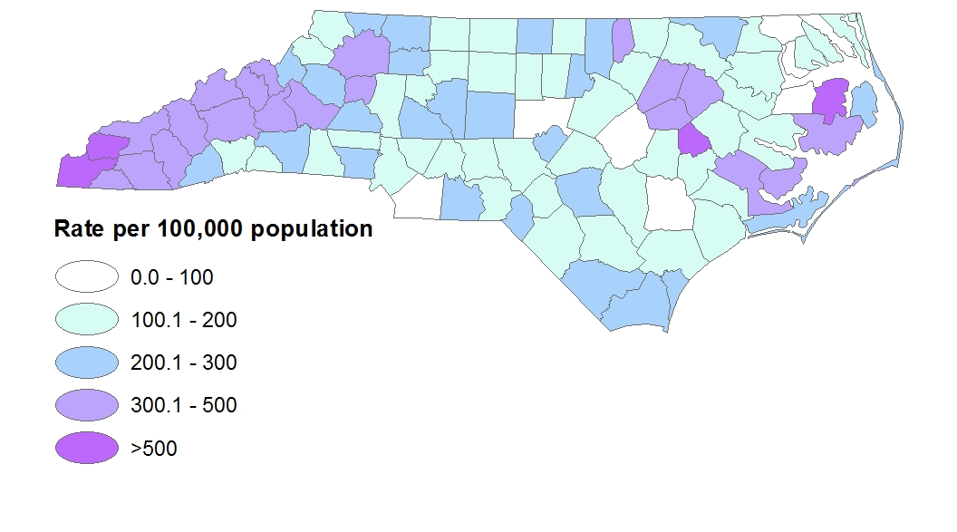

Slide 14
VIRAL HEPATITIS C AND CO-MORBIDITIES
North Carolina DHHS HIV/STD Surveillance Unit

Slide 15
