Slide 1
HIV Epidemiology in North Carolina 2018
August 2019
Division of Public Health/Epidemiology Section/Communicable Disease Branch
HIV/STD/Hepatitis Surveillance Unit
Notes:
I have no disclosures

Slide 2
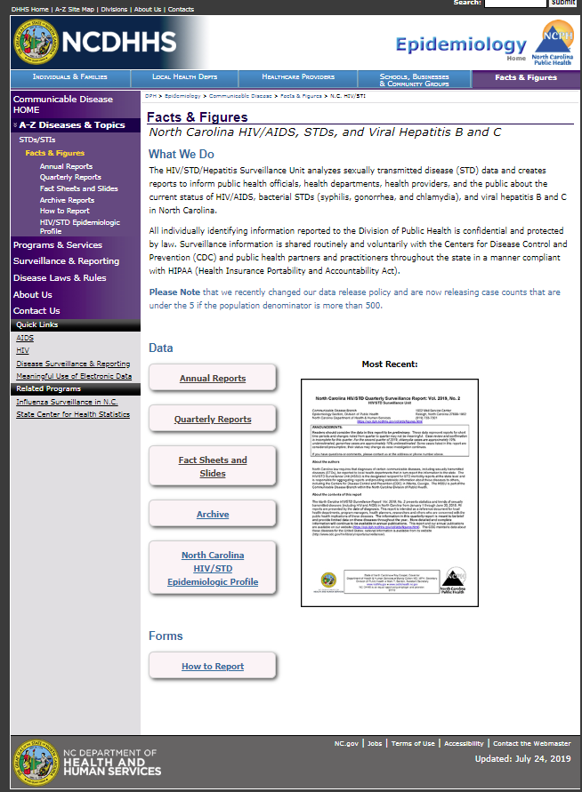
Where to find HIV/STD Information?
http://epi.publichealth.nc.gov/cd/stds/figures.html
Notes:
Add something about the slide sets being available

Slide 3
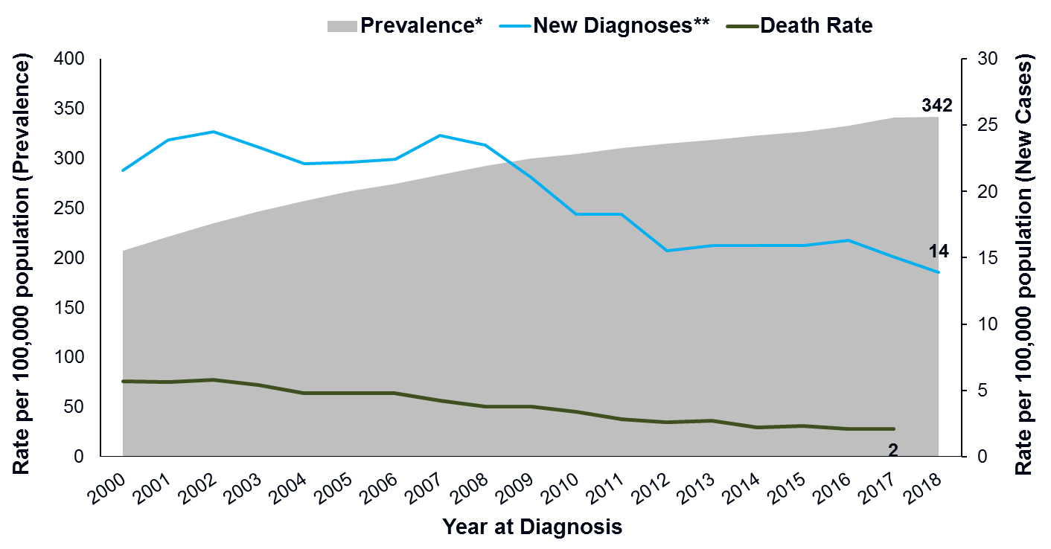
North Carolina HIV Infection Rates by Year of Diagnosis, 2000-2018
*Based on most recent address in eHARS as of December 31 of the given year.
**New cases are only among adults and adolescents (13 years and older).
Data Source: enhanced HIV/AIDS Reporting System (eHARS) (data as of June 26, 2019) and North Carolina Vital Statistics, Volume 2: Leading Causes of Death 2000-2017.

Slide 4
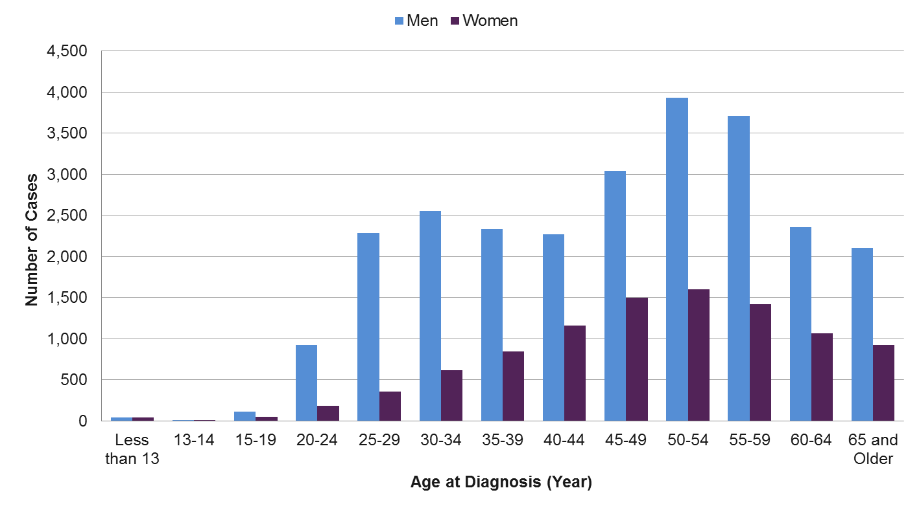
Age Distribution of People Diagnosed with HIV and Living in NC*in 2018
*Based on most recent address in eHARS as of December 31, 2018
Data Source: enhanced HIV/AIDS Reporting System (eHARS) (data as of June 26, 2019).

Slide 5
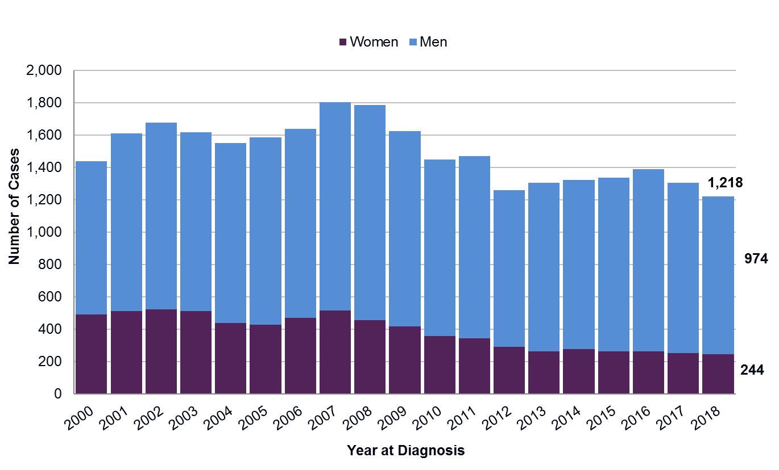
Newly Diagnosed HIV among Adult/ Adolescents (13 years and older) by Gender North Carolina, 2000-2018
Data Source: enhanced HIV/AIDS Reporting System (eHARS) (data as of June 26, 2019).

Slide 6
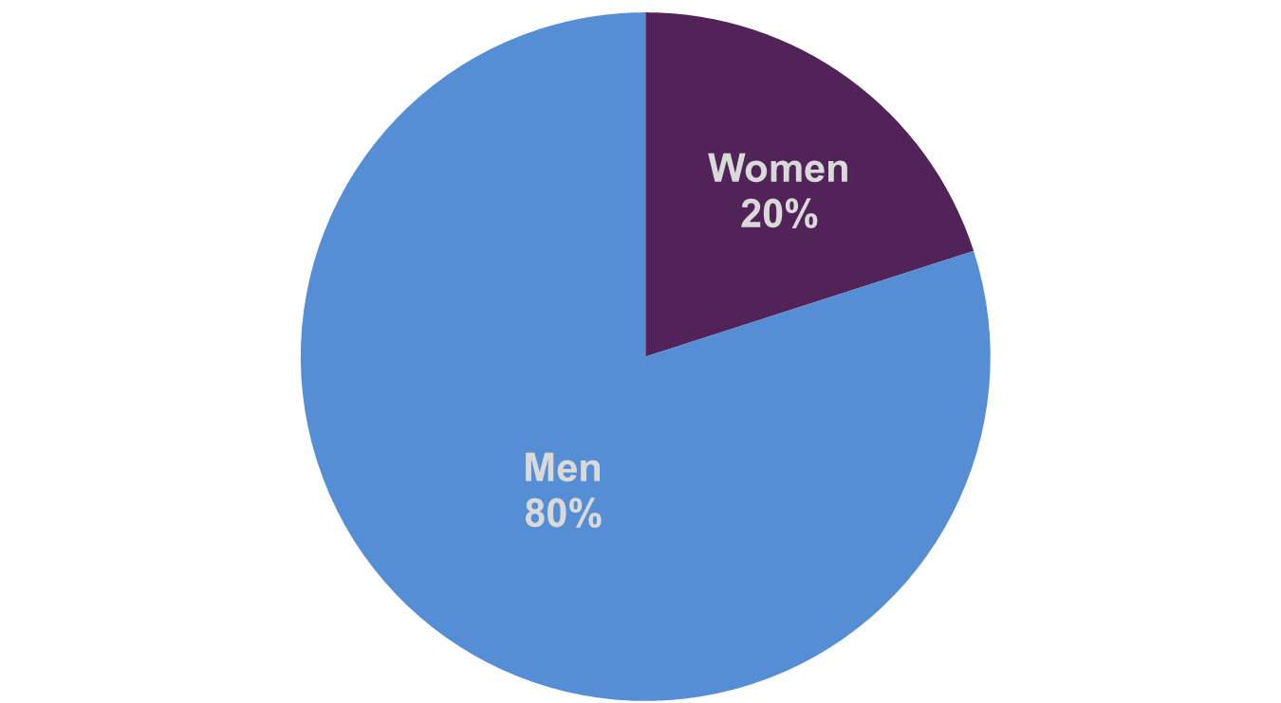
Gender Distribution of Newly Diagnosed Adult/Adolescent (13 years and older) HIV North Carolina, 2018
Data Source: enhanced HIV/AIDS Reporting System (eHARS) (data as of June 26, 2019).

Slide 7
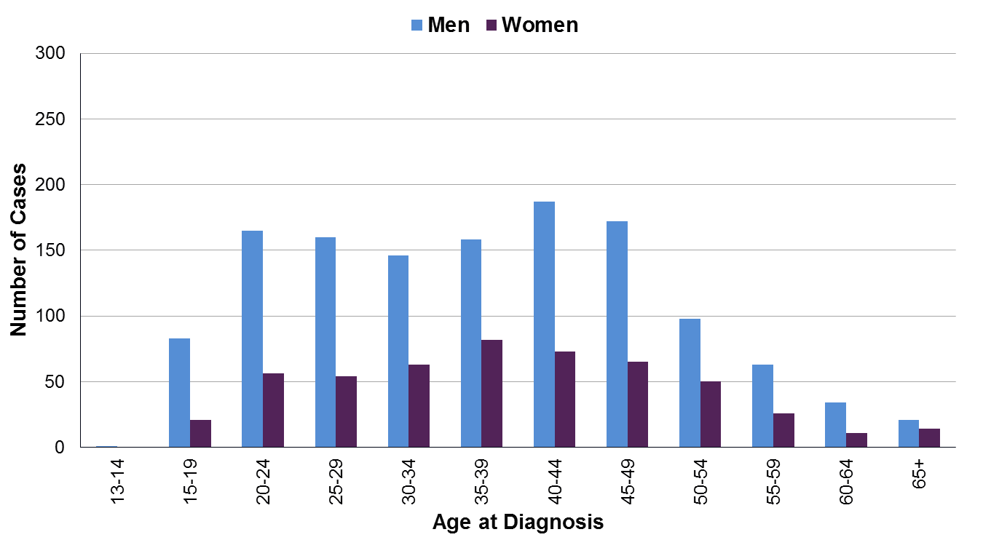
Age Distribution of Newly Diagnosed Adult/Adolescents (13 years and older) HIV by Gender in North Carolina, 2007
Data Source: enhanced HIV/AIDS Reporting System (eHARS) (data as of June 26, 2019).

Slide 8
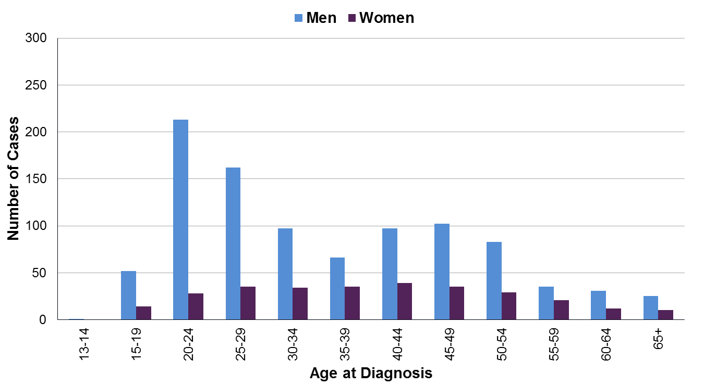
Age Distribution of Newly Diagnosed Adult/Adolescents (13 years and older) HIV by Gender in North Carolina, 2012
Data Source: enhanced HIV/AIDS Reporting System (eHARS) (data as of June 26, 2019).

Slide 9
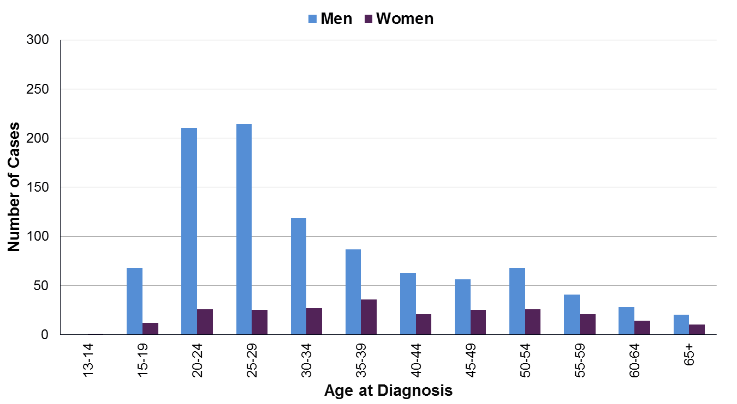
Age Distribution of Newly Diagnosed Adult/Adolescents (13 years and older) HIV by Gender in North Carolina, 2018
Data Source: enhanced HIV/AIDS Reporting System (eHARS) (data as of June 26, 2019).

Slide 10
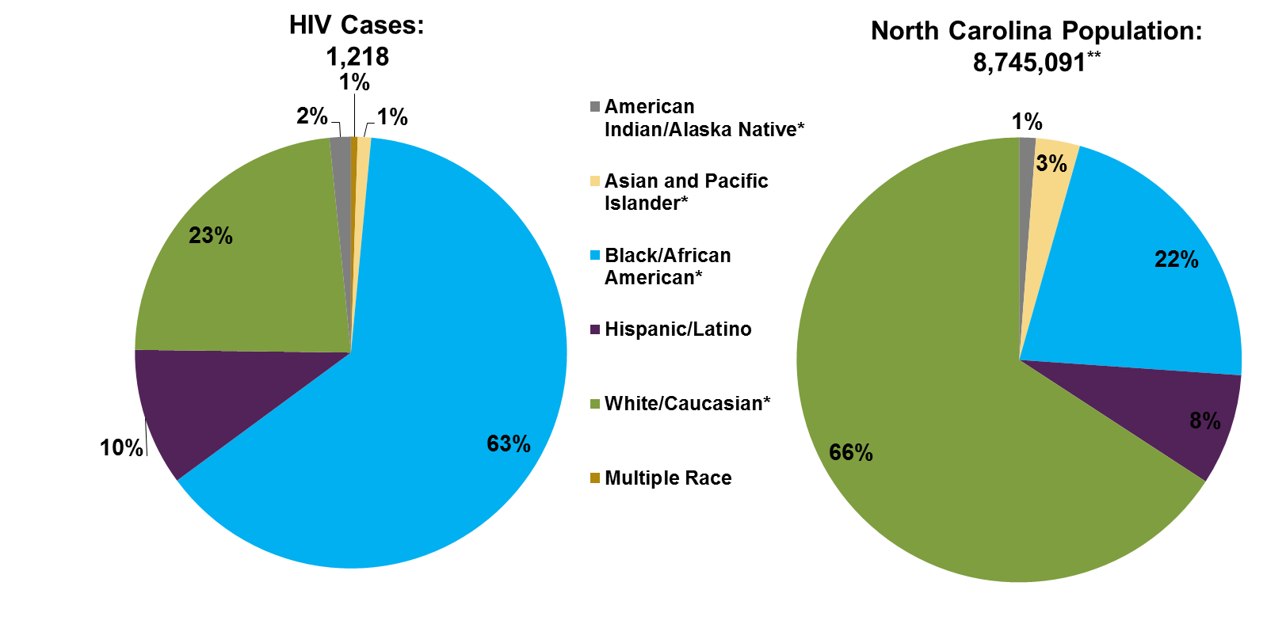
Newly Diagnosed HIV Cases among Adults/Adolescents (13 years and older) by Race/Ethnicity North Carolina 2018 vs North Carolina Population 2018
**US Census Bureau North Carolina 2018 Adult and Adolescent population estimate
*Non-Hispanic/Latino.
Data Source: enhanced HIV/AIDS Reporting System (eHARS) (data as of June 26, 2019).

Slide 11
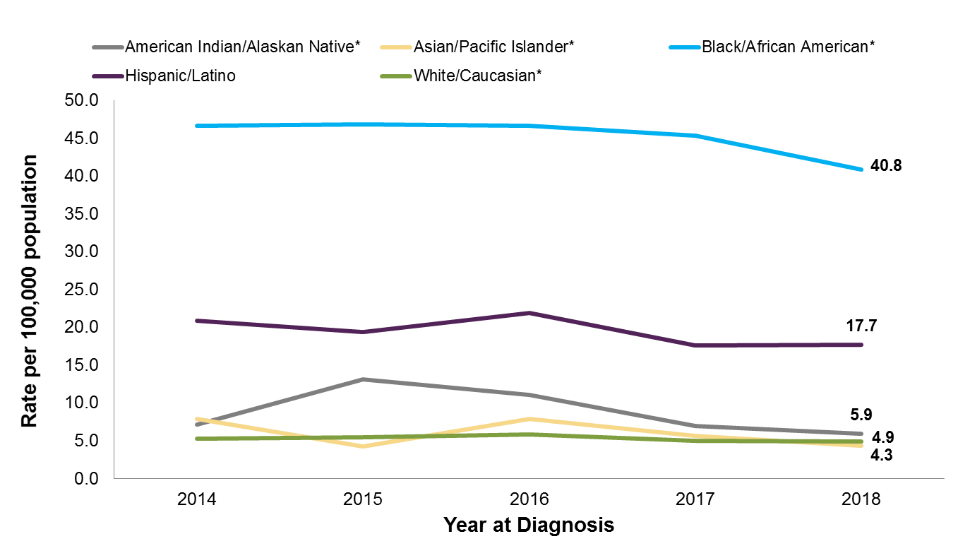
Newly Diagnosed HIV Rates among Adult/Adolescents (13 years and older) by Race/Ethnicity, 2014-2018
*Non-Hispanic/Latino.
Data Source: enhanced HIV/AIDS Reporting System (eHARS) (data as of June 26, 2019).

Slide 12
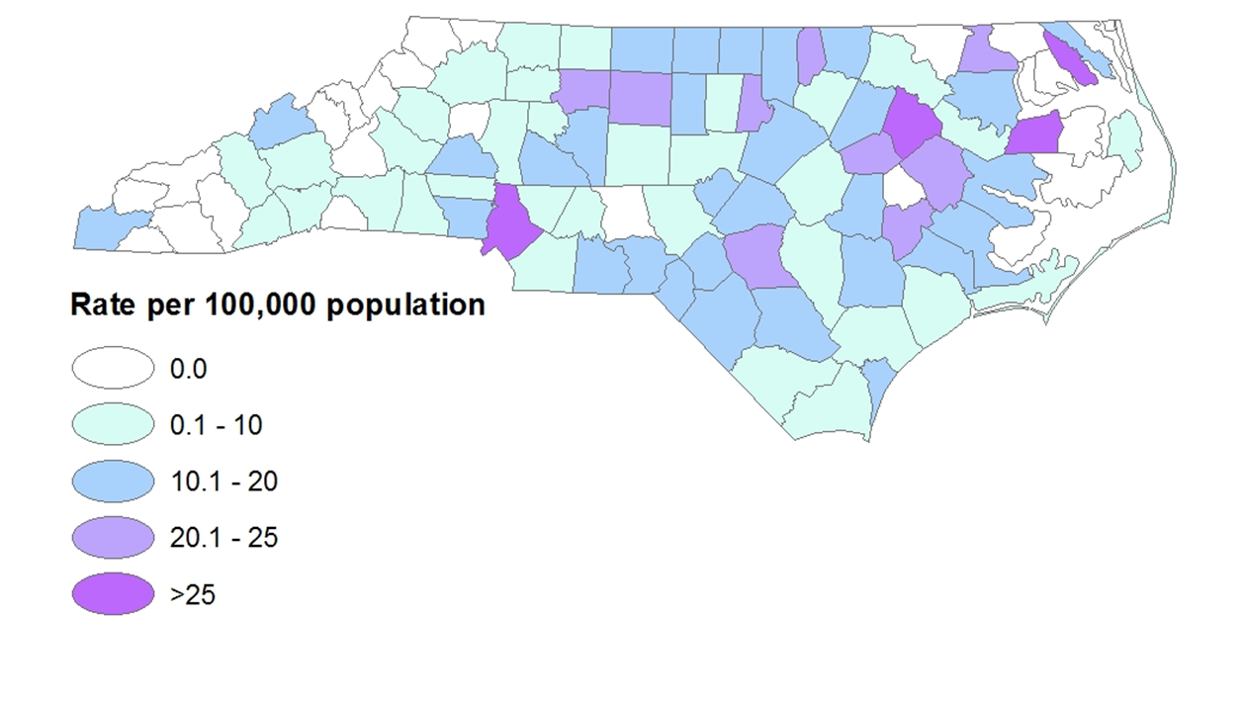
Newly Diagnosed HIV Rates by County North Carolina, 2018
Data Source: enhanced HIV/AIDS Reporting System (eHARS) (data as of June 26, 2019).

Slide 13
HIV Exposure (Hierarchical Risk)

Slide 14
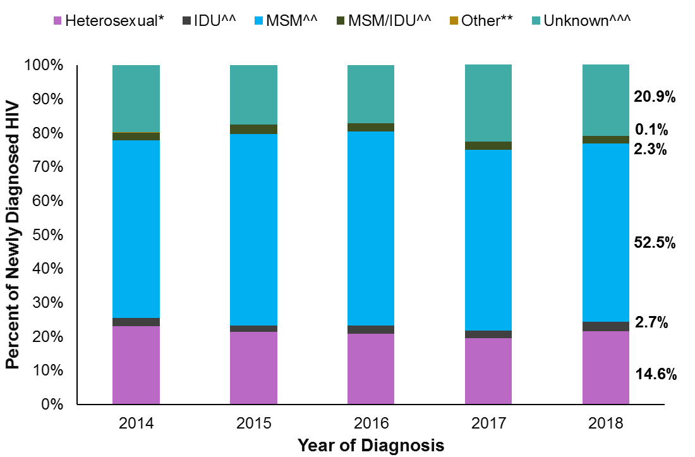
Newly Diagnosed HIV Hierarchical Risk^ among Adult and Adolescents in NC, 2014-2018
^Risk was assigned to each case based on the reported risk that was most likely to have resulted in HIV transmission. While people may have reported more than one behavior that can transmit HIV, each person is only classified with one risk in this chart.
*Heterosexual-all is defined as a person who does not report IDU or MSM, but does report sexual contact with a partner of opposite sex, who is IDU, MSM, or known HIV-positive status. Also, if a person is a victim of sexual assault, exchanges sex for drugs/money, has had a recent STD or has sexual contact while using drugs, they are classified as high risk. It also includes individuals classified as people who reports sex with an opposite sex partner and does not report IDU, MSM, or any other potential "high risk" behaviors.
^^IDU = injection drug use; MSM = men who report sex with men; MSM/IDU = men who report sex with men and injection drug use.
**Other risks include exposure to blood products (adult hemophilia or transfusions), pediatric risk, needle sticks, and health care exposure.
^^^Unknown risk is defined as individuals classified as no identified risk (NIR) and no reported risk (NRR) individuals.
Data Source: enhanced HIV/AIDS Reporting System (eHARS) (data as of June 26, 2019).

Slide 15
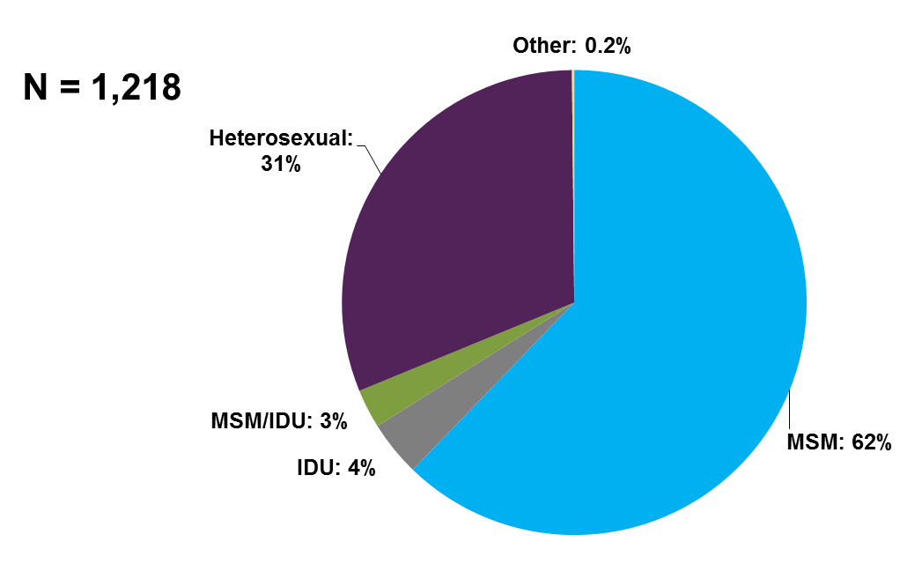
Hierarchical Risk^ (redistributed*) for HIV Exposure among Newly Diagnosed HIV Rates among Adults and Adolescents (13 years and older) North Carolina 2018
^Risk was assigned to each case based on the reported risk that was most likely to have resulted in HIV transmission. While people may have reported more than one behavior that can transmit HIV, each person is only classified with one risk in this chart.
*Unknown risk has been redistributed.
*Heterosexual-all is defined as a person who does not report IDU or MSM, but does report sexual contact with a partner of opposite sex, who is IDU, MSM, or known HIV-positive status. Also, if a person is a victim of sexual assault, exchanges sex for drugs/money, has had a recent STD or has sexual contact while using drugs, they are classified as high risk. It also includes individuals classified as people who reports sex with an opposite sex partner and does not report IDU, MSM, or any other potential "high risk" behaviors.
^^IDU = injection drug use; MSM = men who report sex with men; MSM/IDU = men who report sex with men and injection drug use.
**Other risks include exposure to blood products (adult hemophilia or transfusions), pediatric risk, needle sticks, and health care exposure.
Data Source: enhanced HIV/AIDS Reporting System (eHARS) (data as of June 26, 2019).

Slide 16
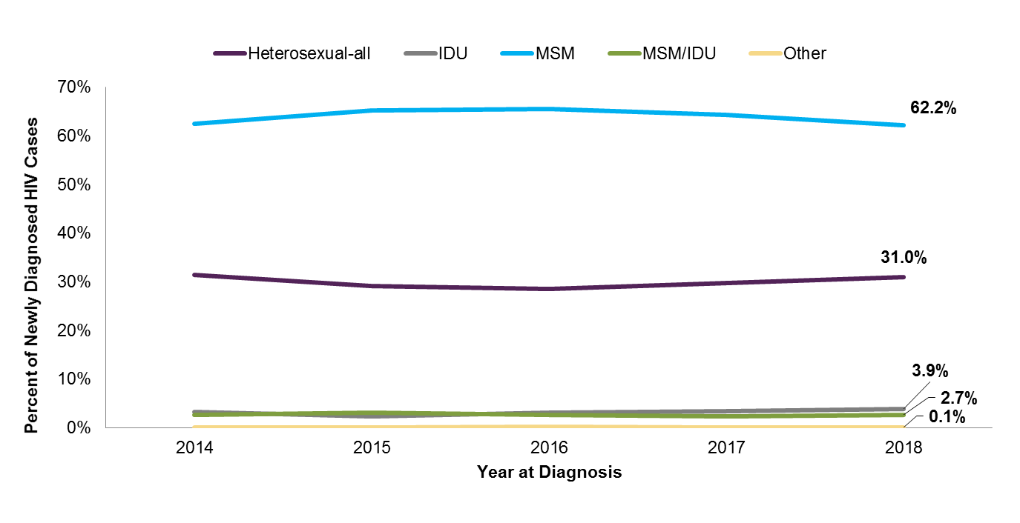
Proportion of Newly Diagnosed HIV among Adults and Adolescents (13 years and older) by Hierarchical Risk^ (redistributed*) North Carolina 2014-2018
^Risk was assigned to each case based on the reported risk that was most likely to have resulted in HIV transmission. While people may have reported more than one behavior that can transmit HIV, each person is only classified with one risk in this chart.
*Unknown risk has been redistributed.
*Heterosexual-all is defined as a person who does not report IDU or MSM, but does report sexual contact with a partner of opposite sex, who is IDU, MSM, or known HIV-positive status. Also, if a person is a victim of sexual assault, exchanges sex for drugs/money, has had a recent STD or has sexual contact while using drugs, they are classified as high risk. It also includes individuals classified as people who reports sex with an opposite sex partner and does not report IDU, MSM, or any other potential "high risk" behaviors.
^^IDU = injection drug use; MSM = men who report sex with men; MSM/IDU = men who report sex with men and injection drug use.
**Other risks include exposure to blood products (adult hemophilia or transfusions), pediatric risk, needle sticks, and health care exposure.
Data Source: enhanced HIV/AIDS Reporting System (eHARS) (data as of June 26, 2019).

Slide 17
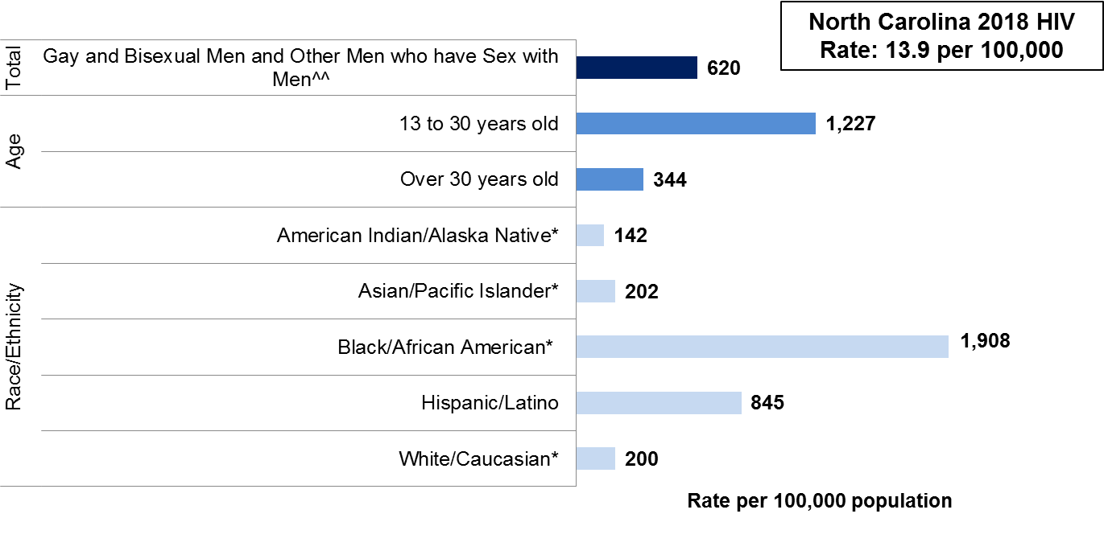
Estimated HIV Infection Rates among Newly Diagnosed Adult and Adolescent (13 years and older) Gay and Bisexual Men and Other Men who have Sex with Men^ in North Carolina 2018
^Unknown risk has been redistributed. People who were classified as MSM and IDU were excluded.
^^Grey et al (2016). JMIR Public Health Surveill; 2(1): e14. https://publichealth.jmir.org/2016/1/e14/
*Non-Hispanic/Latino.
Data Source: enhanced HIV/AIDS Reporting System (eHARS) (data as of June 26,2019).

Slide 18
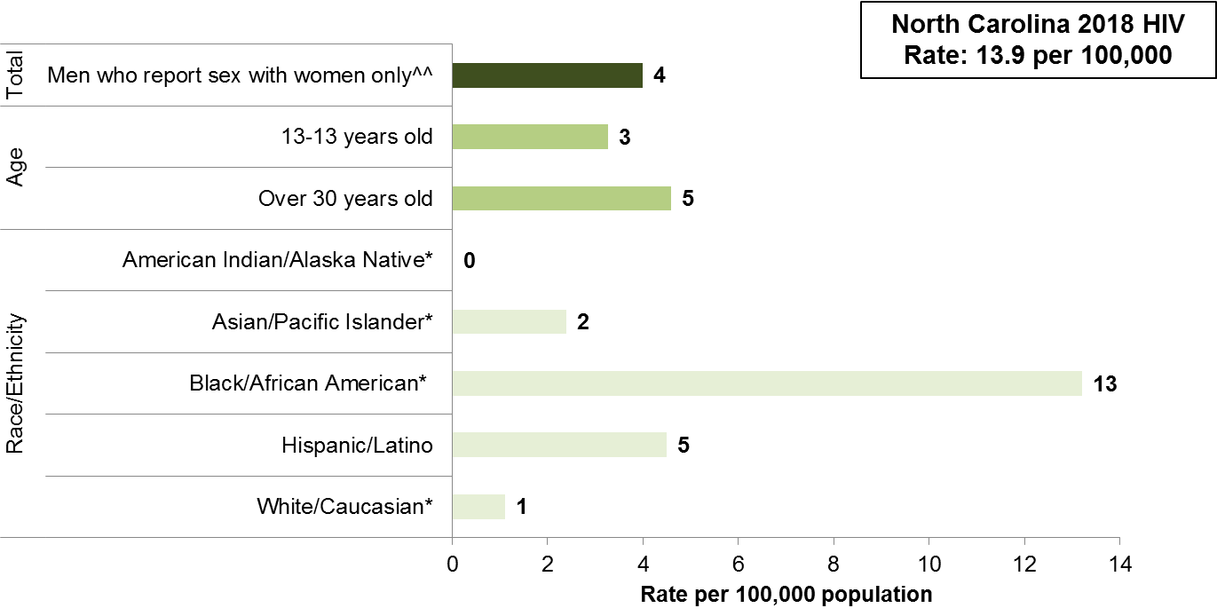
Estimated HIV Infection Rates among Newly Diagnosed Adult and Adolescent (13 years and older) Heterosexual Men^ in North Carolina 2018
^Unknown risk has been redistributed.
^^Rates among heterosexual men are based on an estimated population in North Carolina. Grey et al (2016). JMIR Public Health Surveill; 2(1): e14. https://publichealth.jmir.org/2016/1/e14/. People exposed to HIV through injection drug use (IDU) are excluded.
*Non-Hispanic/Latino.
Data Source: enhanced HIV/AIDS Reporting System (eHARS) (data as of June 26, 2019).

Slide 19
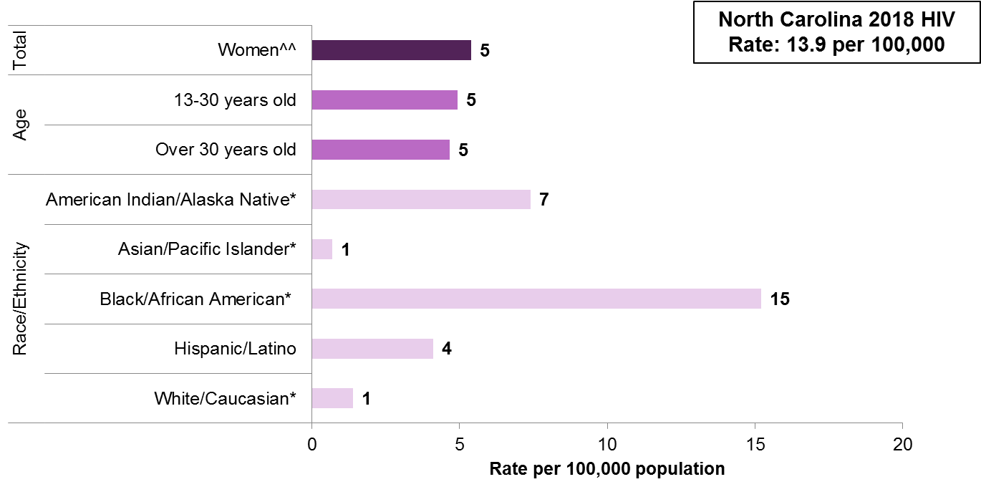
HIV Infection Rates among Newly Diagnosed Adult and Adolescent (13 years and older) Heterosexual Women^ in North Carolina 2018
^Unknown risk has been redistributed.
^^Defined as individuals reporting heterosexual contact with a known HIV-positive or high-risk individual and cases redistributed into the heterosexual classification from the “unknown” risk group. People exposed to HIV through injection drug use (IDU) are excluded.
*Non-Hispanic/Latino.
Data Source: enhanced HIV/AIDS Reporting System (eHARS) (data as of June 26, 2019).

Slide 20
Late Diagnosis of HIV (HIV and AIDS within 6 months)

Slide 21
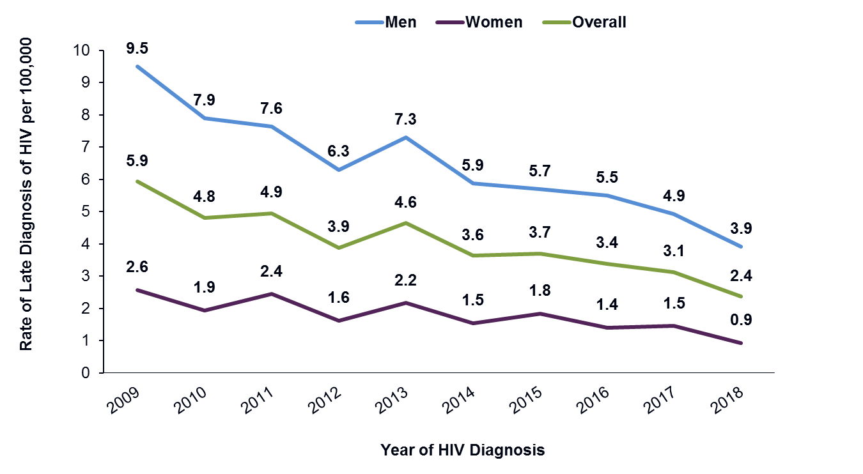
Rate of Newly Diagnosed HIV and AIDS within 6 Months by Gender North Carolina, 2009-2018
Data Source: enhanced HIV/AIDS Reporting System (eHARS) (data as of June 26, 2019).

Slide 22
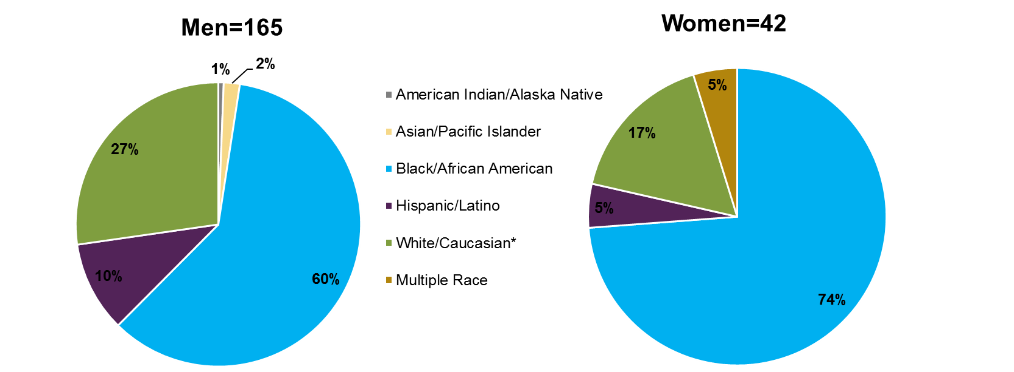
Race/Ethnicity Proportion of Newly Diagnosed HIV and AIDS within 6 Months by Gender North Carolina, 2018
Data Source: enhanced HIV/AIDS Reporting System (eHARS) (data as of June 26, 2019).

Slide 23
HIV AND HEPATITIS B AND C

Slide 24
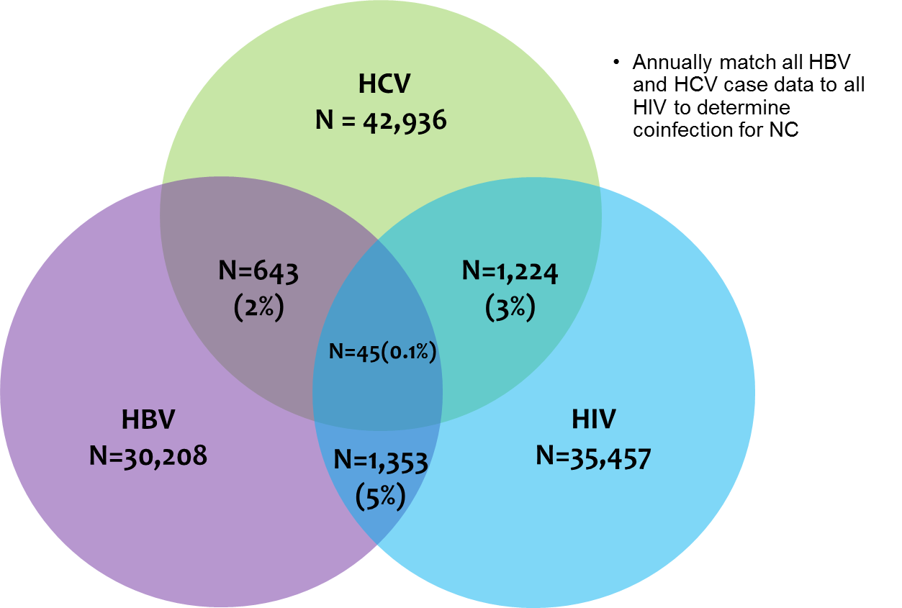
2018 HIV/Hepatitis B/Hepatitis C Coinfection
Data Source: enhanced HIV/AIDS Reporting System (eHARS) (data as of June 26, 2019) and North Carolina Electronic Disease Surveillance System (NC EDSS) (data as of June 1, 2019).

Slide 25
NORTH CAROLINA HIV CONTINUUM OF CARE

Slide 26
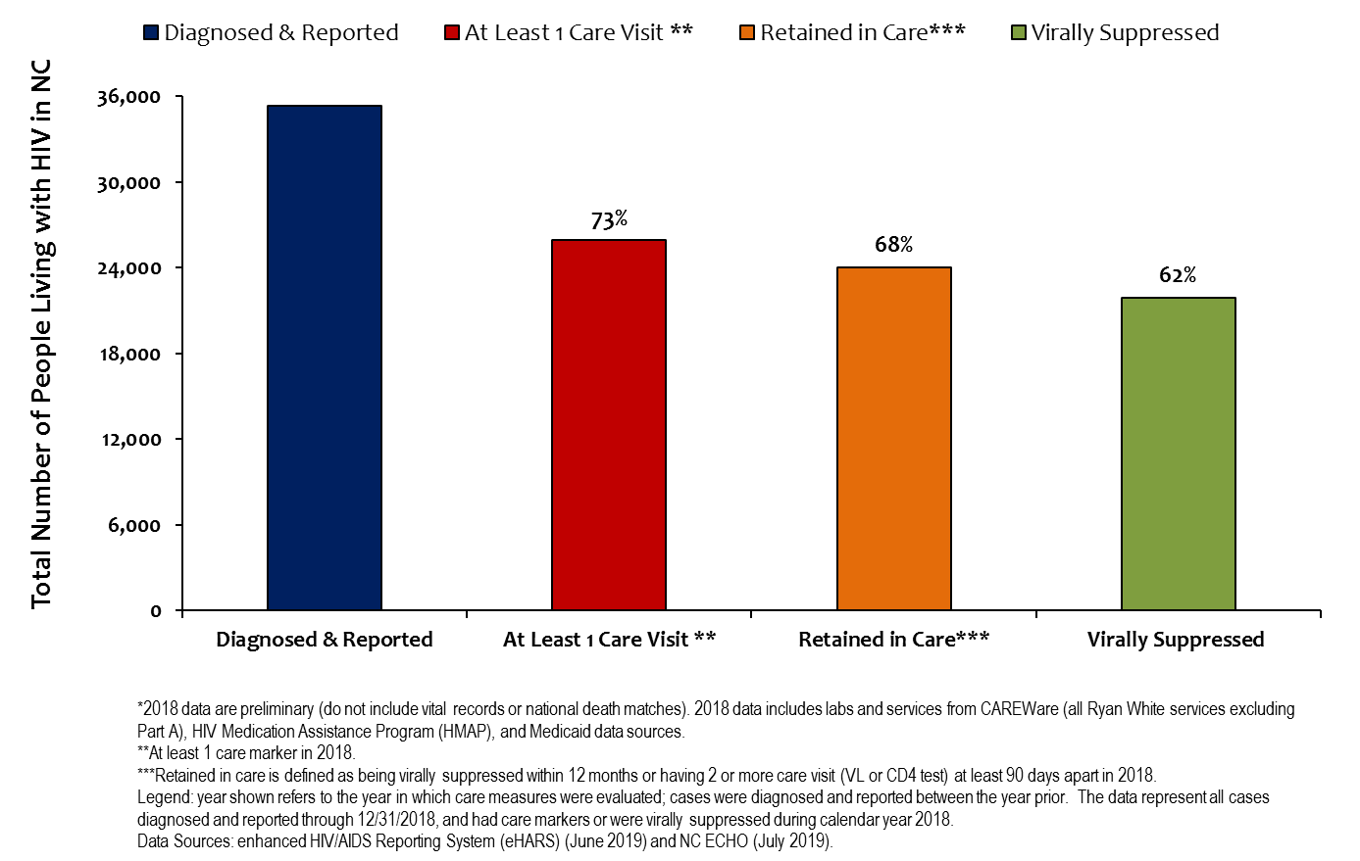
North Carolina HIV Continuum of Care 2018* (Diagnosed through 2018 and living in 2018)

Slide 27
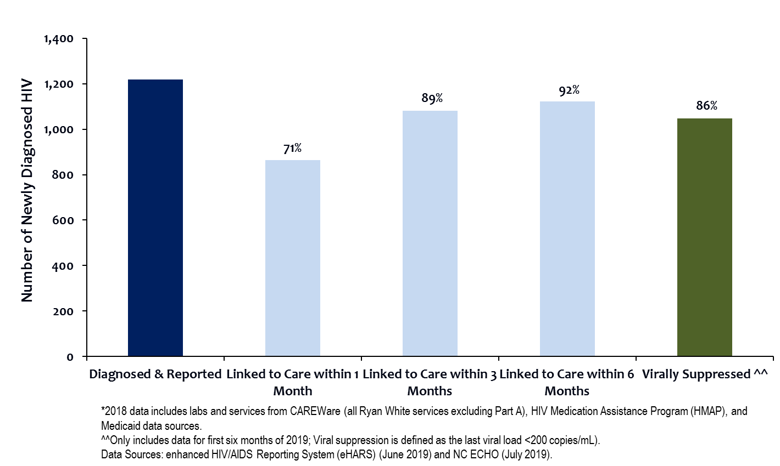
2018* North Carolina Newly Diagnosed HIV Continuum of Care
Notes:
Virally Suppressed any time after HIV dx

